Slide 1
Suppression Issues – How to Litigate and How to Win
Presented by Don Flanary
Goldstein Goldstein and Hilley
Upholding Justice One Client at a Time
TCDLA
July 13, 2016
South Padre Island, Texas

Slide 2
4th Amend Requires a Warrant
Searches and seizures conducted without a warrant are unreasonable per se, subject to a few specifically established and well-delineated exceptions.
McGee v. State, 105 S.W.3d 609, 615 (Tex. Crim. App. 2003).

Slide 3

Attack the
Warrant or the Exception

Slide 4
Warrant or Exception
Then State must prove:
Valid warrant or
Exception applies
Amador v. State, 221 S.W.3d 666, 672-73 (Tex. Crim. App. 2007)

Slide 5
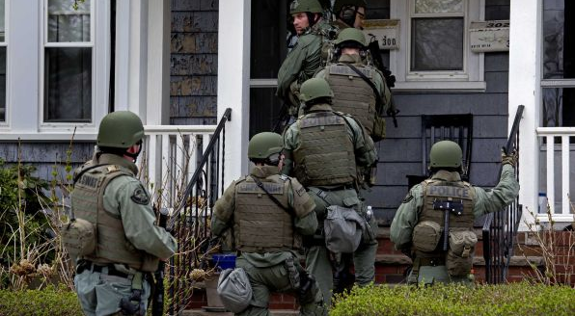
Searches with a Warrant

Slide 6
Attacking the Affidavit
Search warrants must be preceded by affidavits. The affidavit is normally where you will find the defects or issues that can invalidate the search and its fruits. The affidavit must be sworn or affirmed and it must contain probable cause.

Slide 7
Defects in Affidavits
Clerical or typographical error will not normally render the warrant invalid.
The affiant may be any credible person. It does not have to be a police officer or other law enforcement officer.
Dickey v. State, 816 S.W.2d 832 (Tex. App. – Eastland 1991, no pet.).

Slide 8
The Magistrate
Art1 8.01 – Search warrants shall be issued by a magistrate.
18.01(c) goes further to state that an evidentiary search warrant can only be issued by judges who are licensed attorneys.

Slide 9
Any County in Texas
A district judge may sign search warrants for execution in any county in the state. Green v. State, 880 S.W.2d 198 (Tex. App. – Texarkana 1994, no pet.).
But a search warrant may not be issued by a statutory county court judge for execution in a different county.
Sanchez v. State, 365 S.W.3d 681 (Tex. Crim. App. 2012).

Slide 10
Unsigned Warrant
The good faith exception to the exclusionary rule will allow the admission of evidence seized under an unsigned warrant so long as the warrant contained probable cause and was unsigned solely because of the magistrate’s oversight.
Dunn v. State, 951 S.W.2d 478 (Tex. Crim. App. 1997).

Slide 11
Four Corners
Sufficient probable cause to support the warrant exists if the facts contained within the four corners of the affidavit and the reasonable inferences drawn therefrom justify the magistrate’s conclusion that the object of the search is probably on the premises to be searched at the time of issuance.
Cassias v. State, 719 S.W.2d 585 (Tex. Crim. App. 1986); Ramos v. State, 934 S.W.2d 358 (Tex. Crim. App. 1996).

Slide 12
Four Corners
The determination of the legal adequacy of an affidavit in support of a search warrant is to be made within the four corners of the document involved.
Serrano v. State, 123 S.W.3d 53, 58 (Tex. App. – Austin 2003, pet. ref’d) (citing Jones v. State, 833 S.W.2d 118, 123 (Tex. Crim. App. 1992); Oubre v. State, 542 S.W.2d 875, 877 (Tex. Crim. App. 1976); Mayfield v. State, 800 S.W.2d 932, 934 (Tex. App. – San Antonio 1990, no pet.)).

Slide 13
Four Corners
The facts found in the search warrant affidavit must show that “there is a fair probability that contraband or evidence of a crime will be found in that particular place.”
Illinois v. Gates, 462 U.S. 213 (1983); State v. McLain, 337 S.W.3d 268 (Tex.
Crim. App. 2011).

Slide 14
Four Corners
Where failures in the affidavit result in a failure to allege how the conduct cited could result in a violation of the law, the affidavit fails to set forth probable cause.
Hall v. State, 795 S.W.2d 195 (Tex. Crim. App. 1990).

Slide 15
Four Corners
Mere possession of drugs is not enough to warrant the search of a person’s residence.
Ozuna v. State, 88 S.W.3d 307 (Tex. App.-San Antonio 2002, pet. ref’d) citing Cassias v. State, 719 S.W.2d 585 (Tex. Crim. App. 1986).

Slide 16
Hearsay Allowed
Hearsay on hearsay allowed to form the factual basis for a warrant so long as there is a substantial basis for crediting the hearsay at each level.
Hall v. State, 795 S.W.2d 195 (Tex.
Crim. App. 1990); Hennessy v. State, 660 S.W.2d 87 (Tex. Crim. App. 1983).

Slide 17
Totality of Circumstances
A totality of the circumstances test is applied to the facts in the affidavit in determining whether or not probable cause existed to issue the warrant.
Illinois v. Gates, 462 U.S. 213, 103 S.Ct. 2317 (1983); Bower v. State, 769 S.W.2d 887 (Tex.Cr. App. 1989); Ramos v. State, 934
S.W.2d 358 (Tex. Crim. App. 1996).

Slide 18
Totality of Circumstances
Part of the totality of the circumstances that a magistrate should evaluate in making a probable cause determination is the reliability of the affiant and his sources of information.
Jaben v. U.S., 381 U.S. 214 (1965); Johnson v. State, 803 S.W.2d 272 (Tex. Crim. App. 1990).

Slide 19
Totality of Circumstances
When evaluating the affidavit, the task of the magistrate is to make a practical, common- sense decision whether, given the totality of the circumstances set forth in the affidavit, there is a fair probability that contraband or evidence of a crime will be found in a particular place.
Borsari v. State, 919 S.W.2d 913, 917-918 (Tex. App. – Houston [14th Dist.] 1996, pet. ref’d).

Slide 20
Reviewing Mag’s Determination
Although great deference should be paid to the magistrate’s determination of probable cause in issuing the warrant, it is the duty of the reviewing court to ensure the magistrate had a substantial basis for concluding that probable cause existed. Illinois v. Gates, 462 U.S. 213 at 238-39, 103 S.Ct. 2317 (1983).

Slide 21
Reviewing Mag’s Determination
A magistrate’s decision to issue a search warrant will be upheld where the magistrate had a substantial basis for concluding that a search would uncover evidence of wrongdoing.
Illinois v. Gates, 462 U.S. 213 at 238-39, 103 S.Ct. 2317 (1983); Moreno v. State, 415 S.W.3d 284 (Tex. Crim. App. 2013).

Slide 22
Reviewing Mag’s Determination
On appeal, the magistrate’s decision is reviewed under a deferential standard of review, rather than de novo, because of the Fourth Amendment’s strong preference for searches conducted pursuant to a warrant.
Illinois v. Gates, 462 U.S. 213 at 238-39, 103 S.Ct. 2317 (1983); Moreno v. State, 415 S.W.3d 284 (Tex. Crim. App. 2013).

Slide 23
The Motion to Suppress
Where the defendant challenges probable cause for the search and the state relies upon a warrant to establish the basis for the search, the state bears the burden of producing the warrant and affidavit for inspection by the court.
Miller v. State, 736 S.W.2d 643 (Tex. Crim. App. 1987).

Slide 24
The Motion to Suppress
Once the state produces the warrant, the burden of proof shifts to the defendant to go forward with evidence to show the invalidity of the warrant. Johnson v. State, 803 S.W.2d 272 (Tex. Crim. App. 1990).

Slide 25
The Hearing
The Rules of Evidence do not apply to suppression hearings.
Granados v. State, 85 S.W.3d 217 (Tex. Crim. App. 2002).

Slide 26
The Hearing
A defendant may testify at a motion to suppress and does not waive his Fifth Amendment right to not testify at trial.
Simmons v. U.S.

Slide 27
The Hearing
BUT, if the defendant testifies at the suppression hearing (outside presence of jury) and then testifies at trial, he may be impeached with his suppression hearing testimony if he testifies contrary. Nelson v. State, 607 S.W.2d 554 (Tex. Crim. App. 1980).

Slide 28
The Hearing
Need facts and argument, not just allegations
Timing: pretrial hearing or carry with trial?
If you lose, ask for Findings of Facts and Conclusions of Law

Slide 29
Standing
Pick a pony and ride it
Either its your stuff and you have an expectation of privacy or,
The State can’t prove affirmative links
Be SMART and consistent

Slide 30
Common Warrant Problems
Conclusory Statements
A probable cause finding requires the magistrate to make an independent determination of the facts rather than accept the conclusions of the affiant or the affiant’s sources, no matter how honest or reliable they may appear.

Slide 31
Conclusory Statements
Wholly conclusory statements do not provide the magistrate with a substantial basis for determining the existence of probable cause.
Illinois v. Gates, 462 U.S. 213, 103 S.Ct. 2317 (1983).

Slide 32
Conclusory Statments
The affidavit must contain more than mere conclusory statements that give the magistrate virtually no basis at all for making a judgment regarding probable cause.
State v. Anderson, 917 S.W.2d 92, 95 (Tex. App. – Houston [14th Dist.] 1996, pet. ref’d).

Slide 33
Conclusory Statements
The magistrate must be presented with “sufficient information” to allow [him] to determine probable cause; “his action cannot be a mere ratification of the bare conclusions of others.”
State v. Anderson, 917 S.W.2d 92, 95 (Tex. App. – Houston [14th Dist.] 1996, pet. ref’d) citing Illinois v. Gates.

Slide 34
Conclusory Statements
Examples:
John Smith has cocaine at this apartment located at 123 Main St., Alpine,Texas.
My informant told me there are large quantities of drugs in apartment 56 at 123 Main St., Alpine, Texas.
Fingerprints found at the scene have been determined to be those of John Smith.
Your affiant, acting in an undercover capacity, purchased one gram of cocaine from John Smith.

Slide 35
Informant Info Must be Corroborated
The “informant” is treated differently than an average citizen. A magistrate may rely on source information supplied by an average citizen without corroboration since, unlike many police informants, they are much less likely to produce false or untrustworthy information.
Jaben v. U.S., 381 U.S. 214, 85 S.Ct. 1365 (1965); Johnson v. State, 803 S.W.2d 272 (Tex. Crim. App.
1990); Marquez v. State, 725 S.W.2d 217 (Tex. Crim. App. 1987).

Slide 36
Informant Info Must be Corroborated
Where a probable cause affidavit specifies a named informant as supplying the information upon which probable cause is based, the affidavit must be sufficiently detailed to suggest direct knowledge on the informant’s part.
Wilkerson v. State, 726 S.W.2d 542 (Tex. Crim. App. 1986); Matamoros v. State, 901 S.W.2d 470 (Tex. Crim. App. 1995).

Slide 37
Informant Info Must be Corroborated
An anonymous or first-time confidential informant of unknown reliability must be coupled with facts from which an inference may be drawn that the informant is credible or that his information is reliable.
State v. Duarte, 389 S.W.3d 349 (Tex. Crim. App. 2012).

Slide 38
Informant Info Must be Corroborated
The facts may include:
  if the tip is corroborated;
  if it is a statement against penal interest;
  if it is consistent with information provided by other informants;
  if it is a detailed first-hand observation;
  or if it is coupled with an accurate prediction of the subject’s future behavior.
State v. Duarte, 389 S.W.3d 349 (Tex. Crim. App. 2012).

Slide 39
Stale Information
The facts in a search warrant affidavit must be so closely related to the time of the issuance of the warrant that a finding of probable cause is justified. State v. McLain, 337 S.W.3d 268 (Tex. Crim. App. 2011).

Slide 40
Place to be Searched
One of the requirements of the Fourth Amendment is that the warrant must particularly describe the place to be searched.
Long v. State, 132 S.W.3d 443 (Tex. Crim. App. 2004).

Slide 41
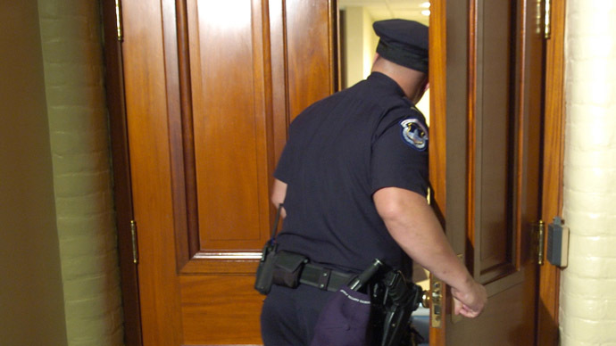
Attacking Warrantless Searches

Slide 42
Presumption of Unreasonableness
Once a threshold showing of no warrant, the burden shifts to the state to prove that the search or seizure was lawfully conducted according to one of the exceptions.
Ford v. State, 158 S.W.3d 488, 492 (Tex. Crim. App. 2005).

Slide 43
Exceptions to Warrant Requirement
Consent
Exigent Circumstances
Vehicle Exception
Search incident to arrest
Inventory
Inevitable Discovery (not used in Texas)
Independent Source
Attenuation
Community Caretaking
Plain view

Slide 44
Knock and Talk
Knock and talks are often the “go-to” investigative technique used by police wanting to search a home. Since their ability to get inside depends on intimidating the occupants into submission to obtain consent, these cases can be a bounty of illegal police action. First, understand that the home has special protection, described with particular eloquence by the courts:
Freedom from intrusion into the home or dwelling is the archetype of the privacy protection secured by the Fourth Amendment.
Payton v. New York, 445 U.S. 573, 586 (1980).
At the very core of the Fourth Amendment stands the right of a person to retreat into his own home and to be free from unreasonable governmental intrusion.
Silverman v. United States, 365 U.S. 505, 511 (1961).

Slide 45
Knock and Talk
Physical entry of the home is the chief evil against which the wording of the Fourth Amendment is directed.
United States v. United States District Court, 407 U.S. 297 (1972).
The right of officers to thrust themselves into a home is… a grave concern, not only to the individual but to a society which chooses to dwell in reasonable security and freedom from surveillance.
Johnson v. United States,333 U.S. 10, 13-14 (1948).

Slide 46
Knock and Talk
Nowhere is the zone of privacy more clearly defined than when bounded by the unambiguous physical dimensions of an individual's home.
Payton v. New York, 445 U.S. 573, 589 (1980)

Slide 47
Knock and Talk
The Fourth Amendment has drawn a firm line at the entrance to the house. Absent exigent circumstances, that threshold may not reasonably be crossed without a warrant.
Payton v. New York, 445 U.S. 573, 590 (1980).
A warrantless entry into a residence is presumptively unreasonable.
Gutierrez v. State, 221 S.W.3d 680, 685 (Tex. Crim. App. 2007).

Slide 48
Knock and Talk
Even if police have probable cause to suspect illegal activity, they generally cannot enter a residence without either consent or exigent circumstances:
The State has the burden of showing that probable cause existed at the time of the search and that exigent circumstances requiring immediate entry made obtaining a warrant impracticable. Turrubiate v. State, 399 S.W.3d 147, 151 (Tex. Crim. App. 2013). Tex. Crim. Proc. Code § art. 14.05 - “Rights of Officer”

Slide 49
An officer making an arrest without a warrant may not enter a residence to make the arrest unless:
(1) a person who resides in the residence consents to the entry;
or
(2) exigent circumstances require that the officer making the arrest enter the residence without the consent of a resident or without a warrant.

Slide 50
Exigent Circumstances
During a knock and talk, police will often claim some emergency occurred that required them to go inside the house. As a common exigency, police claim a concern for the destruction of evidence. They will see or smell drugs in a residence and then enter in order to confiscate it. However, that is not permitted.
In Turrubiate v. State, 399 S.W.3d 147, 151 (Tex. Crim. App. 2013), the Court recently changed the standard for exigent circumstances. Now, there must actually be affirmative conduct by occupants making destruction imminent.

Slide 51
Exigent Circumstance
Opening the door to a cloud of marijuana smoke during a knock and talk is not enough to go in without affirmative conduct showing imminent destruction. Turrubiate v. State, 399 S.W.3d 147 (Tex. Crim. App. 2013).
Occupants who choose not to stand on their constitutional rights but instead elect to attempt to destroy evidence have only themselves to blame for the warrantless exigent-circumstances search that may ensue. Kentucky v. King, 563 U.S. 452 (2011).

Slide 52
Exigent Circumstances
To meet their burden, the State must prove police reasonably believed occupants were actually in the process of destroying or attempting to destroy evidence before going inside.

Slide 53
Show of Force
An unreasonable show of force during a knock and talk amounts to an illegal arrest in one’s home. Officers commonly say they are just doing a knock and talk but then show up late at night looking like the SWAT team and banging on the door. They are required by law to only act like any other polite civilian at a neighbor’s home.

Slide 54
Show of Force
A knock and talk tactic of investigation is premised on the fact that the law permits officers to knock “politely” on a citizen’s door.
See, e.g., Florida v. Bostick, 501 U.S. 429, 433 (1991); Cornealius v. State, 900 S.W.2d 731, 733 (Tex. Crim. App. 1995); State v. Perez, 85 S.W.3d 817, 819 (Tex. Crim. App. 2002)

Slide 55
Show of Force
Police cannot use an unreasonable show of force during a “knock and talk” to compel a defendant to open his door to police.
When a person in his home declines to speak to police, the officers should retreat cautiously, seek a search warrant, or conduct further surveillance. Orosco v. State, 394 S.W.3d 65, 74 (Tex. App.—Houston [1st Dist.] 2012, no pet.).

Slide 56
Show of Force
The appropriate inquiry is whether a reasonable person would feel free to decline the officers’ requests or otherwise terminate the encounter. Florida v. Bostick, 501 U.S. 429, 436 (1991).
If an occupant answers the door in response to an unreasonable show of authority by the officers, he was unconstitutionally seized at that time. Orosco v. State, 394 S.W.3d 65, 75 (Tex. App.—Houston [1st Dist.] 2012, no pet.).

Slide 57
Show of Force
Officers went to the defendant's motel room, where they “knocked consistently for at least twenty minutes while yelling and identifying themselves as police officers.” The defendant opened the motel room door, stepped outside, and was then arrested. He was illegally seized inside his room and the evidence was suppressed.
United States v. Reeves, 524 F.3d 1161, 1164 (10th Cir.2008).

Slide 58
Show of Force
Officers created an illegal show of force when ten to twelve armed officers surrounded the house with a helicopter overhead and demanded the occupant open the door. United States v. Gomez–Moreno, 479 F.3d 350, 352 (5th Cir. 2007).

Slide 59
Show of Force
In United States v. Hernandez, 392 Fed.Appx. 350, 351 (5th Cir. 2010), police knocked and when they received no response, circled the defendant's trailer banging on doors and windows, shouting that police were present and anyone inside should open the door.

Slide 60
Show of Force
A reasonable person faced with several police officers consistently knocking and yelling at their door for twenty minutes in the early morning hours would not feel free to ignore the officers' implicit command to open the door. Orosco v. State, 394 S.W.3d 65, 74 (Tex. App.—Houston [1st Dist.] 2012, no pet.).

Slide 61
Prolonged Detentions
Law Enforcement tactic is to pull over a suspect and then proceed to engage in a drug investigation, fishing for reasonable suspicion by questioning the passengers.

Slide 62
Prolonged Detentions
“No person may be detained, even momentarily, without reasonable and objective grounds.”
Davis v. State, 947 S.W.2d 240, 246 (Tex. Crim. App. 1997) (Mansfield, J., concurring).

Slide 63
Prolonged Detentions
A traffic stop is an investigative detention,
the permissibility of which is analyzed under a dual inquiry:
  (1) whether the officer's action was justified at its inception; and,
  (2) whether it was reasonably related in scope to the circumstances which justified the interference in the first place. Terry v. Ohio, 392 U.S. 1, 19-20 (1968).

Slide 64
Prolonged Detentions
In deciding whether the scope of a Terry detention is “reasonable,” the general rule is that an investigative stop can last no longer than necessary to effect the purpose of the stop.
Florida v. Royer, 460 U.S. 491, 500 (1983) (stating the “the scope of the detention must be carefully tailored to its underlying justification”).

Slide 65
Prolonged Detentions
There is no constitutional impediment to a law enforcement officer's request to examine a driver's license and vehicle registration or rental papers during a traffic stop and to run a computer check on both.
U.S. v. Brigham, 382 F.3d 500, 508 (5th Cir. 2004).
However, a warrant check cannot be used solely as a means to extend a detention “once the reasonable suspicion forming the basis for the stop has been dispelled.”
Davis v. State, 947 S.W.2d 240 (Tex. Crim. App. 1997).

Slide 66
Prolonged Detentions
Any continued detention must be based on articulable facts which, taken together with rational inferences from those facts, would warrant a person of reasonable caution in the belief that a continued detention was justified, i.e., the detainee was or would soon be engaged in criminal activity.
Davis, 947 S.W.2d at 244-45.

Slide 67
Prolonged Detentions
“We hold that a police stop exceeding the time needed to handle the matter for which the stop was made violates the Constitution's shield against unreasonable seizures.”
Rodriguez v. United States, 135 S. Ct. 1609, 1612 (2015).

Slide 68
Prolonged Detentions
Traffic Stop for swerving out of lane
“Overwhelming” scent of air-fresheners emanating from the car
After questioning Rodriguez and another passenger in the car, the officer placed a call for backup and conducted a records check on the vehicle’s passenger
Rodriguez v. United States

Slide 69
Prolonged Detentions
The officer handed a warning ticket to Rodriguez, and then proceeded to walk K-9, around the outside vehicle
When the K-9 alerted, the officer searched the car and discovered meth
Officer reported that approximately seven or eight minutes passed between the time he issued the warning ticket to the time the K-9 alerted
Rodriguez v. United States

Slide 70
Prolonged Detentions
Because addressing the infraction is the purpose of the stop, it may last no longer than is necessary to effectuate that purpose.
Rodriguez v. United States, 135 S. Ct. 1609 (2015).

Slide 71
Prolonged Detentions
The critical question, then, is not whether the dog sniff occurs before or after the officer issues a ticket, but whether conducting the sniff prolongs—i.e., adds time to—the stop. Rodriguez v. United States, 135 S. Ct. 1609, 1615 (2015).

Slide 72
Frisks
Police routinely conduct frisks simply “for officer safety,” perhaps not even realizing that such a search requires them to first meet onerous legal hurdles.
They must first have
1) reasonable suspicion for a detention and
2) “specific and articulable facts” showing the person is “armed and dangerous.”
Then they are only allowed to discover objects that are obviously weapons.
To retrieve drugs, the contraband has to be “immediately apparent”— without any further manipulation or “feeling around.”

Slide 73
Frisks
A detention occurs with the show of authority by police.
Requiring a person to submit to a pat-down search is a show of authority that necessarily creates a detention under the Fourth Amendment. Wade v. State, 422 S.W.3d 661, 669-70 (Tex. Crim. App. 2013)

Slide 74
Frisks
A detention for investigative purposes is permissible only if the circumstances objectively support—with specific and articulable facts—a reasonable suspicion that the person detained is or has been engaged in criminal activity.
The facts relied upon must be “sufficiently detailed and reliable” to justify the seizure. Wade v. State, 422 S.W.3d 661, 668 (Tex. Crim. App. 2013).

Slide 75
Frisks
Constitutional protections against unreasonable searches cannot be whittled away by police regulations or standard operating procedure. Sikes v. State, 981 S.W.2d 490, 494 (Tex. App.—Austin 1998, no pet.).

Slide 76
Frisk
The CCA recently reiterated that an officer “was not entitled to frisk appellant without a reasonable belief that appellant had a weapon and was about to use it.” Wade v. State, 422 S.W.3d 661 (Tex. Crim. App. 2013).

Slide 77
Scope of Frisk
The purpose of a Terry search is not to obtain evidence of a crime, and must be strictly limited only to discovering weapons.
Terry at 26; see also Michigan v. Long, 463 U.S. 1032, 1049 (1983); Ybarra v. Illinois, 444 U.S. 85, 93-94 (1979).
If the protective search goes beyond what is necessary to determine if the suspect is armed, it is no longer valid under Terry and its fruits will be suppressed.
Minnesota v. Dickerson, 508 U.S. 366, 373 (1993); Sibron v. New York, 392 U.S. 40, 65-66 (1968).

Slide 78
Scope of Frisk
The scope of a protective “Terry frisk” is a narrow one.
Balentine v. State, 71 S.W.3d 763, 770 (Tex. Crim. App. 2002).
When a protective search is warranted, the search must be carefully limited to that necessary to discover weapons that could reasonably harm the police officer or others. Terry, 392 U.S. at 25–26.

Slide 79
Scope of Frisk
In Davis v. State, 829 S.W.2d 218, 221 (Tex. Crim. App. 1992), the Court held that even though officers were justified in conducting a frisk, the evidence had to be suppressed because they exceeded the permissible scope by removing a matchbox from the defendant’s pants.

Slide 80
Scope of Frisk
Terry does not permit a search for just any type of weapon – only those weapons that could reasonably harm the police officer. The Court concluded that “it is unreasonable for two armed police officers to fear a razor blade that might be contained in a matchbox.”

Slide 81
Scope of Frisk
An officer conducting a pat down felt a small lump in a pocket and “examined it with his fingers.” He concluded it was crack and pulled it out. The Court held that the officer exceeded his authority when—having dispelled any basis for believing a weapon to be in Dickerson’s pocket—he nevertheless “manipulated the lump” – which constituted an illegal search.
Minnesota v. Dickerson, 508 U.S. 366, 373 (1993).

Slide 82
Plain Feel Exception
When an officer conducts a valid weapons frisk, simply patting down the suspect’s outer clothing, he is only allowed to seize an object not a weapon if it’s “contour or mass makes its identity immediately apparent,” thus invoking the so-called “plain feel” exception. Dickerson, 508 U.S. at 375.

Slide 83
Plain Feel Exception
The plain feel exception is strictly interpreted.
In State v. Davis, the court suppressed a pipe uncovered in a Terry frisk. 988 S.W.2d 466 (Tex. App.−Houston [1st Dist.] 1999).
If the pipe could have been a tobacco pipe, the ‘plain feel’ doctrine would not have applied, because unlawful possession of the pipe would not have been immediately apparent. Id. at 466. The officer could not tell if the pipe was for drugs or tobacco just by feeling of it.

Slide 84
Plain Feel Exception
In Graham v. State, the court suppressed a small amount of cocaine that was discovered during a Terry frisk. 893 S.W.2d 4 (Tex. App.−Dallas 1994).
The officer testified that he felt something “puffy” and heard the crackling of cellophane. He rubbed and pinched the item in the defendant’s pocket and only then did he determine it to be contraband. The court held that the identity of the item was not “immediately apparent.”

Slide 85
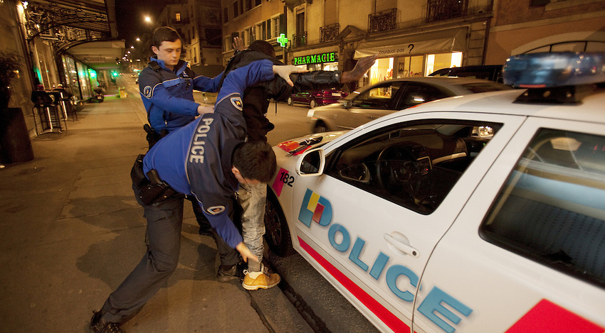
Arrests not Supported by Reasonable Suspicion

Slide 86
Investigative Detention NOT supported by Reasonable Suspicion
Officer saw Defendant and a female leave a motel on foot
Area known for drug activity
  The Officer stated he placed the Defendant in handcuffs for officer safety because he believed him to be a “known criminal”
  Searched the Defendant and found Cocaine
  Brodnex v. State, 2016 WL 1128274 (Tex. Crim. App. Mar. 23, 2016)

Slide 87
Investigative Detention NOT supported by Reasonable Suspicion
  Officer admitted he had no personal knowledge of Defendant’s criminal record
  He only knew what he had been told by other officers
  The officer did not have reasonable suspicion to detain defendant based on observing him walking with another person at 2 a.m. in an area known for narcotics activity and based on the officer's unsubstantiated belief that defendant was a known criminal.
  Brodnex v. State

Slide 88
Search Incident to Arrest
Warrantless search incident to arrest is limited to:
  (1) the arrestees person
  (2) area under immediate control of arrestee.
    Meaning “the area from within which he might gain possession of a weapon or destructible device”
Chimel v. California (1969)
Police searched Chimel’s entire home incident to his arrest

Slide 89
Search Incident to Arrest
Police searched pack of cigarettes found in breast pocket of arrestee’s jacket
  Two permitted searches of “areas”:
    Search “of the person”
    Search of “the area within control of arrestee”
U.S. v. Robinson (1973)

Slide 90
Search Incident to Arrest
Police examined clothing to see if paint from crime scene was present. Because it was late and he had no other clothes to wear they searched the next morning.
  Search of “both person and property in his immediate possession may be searched at the station house after arrest has occurred at another place”
U.S. v. Edwards (1974)

Slide 91
Search Incident to Arrest
Agents searched a footlocker found in a trunk 90 minutes after arrest and at the station
  A closed container in immediate control of arrestee is different than the clothing of the arrestee
  If search of container is remote in time or place of arrest or exigency then there is no exception to the warrant requirement
  “Repository of personal effects”
U.S. v. Chadwick (1977)

Slide 92
Search Incident to Arrest
Since the locker was not part of Chadwick’s “person” when arrested,
Then a warrantless search is not reasonable if no danger arrestee could access property to get a weapon or destroy evidence.
U.S. v. Chadwick (1977)

Slide 93
Search Incident to Arrest
Clothing in Robinson and Edwards are considered to be part of “arrestee’s person”
Distinguishably different from the closed container in the “area within immediate control of arrestee” as in Chadwick

Slide 94
Search Incident to Arrest
New York v. Belton (1981)
  “Area within immediate control of arrestee” can be searched incident to arrest, including passenger compartments
  This includes “containers” in the passenger compartments within reach regardless of whether it could actually hold a weapon or evidence of crime under investigation
  “Container” is any object capable of holding another object

Slide 95
Search Incident to Arrest
Arizona v. Gant (2009)
Limited Belton
  Search of a car incident to arrest unauthorized “after the arrestee has been secured and cannot access the interior of the vehicle”

Slide 96
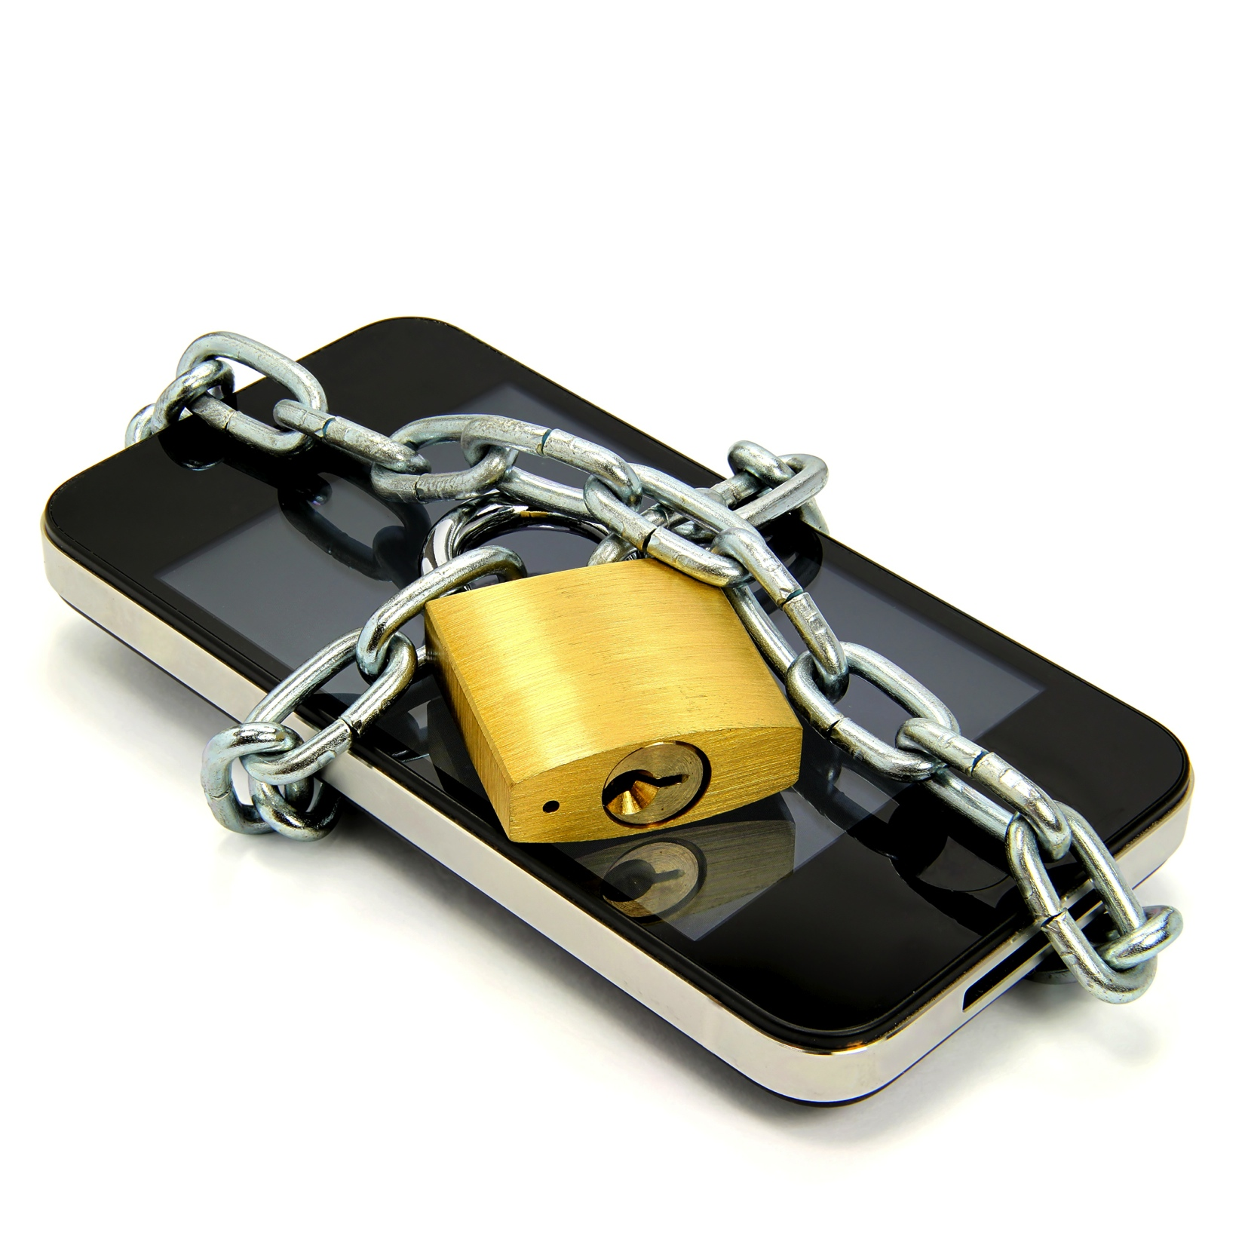
Attacking Cell Phone Searches

Slide 97
United States v. Wurie
Riley v. California
134 S. Ct. 2473 (2014)
Supreme Court unanimously ruled that the search incident to arrest exception does NOT extend to a cell phone and that police need to get a search warrant in order to search an arrestee's phone after arrest

Slide 98
Riley and Wurie
In Wurie, the United States appealed the judgment of the First Circuit which suppressed evidence from the cell phone of the defendant
In Riley, the defendant appealed the judgment of the California Court of Appeals which affirmed his conviction.

Slide 99
Riley and Wurie
In both cases, the contents of the defendants' cell phones were searched after they were arrested and evidence obtained from the cell phones was used to charge the defendants with additional offenses.
While the officers could examine the phones' physical aspects to ensure that the phones would not be used as weapons, digital data stored on the phones could not itself be used as a weapon to harm the arresting officers or to effectuate the defendants' escape.

Slide 100
Riley and Wurie
Further, the potential for destruction of evidence by remote wiping or data encryption was not shown to be prevalent and could be countered by disabling the phones.
Moreover, the immense storage capacity of modern cell phones implicated privacy concerns with regard to the extent of information which could be accessed on the phones.

Slide 101
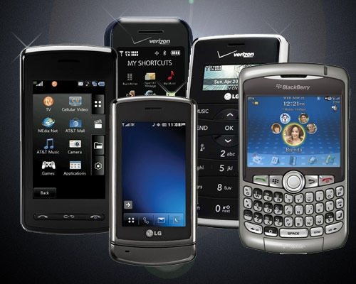

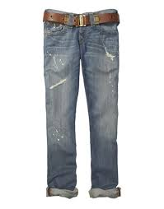
State v. Granville,
423 S.W.3d 399 (Tex Crim App 2014)
“We reject [the State’s] argument that a modern-day cell phone is like a pair of pants or a bag of groceries, for which a person loses all privacy protection once it is checked into a jail property room.”

Slide 102
State v. Granville
“A cell phone is unlike other containers as it can receive, store, and transmit an almost unlimited amount of private information.”
“The potential for invasion of privacy, identify theft, or at a minimum, public embarrassment is enormous.”

Slide 103
State v. Granville
“Searching a person’s cell phone is like searching his home desk, computer, bank vault, and medicine cabinet all at once. There is no doubt that the Fourth Amendment protects the subjective and reasonable privacy interest of citizens in their homes and in their personal ‘papers and effects.’”

Slide 104
State v. Granville
Citizens do not lose their “expectation of privacy in the contents of [their] cell phone merely because [they have] been arrested and [their] cell phone is in the custody of police for safekeeping.”

Slide 105
STATUTORY
Art. 18.0215. Access to Cellular Telephone or Other Wireless Communications Device
A peace officer may not search a person’s cellular telephone or other wireless communications device, pursuant to a lawful arrest of the person without obtaining a warrant under this article.
38.23?

Slide 106
Other Electronic Devices
Cell phones
Laptops
Tablets
USB drives
Digital Cameras
Smart Tv’s
Fitness Trackers

Slide 107
Electronic Tracking
Warrant Required for Electronic Tracking
TCCP 18.21, § 14(a), (c) permits officers to install and use GPS upon sworn application to a district judge

Slide 108
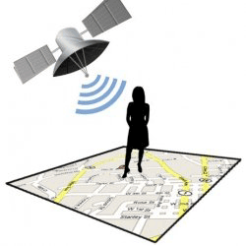
U.S. v. Jones,
132 S.Ct. 645 (2012)
Placing a GPS device on a vehicle and using it to track a vehicle’s movement constitutes a search for 4th Amendment purposes.
Agents obtained a warrant to placed a GPS device on Jones’ Jeep during a drug investigation. However, Agents placed the GPS on the vehicle beyond the timing that the warrant allowed.

Slide 109
U.S. v. Jones,
132 S.Ct. 645 (2012)
Decision based on 18th century law of Trespass
Although a unanimous decision, 5-4 split on whether it is a violation as a trespass on property or a violation of expectation of privacy
Access to factory installed or cell phone GPS was not addressed in Jones (Sotomayor concurring)
Alito addresses Reasonable Expectation of Privacy and GPS

Slide 110
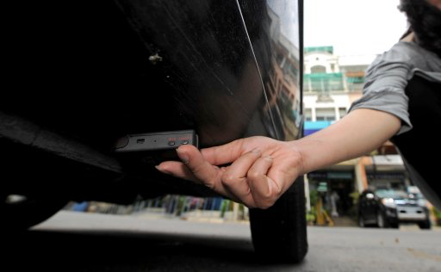
Electronic Tracking Post-Jones

Slide 111
State v. Jackson, 464 S.W.3d 724, (Tex. Crim. App. 2015)
Officers, suspecting Defendant of Meth trafficking
Placed a GPS tracking device on his car
Attempting to ascertain when and where he was obtaining his supply.
Got an Article 18.21 warrant for the GPS after the installed the monitor
Monitored his movement as he traveled at speeds exceeding the speed limit.

Slide 112
State v. Jackson, 464 S.W.3d 724, (Tex. Crim. App. 2015)
Independently verified he was speeding by pacing his car in their own unmarked vehicles.
Later, other officer verified by radar that the Defendant was speeding and pulled him over
Obtained his consent to search
Found methamphetamine in the trunk

Slide 113
State v. Jackson, 464 S.W.3d 724, (Tex. Crim. App. 2015)
As per Jones, the GPS tracking device and its use to monitor defendant constituted a search
However,
the independent verification of defendant's speeding was an intervening circumstance that purged the primary taint of the unconstitutional GPS tracking device search

Slide 114
State v. Jackson, 464 S.W.3d 724, (Tex. Crim. App. 2015)
Defendant's detention and his consent to search, the discovery of the contraband, and his admission were sufficiently attenuated from the primary illegality;
As TCCP 18.21, § 14(a), (c) permitted officers to install and use GPS upon sworn application to a district judge, the search was not a flagrant disregard of defendant's constitutional rights.

Slide 115
New Traffic Stop Cases
Jaganathan v. State
United States v. Alvarado-Zarza

Slide 116
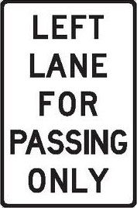
Get out of the left lane!!!

Slide 117
Jaganathan v. State, 479 S.W.3d 244, (Tex. Crim. App. 2015)
Defendant traveling in left lane on I-10
Defendant passed a "Left Lane for Passing Only" sign
Remained in the left lane without passing.
DPS conducted a Traffic Stop
Marijuana Found

Slide 118
Jaganathan v. State, 479 S.W.3d 244, (Tex. Crim. App. 2015)
The stop WAS reasonable suspicion to conduct a traffic stop where defendant passed a:
"left lane for passing only sign,”
and
according to the video she was clearly driving in the left lane without passing after driving past the sign

Slide 119
Jaganathan v. State, 479 S.W.3d 244, (Tex. Crim. App. 2015)
Sometimes it will be obvious that otherwise illegal conduct is justified by surrounding circumstances.
But Defendant must show it was so obvious that an objective officer would be unreasonable in failing to realize that the person's conduct was allowed by law.
The facts here did not establish beyond question that the Defendant needed to remain in the left lane for safety purposes.

Slide 120
United States v. Alvarado-Zarza,
782 F.3d 246 (5th Cir. 2015)
Traffic stop near Mexican Boarder
Officer claimed the D made a “TURN” during a lane change
Consent to Search
Cocaine found
Motion to suppress challenging Reasonable Suspicion

Slide 121
United States v. Alvarado-Zarza,
782 F.3d 246 (5th Cir. 2015)
Tex Trans Code- “operator shall signal 100 feet before turn”
The lane change was NOT a “turn”
Officer’s mistake of law was NOT objectively reasonable

Slide 122
United States v. Alvarado-Zarza,
782 F.3d 246 (5th Cir. 2015)
Remember in Heien v. North Carolina, 135 S. Ct. 530 (2014) the mistake was reasonable because:
  1. statue was ambiguous
  2 no previous appellate court rulings
Reasonable suspicion cannot rest upon a mistake of law or fact unless the mistake is objectively reasonable

Slide 123
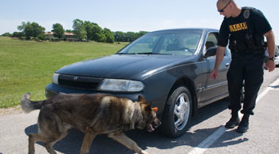
Attaching K-9 Searches

Slide 124
Areas to Sniff out Success
Was there violation of the Fourth Amend.?
    (a lot of bark, no bite)
Was the “K-9 Alert” reliable to establish P. C.?
    (the Real Focus)
      Look at the actions of the Narcotics Detection Team.
      Look at the “Alert” itself.
      Look at the Reliability of the K-9.

Slide 125
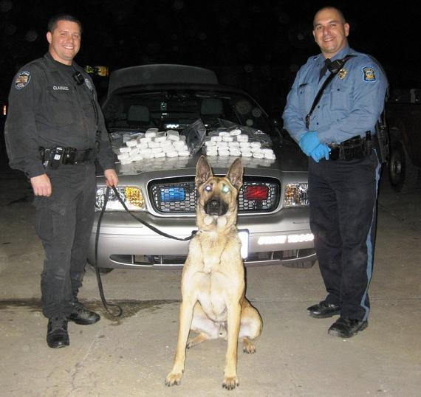
Narcotics Detection Team
The Team works as a “Unit.”
A trained Handler.
A trained K-9.
Reliable only when both are working together properly.

Slide 126
In General, a Sniff is not a Search
U.S. v. Place, 462 U.S. 696 (1983)
  Exposure of luggage to a trained narcotics-detection dog is not a search for 4th Amendment purposes.
Illinois v. Caballes, 543 U.S. 405 (2005)
  Where lawful traffic stop did not extend beyond time necessary to issue ticket and conduct inquires incident to the stop, other officer’s arrival and use of narcotics detection dog to sniff around the exterior of vehicle did not rise to level of infringement of 4th Amendment rights.

Slide 127
U.S. v. Place, 462 U.S. 696 (1983)
Passenger in Miami International Airport suspected of carrying Narcotics.
Passenger arrived at La Guardia and DEA seized his bags based on discrepancies on address tags and nervous behavior.
Took bags to Kennedy Airport and subjected to a drug-dog sniff.
Dog alerted.

Slide 128
U.S. v. Place, 462 U.S. 696 (1983)
Rational:
  The initial taking of the luggage was a reasonable temporary seizure under Terry
  “A K-9 sniff by a well-trained narcotics detection dog,… does not require opening the luggage.”
  “It does not expose non-contraband items that otherwise would remain hidden from public view, as does, for example, the officers rummaging through the contents of the luggage.”

Slide 129
U.S. v. Place, 462 U.S. 696 (1983)
Rational:
  The is “much less intrusive than a typical search.”
  A sniff does not subject the property owner to “embarrassment and inconvenience of a less discriminate and more intrusive investigation method.”

Slide 130
Illinois v. Caballes, 543 U.S. 405 (2005)
Motorist stopped with R.S. for a lawful traffic violation.
While a warning citation being written, second officer arrived with K-9 and sniffed exterior of vehicle.
Stop lasted no more than 10 minutes.
Dog Alerted.

Slide 131
Caballes Sniff
Trained narcotics detection K-9 Team
Lawful traffic stop
Traffic stop does not extended beyond time necessary
Sniff around the exterior of vehicle

Slide 132
United States v. Rodriguez
135 S. Ct. 1609 (2015)
Officers may not extend the length of a traffic stop to conduct a dog sniff unrelated to the original purpose of the stop

Slide 133
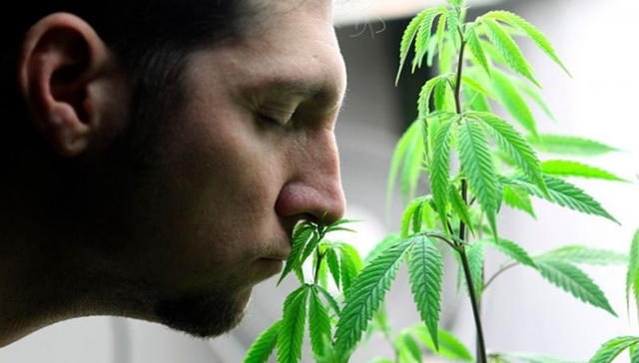
Searching Homes that smell like Weed

Slide 134
Florida v. Jardines,
569 U.S. 1 (2013)
Police use of a trained narcotics detection dog to sniff on the front porch of a private home is a "search" within the meaning of the Fourth Amendment and therefore, without consent, requires both probable cause and a warrant.
Scalia used 18th Century trespass law
The violation is the trespass on the person’s property much

Slide 135
State v. Rendon, 477 S.W.3d 805
(Tex. Crim. App. 2015)
    Detectives took a drug-detection dog to the defendant’s car and then the front door of his apartment
    After a positive alert detectives got a search warrant and found 2 pounds of marijuana
    Trial Court granted motion to suppress reasoning that the landing outside the Apt door was “curtilage” of the defendant’s apartment even though it was in the public or common area because the the landing “led only and directly to the Defendant’s door”

Slide 136
State v. Cuong Phu Le, 463 S.W.3d 872, (Tex. Crim. App. 2015)
Sheriff's Department received a report from concerned citizen about suspicious activity.
Young Asian males arriving at the residence though no one had moved any furniture into the home.
They did not engage in any normal household activities such as yard work or washing cars.
They did not see any lights inside the residence even when the young males visited

Slide 137
State v. Cuong Phu Le, 463 S.W.3d 872, (Tex. Crim. App. 2015)
Officers observed residence and observed drawn blinds consistent with the citizen’s report
Officer subpoenaed electric bills. Defendant was the same person who was on the bill
Officers heard the air condition running continuously even though it was cool outside.
Officers found it consistent with a indoor marijuana grow

Slide 138
State v. Cuong Phu Le, 463 S.W.3d 872, (Tex. Crim. App. 2015)
Officers walked up to the sidewalk and stood at the front door. Officers could smell marijuana
Officer conducted a traffic stop of the Defendant for a traffic violation after leaving the house and smelled marijuana in the car.
Officer then called for a K-9 who alerted on the front of the house
Based on all of the info, officers got a warrant

Slide 139

358 Plants Found Inside

Slide 140
State v. Cuong Phu Le, 463 S.W.3d 872, (Tex. Crim. App. 2015)
The Search warrant affidavit for the residence, minus the drug-dog's alert, clearly established probable cause
Because the tip came from a concerned citizen in good standing in the community, and the citizen's detailed information was verified by the officers over their three-week investigation.
One officer verified the smell of raw marijuana at the front door of the residence and the other officer smelled raw marijuana on defendant's person and in his car after he saw defendant leave the residence with the suspected marijuana growing operation.

Slide 141
Florida v. Harris,
568 US.___ (2013)
SCOUTS addressed the reliability of a dog sniff by a detection dog trained to identify narcotics, under the specific context of whether law enforcement’s assertions that the dog is trained or certified is sufficient to establish probable cause for a search of a vehicle under the Fourth Amendment. Harris was the first Supreme Court case to challenge the dog's reliability, backed by data that asserts that on average, up to 80% of a dog's alerts are wrong.

Slide 142
Florida v. Harris,
568 US.___ (2013)
The Court unanimously held that if a bona fide organization has certified a dog after testing his reliability in a controlled setting, or if the dog has recently and successfully completed a training program that evaluated his proficiency, a court can presume (subject to any conflicting evidence offered) that the dog's alert provides probable cause to search, using a "totality-of-the-circumstances" approach.

Slide 143
Florida v. Harris,
568 US.___ (2013)
Most important point,
You can look to the underlying reliability of the K9

Slide 144
Trained Narcotics Detection K-9 Team
The K-9 alert must be sufficiently reliable to provide probable cause to conduct the search.
Therefore, the Hander and the Dog must have received proper training and be current in that training.
Testimony and records must support proper training.

Slide 145
Trained Narcotics Detection K-9 Team
Remember FRE 702 Expert requirements.
The training that officers receive varies greatly from department to department.
The training records for the K-9 should be extensive and detailed.
The training records should include a log of every training session as well as every use of the dog in the field.
K-9s should receive a minimum of 4 hours training per week.

Slide 146
Trained Narcotics Detection K-9 Team
The dog must be trained, certified and reliable. The dog does not have to be 100% accurate or perfect. The courts have recognized the fact that “false responses”, “false positives” or “false alerts” occur and dogs can be as low as 54% accurate. United States v Cedano-Arellano, 332 F. 3d 568 (9th Cir 2003)

Slide 147
Trained Narcotics Detection K-9 Team
While the vast majority of cases in most jurisdictions simply require a showing that the dog was “trained,” the following issue can provide fertile ground for cross-examination of the officer regarding the sufficiency of training:
Type of training.
Duration of training.
Date of last training.
Ability of officer to explain training.
Relevancy of training to actual field use.

Slide 148
Discovery of K-9 Training and Certification Materials
The following should be discovered:
1. Verification that the canine was trained to detect the odors for the particular drug.
2. Verification of the canine’s success rate.
3. The method used to train the canine to indicate an alert.
4. The type of alert used.
5. A statement showing that the canine positively alerted to the presence of narcotics in the proper fashion.
6. Proof of the canine’s certification.
7. Proof that the canine has continued to meet all certification requirements and received necessary training on a regular basis.
8. Verification that the handler has been trained to handle narcotics-detection canines.

Slide 149
Sniff Around the Exterior of Vehicle
The sniff must be limited to the exterior of vehicle.
Dog cannot be taken in to the vehicle without prior probable cause.
*What if the dog jumps in?
*What if the dog “breaks the plane” of the window?
*What if the officer opens the door for the dog?

Slide 150
Rodriguez and Caballes Did Not Challenge the Alert
Remember that Rodriguez and Caballes only dealt with:
Trained K-9 Team.
Lawful traffic stop.
Duration of traffic stop.
Sniff of Exterior of vehicle.
THE ALERT ITSELF WAS NOT CHALLENGED

Slide 151
Caballes Did Not Challenge the Alert
The vast majority of K-9 Sniff case law deals with the factors surrounding and leading up to the search.
Most case law does not deal with the validity of the Alert itself.

Slide 152
Persons
The non-contact dog sniff of a passenger, after the dog had alerted to the presence of narcotics in the passenger compartment of a bus, was not a search within the meaning of the Fourth Amendment. The dog was four to five feet away from the passenger when sniffed, and the handler did not intend to have the dog sniff the passenger as he exited the bus. United States v. Reyes, 349 F.3d 219 (5th Cir. 2003).

Slide 153
Persons
BUT:
An up close sniffing of a person at the border by a trained K-9 offends reasonable expectations of privacy and is thus a “search” under the 4th Amendment. U.S. v. Kelly, 302 F.3d 291 (5th Cir. 2002.)

Slide 154
Border Exception to 4th Amendment
Under the “border-search doctrine,” government agents may conduct routine searches at international borders or their functional equivalents without probable cause, a warrant, or any suspicion to justify a search. U.S. v. Rivas, 157 F.3d 364, at 367 (5th Cir. 1998).
But the stop and search must be ROUTINE!!!!
Otherwise, reasonable suspicion is required.

Slide 155
The Focus of the
Motion to Suppress
Was the “Alert” sufficiently reliable to establish probable cause for the Search?
  Look at the Alert itself
  Explore the reliability of the Team to do its job
    Was the Team properly trained?
    Does the Team execute its job according to that training?

Slide 156
Was it a legitimate “Alert”?
A trained or conditioned response by a K-9 to a stimulus.
Two types of alerts:
  Passive
    Sitting, stop and stare, lay down, a bark, something passive and non-aggressive.
  Aggressive
    Scratching, clawing, and/or biting

Slide 157
Reasons for different types
Alerts
Passive alerts are used for explosives, to prevent to personal property damage, and minimize liability.
Aggressive alerts is a more natural response for the dog and easier to train.
Neither are better than the other.

Slide 158
THE END

