Slide 1
Suppression Issues – How to Litigate and How to Win
Presented by Don Flanary
Goldstein Goldstein and Hilley
Upholding Justice One Client at a Time
TCDLA
July 13, 2016
South Padre Island, Texas

Slide 2
4th Amend Requires a Warrant
Searches and seizures conducted without a warrant are unreasonable per se, subject to a few specifically established and well-delineated exceptions.
McGee v. State, 105 S.W.3d 609, 615 (Tex. Crim. App. 2003).

Slide 3

Attack the
Warrant or the Exception

Slide 4
Warrant or Exception
Then State must prove:
Valid warrant or
Exception applies
Amador v. State, 221 S.W.3d 666, 672-73 (Tex. Crim. App. 2007)

Slide 5
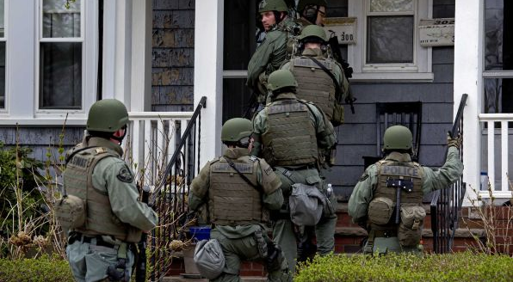
Searches with a Warrant

Slide 6
Attacking the Affidavit
Search warrants must be preceded by affidavits. The affidavit is normally where you will find the defects or issues that can invalidate the search and its fruits. The affidavit must be sworn or affirmed and it must contain probable cause.

Slide 7
Defects in Affidavits
Clerical or typographical error will not normally render the warrant invalid.
The affiant may be any credible person. It does not have to be a police officer or other law enforcement officer.
Dickey v. State, 816 S.W.2d 832 (Tex. App. – Eastland 1991, no pet.).

Slide 8
The Magistrate
Art1 8.01 – Search warrants shall be issued by a magistrate.
18.01(c) goes further to state that an evidentiary search warrant can only be issued by judges who are licensed attorneys.

Slide 9
Any County in Texas
A district judge may sign search warrants for execution in any county in the state. Green v. State, 880 S.W.2d 198 (Tex. App. – Texarkana 1994, no pet.).
But a search warrant may not be issued by a statutory county court judge for execution in a different county.
Sanchez v. State, 365 S.W.3d 681 (Tex. Crim. App. 2012).

Slide 10
Unsigned Warrant
The good faith exception to the exclusionary rule will allow the admission of evidence seized under an unsigned warrant so long as the warrant contained probable cause and was unsigned solely because of the magistrate’s oversight.
Dunn v. State, 951 S.W.2d 478 (Tex. Crim. App. 1997).

Slide 11
Four Corners
Sufficient probable cause to support the warrant exists if the facts contained within the four corners of the affidavit and the reasonable inferences drawn therefrom justify the magistrate’s conclusion that the object of the search is probably on the premises to be searched at the time of issuance.
Cassias v. State, 719 S.W.2d 585 (Tex. Crim. App. 1986); Ramos v. State, 934 S.W.2d 358 (Tex. Crim. App. 1996).

Slide 12
Four Corners
The determination of the legal adequacy of an affidavit in support of a search warrant is to be made within the four corners of the document involved.
Serrano v. State, 123 S.W.3d 53, 58 (Tex. App. – Austin 2003, pet. ref’d) (citing Jones v. State, 833 S.W.2d 118, 123 (Tex. Crim. App. 1992); Oubre v. State, 542 S.W.2d 875, 877 (Tex. Crim. App. 1976); Mayfield v. State, 800 S.W.2d 932, 934 (Tex. App. – San Antonio 1990, no pet.)).

Slide 13
Four Corners
The facts found in the search warrant affidavit must show that “there is a fair probability that contraband or evidence of a crime will be found in that particular place.”
Illinois v. Gates, 462 U.S. 213 (1983); State v. McLain, 337 S.W.3d 268 (Tex.
Crim. App. 2011).

Slide 14
Four Corners
Where failures in the affidavit result in a failure to allege how the conduct cited could result in a violation of the law, the affidavit fails to set forth probable cause.
Hall v. State, 795 S.W.2d 195 (Tex. Crim. App. 1990).

Slide 15
Four Corners
Mere possession of drugs is not enough to warrant the search of a person’s residence.
Ozuna v. State, 88 S.W.3d 307 (Tex. App.-San Antonio 2002, pet. ref’d) citing Cassias v. State, 719 S.W.2d 585 (Tex. Crim. App. 1986).

Slide 16
Hearsay Allowed
Hearsay on hearsay allowed to form the factual basis for a warrant so long as there is a substantial basis for crediting the hearsay at each level.
Hall v. State, 795 S.W.2d 195 (Tex.
Crim. App. 1990); Hennessy v. State, 660 S.W.2d 87 (Tex. Crim. App. 1983).

Slide 17
Totality of Circumstances
A totality of the circumstances test is applied to the facts in the affidavit in determining whether or not probable cause existed to issue the warrant.
Illinois v. Gates, 462 U.S. 213, 103 S.Ct. 2317 (1983); Bower v. State, 769 S.W.2d 887 (Tex.Cr. App. 1989); Ramos v. State, 934
S.W.2d 358 (Tex. Crim. App. 1996).

Slide 18
Totality of Circumstances
Part of the totality of the circumstances that a magistrate should evaluate in making a probable cause determination is the reliability of the affiant and his sources of information.
Jaben v. U.S., 381 U.S. 214 (1965); Johnson v. State, 803 S.W.2d 272 (Tex. Crim. App. 1990).

Slide 19
Totality of Circumstances
When evaluating the affidavit, the task of the magistrate is to make a practical, common- sense decision whether, given the totality of the circumstances set forth in the affidavit, there is a fair probability that contraband or evidence of a crime will be found in a particular place.
Borsari v. State, 919 S.W.2d 913, 917-918 (Tex. App. – Houston [14th Dist.] 1996, pet. ref’d).

Slide 20
Reviewing Mag’s Determination
Although great deference should be paid to the magistrate’s determination of probable cause in issuing the warrant, it is the duty of the reviewing court to ensure the magistrate had a substantial basis for concluding that probable cause existed. Illinois v. Gates, 462 U.S. 213 at 238-39, 103 S.Ct. 2317 (1983).

Slide 21
Reviewing Mag’s Determination
A magistrate’s decision to issue a search warrant will be upheld where the magistrate had a substantial basis for concluding that a search would uncover evidence of wrongdoing.
Illinois v. Gates, 462 U.S. 213 at 238-39, 103 S.Ct. 2317 (1983); Moreno v. State, 415 S.W.3d 284 (Tex. Crim. App. 2013).

Slide 22
Reviewing Mag’s Determination
On appeal, the magistrate’s decision is reviewed under a deferential standard of review, rather than de novo, because of the Fourth Amendment’s strong preference for searches conducted pursuant to a warrant.
Illinois v. Gates, 462 U.S. 213 at 238-39, 103 S.Ct. 2317 (1983); Moreno v. State, 415 S.W.3d 284 (Tex. Crim. App. 2013).

Slide 23
The Motion to Suppress
Where the defendant challenges probable cause for the search and the state relies upon a warrant to establish the basis for the search, the state bears the burden of producing the warrant and affidavit for inspection by the court.
Miller v. State, 736 S.W.2d 643 (Tex. Crim. App. 1987).

Slide 24
The Motion to Suppress
Once the state produces the warrant, the burden of proof shifts to the defendant to go forward with evidence to show the invalidity of the warrant. Johnson v. State, 803 S.W.2d 272 (Tex. Crim. App. 1990).

Slide 25
The Hearing
The Rules of Evidence do not apply to suppression hearings.
Granados v. State, 85 S.W.3d 217 (Tex. Crim. App. 2002).

Slide 26
The Hearing
A defendant may testify at a motion to suppress and does not waive his Fifth Amendment right to not testify at trial.
Simmons v. U.S.

Slide 27
The Hearing
BUT, if the defendant testifies at the suppression hearing (outside presence of jury) and then testifies at trial, he may be impeached with his suppression hearing testimony if he testifies contrary. Nelson v. State, 607 S.W.2d 554 (Tex. Crim. App. 1980).

Slide 28
The Hearing
Need facts and argument, not just allegations
Timing: pretrial hearing or carry with trial?
If you lose, ask for Findings of Facts and Conclusions of Law

Slide 29
Standing
Pick a pony and ride it
Either its your stuff and you have an expectation of privacy or,
The State can’t prove affirmative links
Be SMART and consistent

Slide 30
Common Warrant Problems
Conclusory Statements
A probable cause finding requires the magistrate to make an independent determination of the facts rather than accept the conclusions of the affiant or the affiant’s sources, no matter how honest or reliable they may appear.

Slide 31
Conclusory Statements
Wholly conclusory statements do not provide the magistrate with a substantial basis for determining the existence of probable cause.
Illinois v. Gates, 462 U.S. 213, 103 S.Ct. 2317 (1983).

Slide 32
Conclusory Statments
The affidavit must contain more than mere conclusory statements that give the magistrate virtually no basis at all for making a judgment regarding probable cause.
State v. Anderson, 917 S.W.2d 92, 95 (Tex. App. – Houston [14th Dist.] 1996, pet. ref’d).

Slide 33
Conclusory Statements
The magistrate must be presented with “sufficient information” to allow [him] to determine probable cause; “his action cannot be a mere ratification of the bare conclusions of others.”
State v. Anderson, 917 S.W.2d 92, 95 (Tex. App. – Houston [14th Dist.] 1996, pet. ref’d) citing Illinois v. Gates.

Slide 34
Conclusory Statements
Examples:
John Smith has cocaine at this apartment located at 123 Main St., Alpine,Texas.
My informant told me there are large quantities of drugs in apartment 56 at 123 Main St., Alpine, Texas.
Fingerprints found at the scene have been determined to be those of John Smith.
Your affiant, acting in an undercover capacity, purchased one gram of cocaine from John Smith.

Slide 35
Informant Info Must be Corroborated
The “informant” is treated differently than an average citizen. A magistrate may rely on source information supplied by an average citizen without corroboration since, unlike many police informants, they are much less likely to produce false or untrustworthy information.
Jaben v. U.S., 381 U.S. 214, 85 S.Ct. 1365 (1965); Johnson v. State, 803 S.W.2d 272 (Tex. Crim. App.
1990); Marquez v. State, 725 S.W.2d 217 (Tex. Crim. App. 1987).

Slide 36
Informant Info Must be Corroborated
Where a probable cause affidavit specifies a named informant as supplying the information upon which probable cause is based, the affidavit must be sufficiently details to suggest direct knowledge on the informant’s part.
Wilkerson v. State, 726 S.W.2d 542 (Tex. Crim. App. 1986); Matamoros v. State, 901 S.W.2d 470 (Tex. Crim. App. 1995).

Slide 37
Informant Info Must be Corroborated
An anonymous or first-time confidential informant of unknown reliability must be coupled with facts from which an inference may be drawn that the informant is credible or that his information is reliable.
State v. Duarte, 389 S.W.3d 349 (Tex. Crim. App. 2012).

Slide 38
Informant Info Must be Corroborated
The facts may include:
  if the tip is corroborated;
  if it is a statement against penal interest;
  if it is consistent with information provided by other informants;
  if it is a detailed first-hand observation;
  or if it is coupled with an accurate prediction of the subject’s future behavior.
State v. Duarte, 389 S.W.3d 349 (Tex. Crim. App. 2012).

Slide 39
Stale Information
The facts in a search warrant affidavit must be so closely related to the time of the issuance of the warrant that a finding of probable cause is justified. State v. McLain, 337 S.W.3d 268 (Tex. Crim. App. 2011).

Slide 40
Place to be Searched
One of the requirements of the Fourth Amendment is that the warrant must particularly describe the place to be searched.
Long v. State, 132 S.W.3d 443 (Tex. Crim. App. 2004).

Slide 41
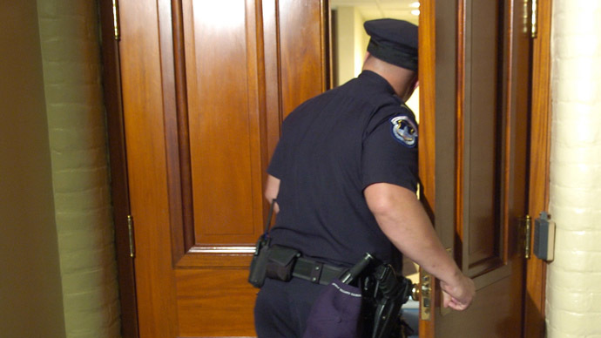
Attacking Warrantless Searches

Slide 42
Presumption of Unreasonableness
Once a threshold showing of no warrant, the burden shifts to the state to prove that the search or seizure was lawfully conducted according to one of the exceptions.
Ford v. State, 158 S.W.3d 488, 492 (Tex. Crim. App. 2005).

Slide 43
Exceptions to Warrant Requirement
Consent
Exigent Circumstances
Vehicle Exception
Search incident to arrest
Inventory
Inevitable Discovery (not used in Texas)
Independent Source
Attenuation
Community Caretaking
Plain view

Slide 44
Knock and Talk
Knock and talks are often the “go-to” investigative technique used by police wanting to search a home. Since their ability to get inside depends on intimidating the occupants into submission to obtain consent, these cases can be a bounty of illegal police action. First, understand that the home has special protection, described with particular eloquence by the courts:
Freedom from intrusion into the home or dwelling is the archetype of the privacy protection secured by the Fourth Amendment.
Payton v. New York, 445 U.S. 573, 586 (1980).
At the very core of the Fourth Amendment stands the right of a person to retreat into his own home and to be free from unreasonable governmental intrusion.
Silverman v. United States, 365 U.S. 505, 511 (1961).

Slide 45
Knock and Talk
Physical entry of the home is the chief evil against which the wording of the Fourth Amendment is directed.
United States v. United States District Court, 407 U.S. 297 (1972).
The right of officers to thrust themselves into a home is… a grave concern, not only to the individual but to a society which chooses to dwell in reasonable security and freedom from surveillance.
Johnson v. United States,333 U.S. 10, 13-14 (1948).

Slide 46
Knock and Talk
Nowhere is the zone of privacy more clearly defined than when bounded by the unambiguous physical dimensions of an individual's home.
Payton v. New York, 445 U.S. 573, 589 (1980)

Slide 47
Knock and Talk
The Fourth Amendment has drawn a firm line at the entrance to the house. Absent exigent circumstances, that threshold may not reasonably be crossed without a warrant.
Payton v. New York, 445 U.S. 573, 590 (1980).
A warrantless entry into a residence is presumptively unreasonable.
Gutierrez v. State, 221 S.W.3d 680, 685 (Tex. Crim. App. 2007).

Slide 48
Knock and Talk
Even if police have probable cause to suspect illegal activity, they generally cannot enter a residence without either consent or exigent circumstances:
The State has the burden of showing that probable cause existed at the time of the search and that exigent circumstances requiring immediate entry made obtaining a warrant impracticable. Turrubiate v. State, 399 S.W.3d 147, 151 (Tex. Crim. App. 2013). Tex. Crim. Proc. Code § art. 14.05 - “Rights of Officer”

Slide 49
An officer making an arrest without a warrant may not enter a residence to make the arrest unless:
(1) a person who resides in the residence consents to the entry;
or
(2) exigent circumstances require that the officer making the arrest enter the residence without the consent of a resident or without a warrant.

Slide 50
Exigent Circumstances
During a knock and talk, police will often claim some emergency occurred that required them to go inside the house. As a common exigency, police claim a concern for the destruction of evidence. They will see or smell drugs in a residence and then enter in order to confiscate it. However, that is not permitted.
In Turrubiate v. State, 399 S.W.3d 147, 151 (Tex. Crim. App. 2013), the Court recently changed the standard for exigent circumstances. Now, there must actually be affirmative conduct by occupants making destruction imminent.

Slide 51
Exigent Circumstance
Opening the door to a cloud of marijuana smoke during a knock and talk is not enough to go in without affirmative conduct showing imminent destruction. Turrubiate v. State, 399 S.W.3d 147 (Tex. Crim. App. 2013).
Occupants who choose not to stand on their constitutional rights but instead elect to attempt to destroy evidence have only themselves to blame for the warrantless exigent-circumstances search that may ensue. Kentucky v. King, 563 U.S. 452 (2011).

Slide 52
Exigent Circumstances
To meet their burden, the State must prove police reasonably believed occupants were actually in the process of destroying or attempting to destroy evidence before going inside.

Slide 53
Show of Force
An unreasonable show of force during a knock and talk amounts to an illegal arrest in one’s home. Officers commonly say they are just doing a knock and talk but then show up late at night looking like the SWAT team and banging on the door. They are required by law to only act like any other polite civilian at a neighbor’s home.

Slide 54
Show of Force
A knock and talk tactic of investigation is premised on the fact that the law permits officers to knock “politely” on a citizen’s door.
See, e.g., Florida v. Bostick, 501 U.S. 429, 433 (1991); Cornealius v. State, 900 S.W.2d 731, 733 (Tex. Crim. App. 1995); State v. Perez, 85 S.W.3d 817, 819 (Tex. Crim. App. 2002)

Slide 55
Show of Force
Police cannot use an unreasonable show of force during a “knock and talk” to compel a defendant to open his door to police.
When a person in his home declines to speak to police, the officers should retreat cautiously, seek a search warrant, or conduct further surveillance. Orosco v. State, 394 S.W.3d 65, 74 (Tex. App.—Houston [1st Dist.] 2012, no pet.).

Slide 56
Show of Force
The appropriate inquiry is whether a reasonable person would feel free to decline the officers’ requests or otherwise terminate the encounter. Florida v. Bostick, 501 U.S. 429, 436 (1991).
If an occupant answers the door in response to an unreasonable show of authority by the officers, he was unconstitutionally seized at that time. Orosco v. State, 394 S.W.3d 65, 75 (Tex. App.—Houston [1st Dist.] 2012, no pet.).

Slide 57
Show of Force
Officers went to the defendant's motel room, where they “knocked consistently for at least twenty minutes while yelling and identifying themselves as police officers.” The defendant opened the motel room door, stepped outside, and was then arrested. He was illegally seized inside his room and the evidence was suppressed.
United States v. Reeves, 524 F.3d 1161, 1164 (10th Cir.2008).

Slide 58
Show of Force
Officers created an illegal show of force when ten to twelve armed officers surrounded the house with a helicopter overhead and demanded the occupant open the door. United States v. Gomez–Moreno, 479 F.3d 350, 352 (5th Cir. 2007).

Slide 59
Show of Force
In United States v. Hernandez, 392 Fed.Appx. 350, 351 (5th Cir. 2010), police knocked and when they received no response, circled the defendant's trailer banging on doors and windows, shouting that police were present and anyone inside should open the door.

Slide 60
Show of Force
A reasonable person faced with several police officers consistently knocking and yelling at their door for twenty minutes in the early morning hours would not feel free to ignore the officers' implicit command to open the door. Orosco v. State, 394 S.W.3d 65, 74 (Tex. App.—Houston [1st Dist.] 2012, no pet.).

Slide 61
Prolonged Detentions
Law Enforcement tactic is to pull over a suspect and then proceed to engage in a drug investigation, fishing for reasonable suspicion by questioning the passengers.

Slide 62
Prolonged Detentions
“No person may be detained, even momentarily, without reasonable and objective grounds.”
Davis v. State, 947 S.W.2d 240, 246 (Tex. Crim. App. 1997) (Mansfield, J., concurring).

Slide 63
Prolonged Detentions
A traffic stop is an investigative detention,
the permissibility of which is analyzed under a dual inquiry:
  (1) whether the officer's action was justified at its inception; and,
  (2) whether it was reasonably related in scope to the circumstances which justified the interference in the first place. Terry v. Ohio, 392 U.S. 1, 19-20 (1968).

Slide 64
Prolonged Detentions
In deciding whether the scope of a Terry detention is “reasonable,” the general rule is that an investigative stop can last no longer than necessary to effect the purpose of the stop.
Florida v. Royer, 460 U.S. 491, 500 (1983) (stating the “the scope of the detention must be carefully tailored to its underlying justification”).

Slide 65
Prolonged Detentions
There is no constitutional impediment to a law enforcement officer's request to examine a driver's license and vehicle registration or rental papers during a traffic stop and to run a computer check on both.
U.S. v. Brigham, 382 F.3d 500, 508 (5th Cir. 2004).
However, a warrant check cannot be used solely as a means to extend a detention “once the reasonable suspicion forming the basis for the stop has been dispelled.”
Davis v. State, 947 S.W.2d 240 (Tex. Crim. App. 1997).

Slide 66
Prolonged Detentions
Any continued detention must be based on articulable facts which, taken together with rational inferences from those facts, would warrant a person of reasonable caution in the belief that a continued detention was justified, i.e., the detainee was or would soon be engaged in criminal activity.
Davis, 947 S.W.2d at 244-45.

Slide 67
Prolonged Detentions
“We hold that a police stop exceeding the time needed to handle the matter for which the stop was made violates the Constitution's shield against unreasonable seizures.”
Rodriguez v. United States, 135 S. Ct. 1609, 1612 (2015).

Slide 68
Prolonged Detentions
Because addressing the infraction is the purpose of the stop, it may last no longer than is necessary to effectuate that purpose.
Rodriguez v. United States, 135 S. Ct. 1609 (2015).

Slide 69
Prolonged Detentions
The critical question, then, is not whether the dog sniff occurs before or after the officer issues a ticket, but whether conducting the sniff prolongs—i.e., adds time to—the stop. Rodriguez v. United States, 135 S. Ct. 1609, 1615 (2015).

Slide 70
Frisks
Police routinely conduct frisks simply “for officer safety,” perhaps not even realizing that such a search requires them to first meet onerous legal hurdles.
They must first have
1) reasonable suspicion for a detention and
2) “specific and articulable facts” showing the person is “armed and dangerous.”
Then they are only allowed to discover objects that are obviously weapons.
To retrieve drugs, the contraband has to be “immediately apparent”— without any further manipulation or “feeling around.”

Slide 71
Frisks
A detention occurs with the show of authority by police.
Requiring a person to submit to a pat-down search is a show of authority that necessarily creates a detention under the Fourth Amendment. Wade v. State, 422 S.W.3d 661, 669-70 (Tex. Crim. App. 2013)

Slide 72
Frisks
A detention for investigative purposes is permissible only if the circumstances objectively support—with specific and articulable facts—a reasonable suspicion that the person detained is or has been engaged in criminal activity.
The facts relied upon must be “sufficiently detailed and reliable” to justify the seizure. Wade v. State, 422 S.W.3d 661, 668 (Tex. Crim. App. 2013).

Slide 73
Frisks
Constitutional protections against unreasonable searches cannot be whittled away by police regulations or standard operating procedure. Sikes v. State, 981 S.W.2d 490, 494 (Tex. App.—Austin 1998, no pet.).

Slide 74
Frisk
The CCA recently reiterated that an officer “was not entitled to frisk appellant without a reasonable belief that appellant had a weapon and was about to use it.” Wade v. State, 422 S.W.3d 661 (Tex. Crim. App. 2013).

Slide 75
Scope of Frisk
The purpose of a Terry search is not to obtain evidence of a crime, and must be strictly limited only to discovering weapons.
Terry at 26; see also Michigan v. Long, 463 U.S. 1032, 1049 (1983); Ybarra v. Illinois, 444 U.S. 85, 93-94 (1979).
If the protective search goes beyond what is necessary to determine if the suspect is armed, it is no longer valid under Terry and its fruits will be suppressed.
Minnesota v. Dickerson, 508 U.S. 366, 373 (1993); Sibron v. New York, 392 U.S. 40, 65-66 (1968).

Slide 76
Scope of Frisk
The scope of a protective “Terry frisk” is a narrow one.
Balentine v. State, 71 S.W.3d 763, 770 (Tex. Crim. App. 2002).
When a protective search is warranted, the search must be carefully limited to that necessary to discover weapons that could reasonably harm the police officer or others. Terry, 392 U.S. at 25–26.

Slide 77
Scope of Frisk
In Davis v. State, 829 S.W.2d 218, 221 (Tex. Crim. App. 1992), the Court held that even though officers were justified in conducting a frisk, the evidence had to be suppressed because they exceeded the permissible scope by removing a matchbox from the defendant’s pants.

Slide 78
Scope of Frisk
Terry does not permit a search for just any type of weapon – only those weapons that could reasonably harm the police officer. The Court concluded that “it is unreasonable for two armed police officers to fear a razor blade that might be contained in a matchbox.”

Slide 79
Scope of Frisk
An officer conducting a pat down felt a small lump in a pocket and “examined it with his fingers.” He concluded it was crack and pulled it out. The Court held that the officer exceeded his authority when—having dispelled any basis for believing a weapon to be in Dickerson’s pocket—he nevertheless “manipulated the lump” – which constituted an illegal search.
Minnesota v. Dickerson, 508 U.S. 366, 373 (1993).

Slide 80
Plain Feel Exception
When an officer conducts a valid weapons frisk, simply patting down the suspect’s outer clothing, he is only allowed to seize an object not a weapon if it’s “contour or mass makes its identity immediately apparent,” thus invoking the so-called “plain feel” exception. Dickerson, 508 U.S. at 375.

Slide 81
Plain Feel Exception
The plain feel exception is strictly interpreted.
In State v. Davis, the court suppressed a pipe uncovered in a Terry frisk. 988 S.W.2d 466 (Tex. App.−Houston [1st Dist.] 1999).
If the pipe could have been a tobacco pipe, the ‘plain feel’ doctrine would not have applied, because unlawful possession of the pipe would not have been immediately apparent. Id. at 466. The officer could not tell if the pipe was for drugs or tobacco just by feeling of it.

Slide 82
Plain Feel Exception
In Graham v. State, the court suppressed a small amount of cocaine that was discovered during a Terry frisk. 893 S.W.2d 4 (Tex. App.−Dallas 1994).
The officer testified that he felt something “puffy” and heard the crackling of cellophane. He rubbed and pinched the item in the defendant’s pocket and only then did he determine it to be contraband. The court held that the identity of the item was not “immediately apparent.”

Slide 83
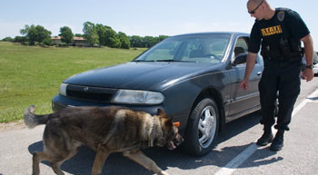
Attaching K-9 Searches

Slide 84
Goals
Challenging Assumptions about Narcotics-Detection K-9s for:
      Judges
      Prosecutors
      You
The law regarding Narcotics-Detection K-9s
How K-9’s detect Narcotics

Slide 85
Areas to Sniff out Success
Was there violation of the Fourth Amend.?
    (a lot of bark, no bite)
Was the “K-9 Alert” reliable to establish P. C.?
    (the Real Focus)
      Look at the actions of the Narcotics Detection Team.
      Look at the “Alert” itself.
      Look at the Reliability of the K-9.

Slide 86
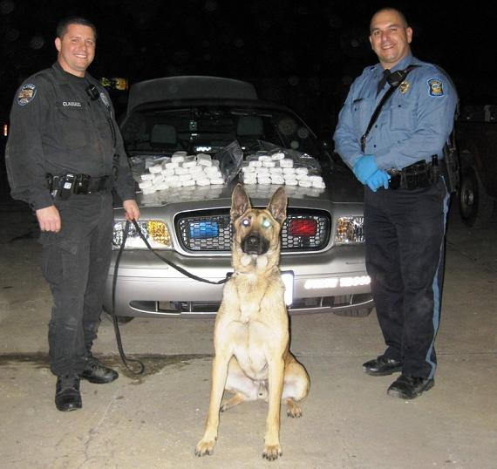
Narcotics Detection Team
The Team works as a “Unit.”
A trained Handler.
A trained K-9.
Reliable only when both are working together properly.

Slide 87
In General, a Sniff is not a Search
U.S. v. Place, 462 U.S. 696 (1983)
  Exposure of luggage to a trained narcotics-detection dog is not a search for 4th Amendment purposes.
Illinois v. Caballes, 543 U.S. 405 (2005)
  Where lawful traffic stop did not extend beyond time necessary to issue ticket and conduct inquires incident to the stop, other officer’s arrival and use of narcotics detection dog to sniff around the exterior of vehicle did not rise to level of infringement of 4th Amendment rights.

Slide 88
U.S. v. Place, 462 U.S. 696 (1983)
Passenger in Miami International Airport suspected of carrying Narcotics.
Passenger arrived at La Guardia and DEA seized his bags based on discrepancies on address tags and nervous behavior.
Took bags to Kennedy Airport and subjected to a drug-dog sniff.
Dog alerted.

Slide 89
U.S. v. Place, 462 U.S. 696 (1983)
Rational:
  The initial taking of the luggage was a reasonable temporary seizure under Terry
  “A K-9 sniff by a well-trained narcotics detection dog,… does not require opening the luggage.”
  “It does not expose non-contraband items that otherwise would remain hidden from public view, as does, for example, the officers rummaging through the contents of the luggage.”

Slide 90
U.S. v. Place, 462 U.S. 696 (1983)
Rational:
  The is “much less intrusive than a typical search.”
  A sniff does not subject the property owner to “embarrassment and inconvenience of a less discriminate and more intrusive investigation method.”

Slide 91
Illinois v. Caballes, 543 U.S. 405 (2005)
Motorist stopped with R.S. for a lawful traffic violation.
While a warning citation being written, second officer arrived with K-9 and sniffed exterior of vehicle.
Stop lasted no more than 10 minutes.
Dog Alerted.

Slide 92
Caballes Sniff
Trained narcotics detection K-9 Team
Lawful traffic stop
Traffic stop does not extended beyond time necessary
Sniff around the exterior of vehicle

Slide 93
United States v. Rodriguez
575 U.S. ____ (2015)
Officers may not extend the length of a traffic stop to conduct a dog sniff unrelated to the original purpose of the stop

Slide 94
Florida v. Jardines,
569 U.S. 1 (2013)
Police use of a trained narcotics detection dog to sniff on the front porch of a private home is a "search" within the meaning of the Fourth Amendment and therefore, without consent, requires both probable cause and a warrant.
Scalia used 18th Century trespass law
The violation is the trespass on the person’s property much

Slide 95
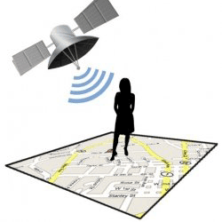
U.S. v. Jones,
132 S.Ct. 645 (2012)
Placing a GPS device on a vehicle and using it to track a vehicle’s movement constitutes a search for 4th Amendment purposes.
Agents obtained a warrant to placed a GPS device on Jones’ Jeep during a drug investigation. However, Agents placed the GPS on the vehicle beyond the timing that the warrant allowed.

Slide 96
U.S. v. Jones,
132 S.Ct. 645 (2012)
Decision based on 18th century law of Trespass
Although a unanimous decision, 5-4 split on whether it is a violation as a trespass on property or a violation of expectation of privacy
Access to factory installed or cell phone GPS was not addressed in Jones (Sotomayor concurring)
Alito addresses Reasonable Expectation of Privacy and GPS

Slide 97
Florida v. Harris,
568 US.___ (2013)
SCOUTS addressed the reliability of a dog sniff by a detection dog trained to identify narcotics, under the specific context of whether law enforcement’s assertions that the dog is trained or certified is sufficient to establish probable cause for a search of a vehicle under the Fourth Amendment. Harris was the first Supreme Court case to challenge the dog's reliability, backed by data that asserts that on average, up to 80% of a dog's alerts are wrong.

Slide 98
Florida v. Harris,
568 US.___ (2013)
The Court unanimously held that if a bona fide organization has certified a dog after testing his reliability in a controlled setting, or if the dog has recently and successfully completed a training program that evaluated his proficiency, a court can presume (subject to any conflicting evidence offered) that the dog's alert provides probable cause to search, using a "totality-of-the-circumstances" approach.

Slide 99
Florida v. Harris,
568 US.___ (2013)
Most important point,
You can look to the underlying reliability of the K9

Slide 100
Trained Narcotics Detection K-9 Team
The K-9 alert must be sufficiently reliable to provide probable cause to conduct the search.
Therefore, the Hander and the Dog must have received proper training and be current in that training.
Testimony and records must support proper training.

Slide 101
Trained Narcotics Detection K-9 Team
Remember FRE 702 Expert requirements.
The training that officers receive varies greatly from department to department.
The training records for the K-9 should be extensive and detailed.
The training records should include a log of every training session as well as every use of the dog in the field.
K-9s should receive a minimum of 4 hours training per week.

Slide 102
Trained Narcotics Detection K-9 Team
The dog must be trained, certified and reliable. The dog does not have to be 100% accurate or perfect. The courts have recognized the fact that “false responses”, “false positives” or “false alerts” occur and dogs can be as low as 54% accurate. United States v Cedano-Arellano, 332 F. 3d 568 (9th Cir 2003)

Slide 103
Trained Narcotics Detection K-9 Team
While the vast majority of cases in most jurisdictions simply require a showing that the dog was “trained,” the following issue can provide fertile ground for cross-examination of the officer regarding the sufficiency of training:
Type of training.
Duration of training.
Date of last training.
Ability of officer to explain training.
Relevancy of training to actual field use.

Slide 104
The Science of Sniff
(the place for great Cross-X)
Principles of Conditioning
There a number of steps that are required to take a dog from untrained to a Narcotics-Detection K-9.
Dogs must learn through a series of methodical steps.
Dogs are taught on each drug separately.
No short cuts in training.

Slide 105
Discovery of K-9 Training and Certification Materials
The following should be discovered:
1. Verification that the canine was trained to detect the odors for the particular drug.
2. Verification of the canine’s success rate.
3. The method used to train the canine to indicate an alert.
4. The type of alert used.
5. A statement showing that the canine positively alerted to the presence of narcotics in the proper fashion.
6. Proof of the canine’s certification.
7. Proof that the canine has continued to meet all certification requirements and received necessary training on a regular basis.
8. Verification that the handler has been trained to handle narcotics-detection canines.

Slide 106
Sniff Around the Exterior of Vehicle
The sniff must be limited to the exterior of vehicle.
Dog cannot be taken in to the vehicle without prior probable cause.
*What if the dog jumps in?
*What if the dog “breaks the plane” of the window?
*What if the officer opens the door for the dog?

Slide 107
Caballes Did Not Challenge the Alert
Remember that Caballes only dealt with:
Trained K-9 Team.
Lawful traffic stop.
Short duration of traffic stop.
Sniff of Exterior of vehicle.
THE ALERT ITSELF WAS NOT CHALLENGED

Slide 108
Caballes Did Not Challenge the Alert
The vast majority of K-9 Sniff case law deals with the factors surrounding and leading up to the search.
Most case law does not deal with the validity of the Alert itself.

Slide 109
Other K-9 Searches
Luggage
Automobiles
Hotels, Motels, etc.
Packages
School Lockers
Persons
International Borders

Slide 110
Automobiles
REMEMBER, at a Checkpoint, must still have:
Trained K-9 Team.
Reasonable duration of stop.
Sniff of Exterior of vehicle.

Slide 111
Hotels, Motels, etc.
The use of a narcotics-detection dog at the exterior of a motel-room door that opens onto a public sidewalk and parking lot is not a search within the meaning of the Fourth Amendment. United States v. Marlar, 828 F.Supp 415 (N.D. Miss. 1993), dismissed, 68 F.3d 464 (5th Cir. 1995).
Different than residences because exterior of motel is public.
The Alert can still be challenged.

Slide 112
Packages
A canine sniff outside a package on a common air-carrier is not a search within the meaning of the Fourth Amendment. United States v. Daniel, 982 F.2d 146 (5th Cir. 1993).
Similar to luggage.

Slide 113
School Lockers
A dog sniff of a student’s locker at a school is not a search within the meaning of the Fourth Amendment. United States v. Daniel, 982 F.2d 146 (5th Cir. 1993).
Similar to hotel door.

Slide 114
Persons
The non-contact dog sniff of a passenger, after the dog had alerted to the presence of narcotics in the passenger compartment of a bus, was not a search within the meaning of the Fourth Amendment. The dog was four to five feet away from the passenger when sniffed, and the handler did not intend to have the dog sniff the passenger as he exited the bus. United States v. Reyes, 349 F.3d 219 (5th Cir. 2003).

Slide 115
Persons
BUT:
An up close sniffing of a person at the border by a trained K-9 offends reasonable expectations of privacy and is thus a “search” under the 4th Amendment. U.S. v. Kelly, 302 F.3d 291 (5th Cir. 2002.)

Slide 116
Border Exception to 4th Amendment
Under the “border-search doctrine,” government agents may conduct routine searches at international borders or their functional equivalents without probable cause, a warrant, or any suspicion to justify a search. U.S. v. Rivas, 157 F.3d 364, at 367 (5th Cir. 1998).
But the stop and search must be ROUTINE!!!!
Otherwise, reasonable suspicion is required.

Slide 117
Border Exception to 4th Amendment
Routine stop and searches under Rivas, are ones that do not “seriously invade a traveler’s privacy.”
In Rivas, the court suppressed a sniff known as “casting”.
Casting is an improper alert in which the handler claims that a K-9 smelled contraband from a distance.
The agents “drilled” into a vehicle in Rivas which would not be considered “routine”.

Slide 118
Border Exception to 4th Amendment
Remember Kelly, an up close sniff of a person, even a the border is a search,
But, under the “border-search doctrine,” an up close sniff at the boarder is permitted without reasonable suspicion as long as it is routine .

Slide 119
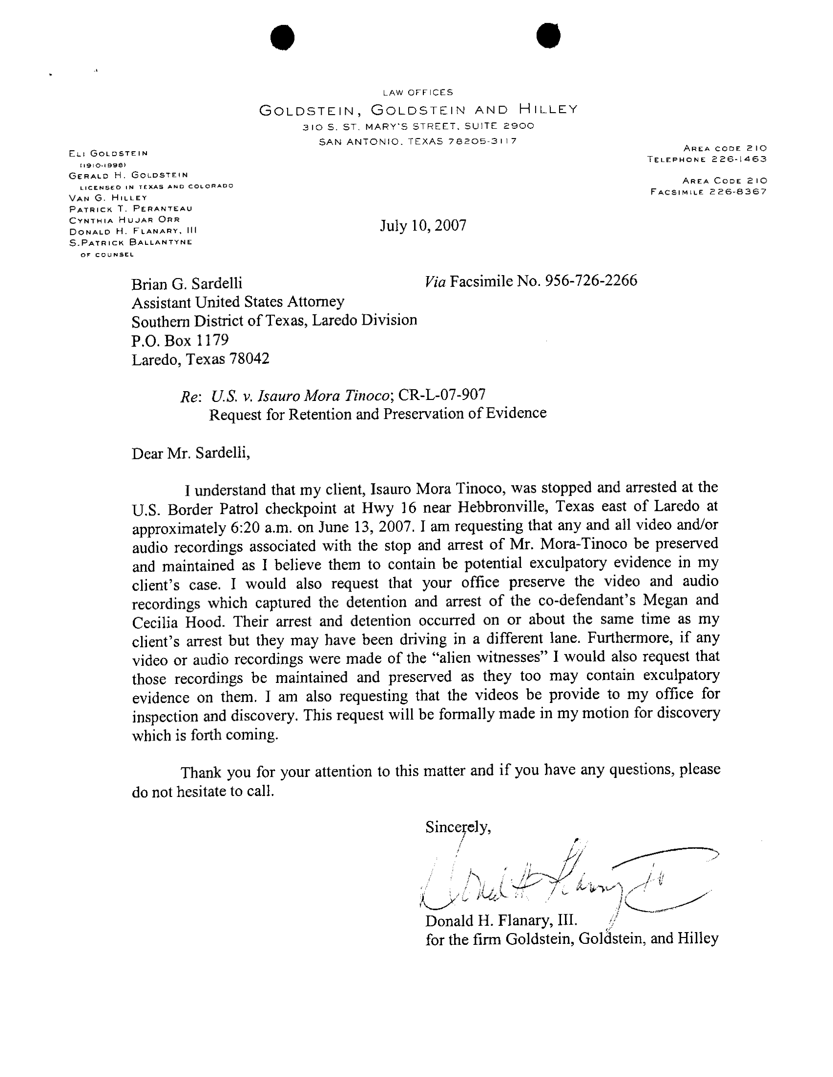

Slide 120
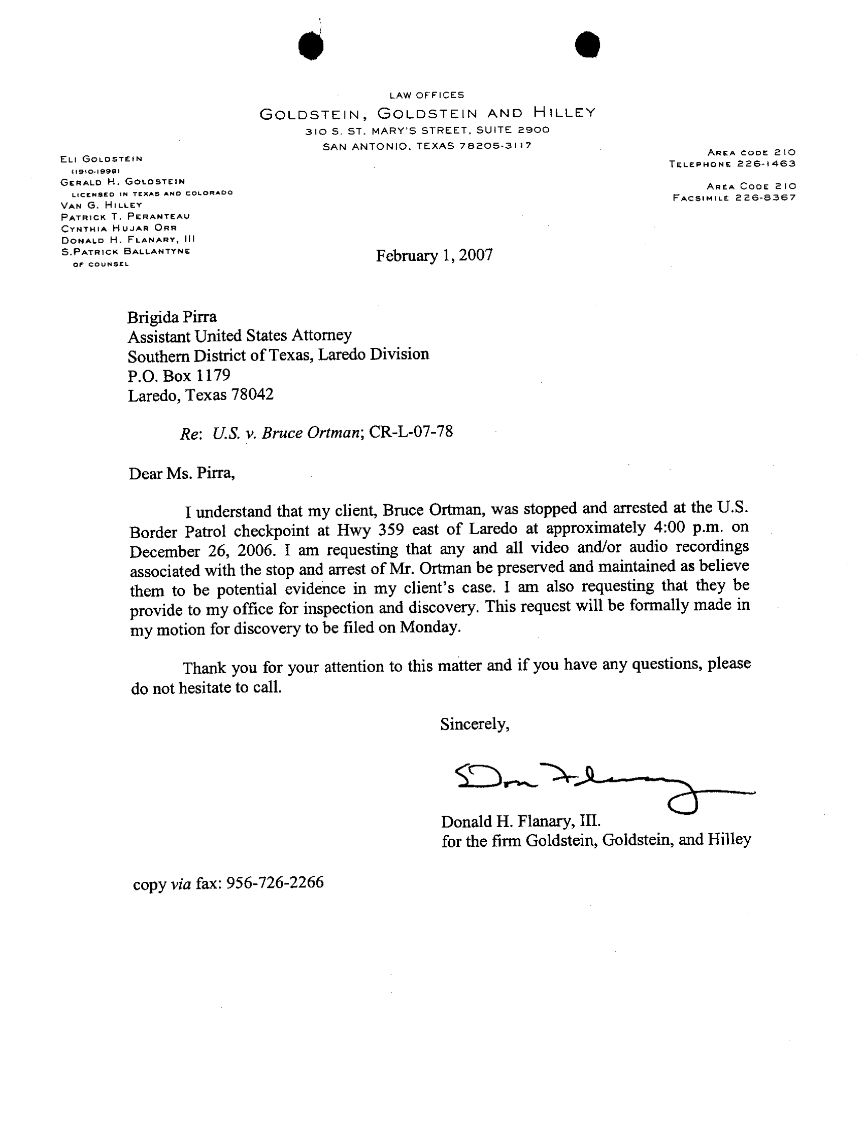

Slide 121
The Alert
The Alert is the Second half of the Inquiry!
Place and Cabellas do not deal with the Alert
Most fertile ground to attack the Probable Cause
But, biggest obstacle to overcome.

Slide 122
The Focus of the
Motion to Suppress
Was the “Alert” sufficiently reliable to establish probable cause for the Search?
  Look at the Alert itself
  Explore the reliability of the Team to do its job
    Was the Team properly trained?
    Does the Team execute its job according to that training?

Slide 123
Was it a legitimate “Alert”?
A trained or conditioned response by a K-9 to a stimulus.
Two types of alerts:
  Passive
    Sitting, stop and stare, lay down, a bark, something passive and non-aggressive.
  Aggressive
    Scratching, clawing, and/or biting

Slide 124
Reasons for different types
Alerts
Passive alerts are used for explosives, to prevent to personal property damage, and minimize liability.
Aggressive alerts is a more natural response for the dog and easier to train.
Neither are better than the other.

Slide 125
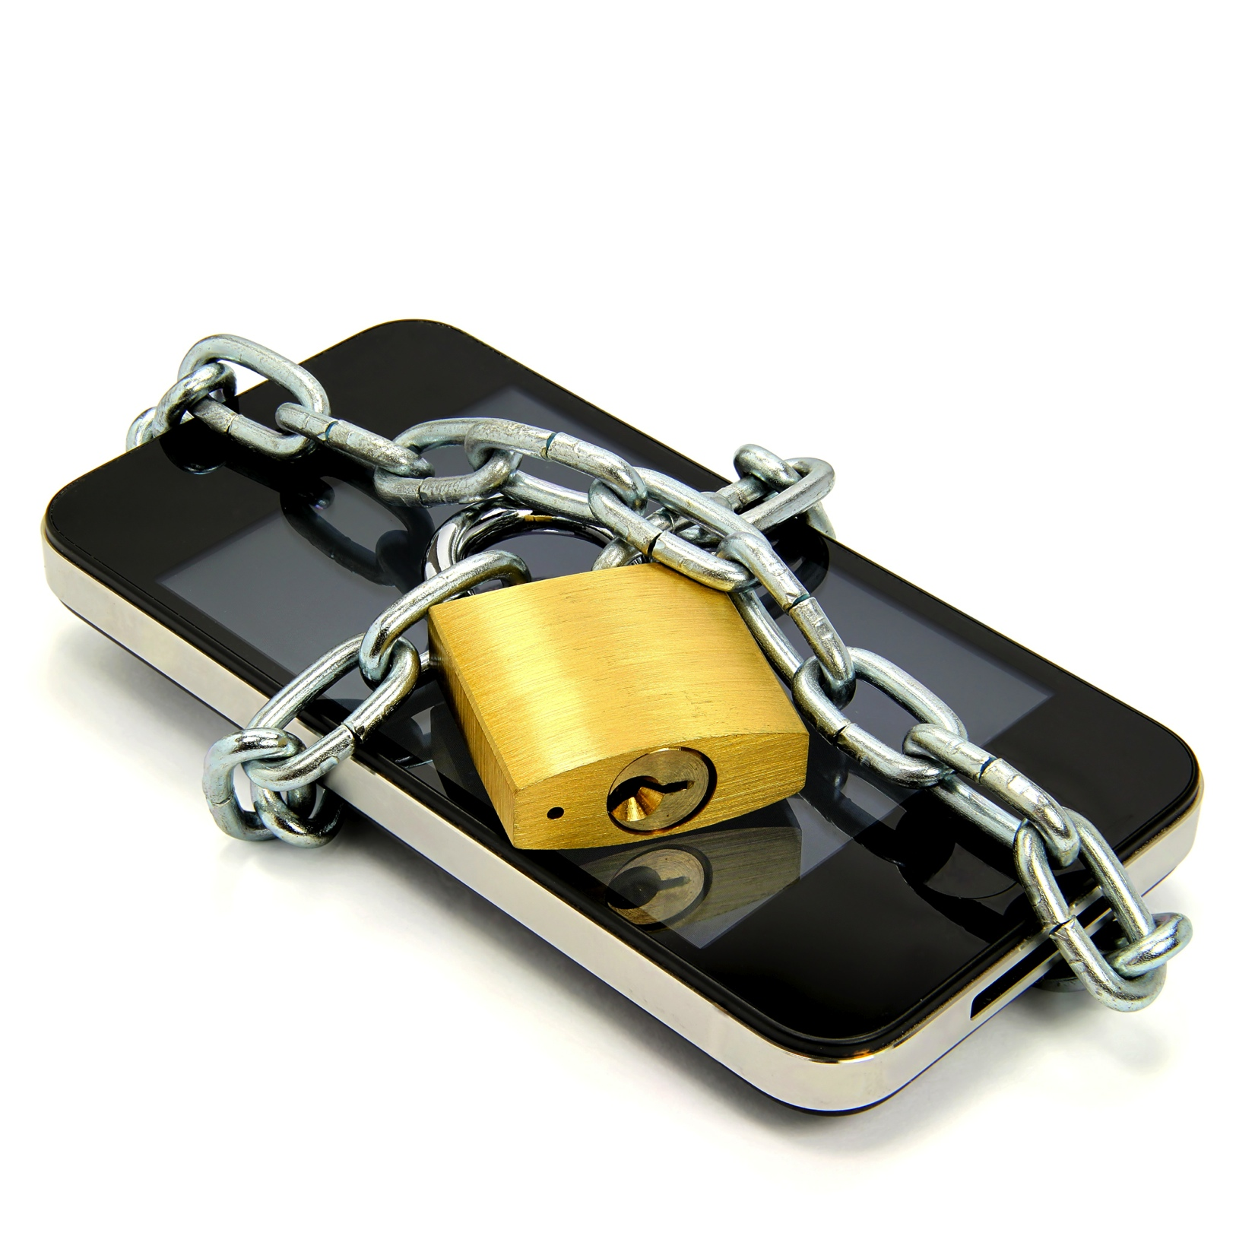
Attacking Cell Phone Searches

Slide 126
Warrantless Search of Cell Phones Incident to Arrest
Constitutional Debate:
  Cell phone is a “Container”
vs
  Cell phone is a “mini-computer”
  18th Century concepts for 21st Century Technology

Slide 127
Back to the Basics - Search Incident to Arrest
Katz v. U.S. (1967)
  Search must be reasonable, meaning: pursuant to a warrant or an established exception
    Search incident to arrest
    Exigent circumstances
    Written policy on inventory
    Vehicle exception

Slide 128
Search Incident to Arrest
Chimel v. California (1969)
Police searched Chimel’s entire home incident to his arrest
Warrantless search incident to arrest is limited to:
  (1) the arrestees person
  (2) area under immediate control of arrestee.
    Meaning “the area from within which he might gain possession of a weapon or destructible device”

Slide 129
Search Incident to Arrest
U.S. v. Robinson (1973)
Police searched pack of cigarettes found in breast pocket of arrestee’s jacket
  Two permitted searches of “areas”:
    Search “of the person”
    Search of “the area within control of arrestee”

Slide 130
Search Incident to Arrest
U.S. v. Edwards (1974)
Police examined clothing to see if paint from crime scene was present. Because it was late and he had no other clothes to wear they searched the next morning.
  Search of “both person and property in his immediate possession may be searched at the station house after arrest has occurred at another place”

Slide 131
Search Incident to Arrest
U.S. v. Chadwick (1977)
Agents searched a footlocker found in a trunk 90 minutes after arrest and at the station
  A closed container in immediate control of arrestee is different than the clothing of the arrestee
  If search of container is remote in time or place of arrest or exigency then there is no exception to the warrant requirement
  “Repository of personal effects”

Slide 132
Search Incident to Arrest
U.S. v. Chadwick (1977)
Since the locker was not part of Chadwick’s “person” when arrested,
Then a warrantless search is not reasonable if no danger arrestee could access property to get a weapon or destroy evidence.

Slide 133
Search Incident to Arrest
Clothing in Robinson and Edwards are considered to be part of “arrestee’s person”
Distinguishably different from the closed container in the “area within immediate control of arrestee” as in Chadwick

Slide 134
Search Incident to Arrest
New York v. Belton (1981)
  “Area within immediate control of arrestee” can be searched incident to arrest, including passenger compartments
  This includes “containers” in the passenger compartments within reach regardless of whether it could actually hold a weapon or evidence of crime under investigation
  “Container” is any object capable of holding another object

Slide 135
Search Incident to Arrest
Arizona v. Gant (2009)
Limited Belton
  Search of a car incident to arrest unauthorized “after the arrestee has been secured and cannot access the interior of the vehicle”

Slide 136
Cell Phone Search Incident to Arrest
The debate hinges on whether a cell phone is:
  a container immediately associated with the person
    Like a cigarette pack in Robinson or clothing in Edwards
  Or
  an item not associated with the person, but an item within a person’s immediate control
    Like a footlocker in Chadwick

Slide 137
United States v. Wurie
Riley v. California
134 S. Ct. 2473 (2014)
Supreme Court unanimously ruled that the search incident to arrest exception does NOT extend to a cell phone and that police need to get a search warrant in order to search an arrestee's phone after arrest

Slide 138
Riley and Wurie
In Wurie, the United States appealed the judgment of the First Circuit which suppressed evidence from the cell phone of the defendant
In Riley, the defendant appealed the judgment of the California Court of Appeals which affirmed his conviction.

Slide 139
Riley and Wurie
In both cases, the contents of the defendants' cell phones were searched after they were arrested and evidence obtained from the cell phones was used to charge the defendants with additional offenses.
While the officers could examine the phones' physical aspects to ensure that the phones would not be used as weapons, digital data stored on the phones could not itself be used as a weapon to harm the arresting officers or to effectuate the defendants' escape.

Slide 140
Riley and Wurie
Further, the potential for destruction of evidence by remote wiping or data encryption was not shown to be prevalent and could be countered by disabling the phones.
Moreover, the immense storage capacity of modern cell phones implicated privacy concerns with regard to the extent of information which could be accessed on the phones.

Slide 141
Cell Phone searches in Texas

Slide 142
State v. Granville,
423 S.W.3d 399 (Tex Crim App 2014)
Defendant arrested at a school for disorderly conduct.
Defendant’s cell phone was searched and then charged with “improper photography”
Cell phone was in the property room and accessed by police
Most logical and outspoken rejection of Finley

Slide 143
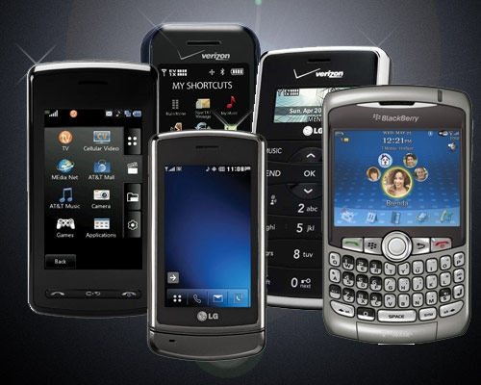

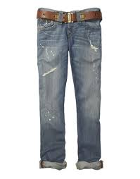
State v. Granville
“We reject [the State’s] argument that a modern-day cell phone is like a pair of pants or a bag of groceries, for which a person loses all privacy protection once it is checked into a jail property room.”

Slide 144
State v. Granville
“A cell phone is unlike other containers as it can receive, store, and transmit an almost unlimited amount of private information.”
“The potential for invasion of privacy, identify theft, or at a minimum, public embarrassment is enormous.”

Slide 145
State v. Granville
“Searching a person’s cell phone is like searching his home desk, computer, bank vault, and medicine cabinet all at once. There is no doubt that the Fourth Amendment protects the subjective and reasonable privacy interest of citizens in their homes and in their personal ‘papers and effects.’”

Slide 146
State v. Granville
Citizens do not lose their “expectation of privacy in the contents of [their] cell phone merely because [they have] been arrested and [their] cell phone is in the custody of police for safekeeping.”
The officer “could have seized appellant’s phone and held it while he sought a search warrant, but, even with probable cause, he could not ‘activate and search the contents of an inventoried cellular phone’ without one.”

Slide 147
Other Electronic Devices
Cell phones
Laptops
Tablets
USB drives
Digital Cameras
Smart Tv’s
Fitness Trackers

Slide 148
STATUTORY
Art. 18.0215. Access to Cellular Telephone or Other Wireless Communications Device
A peace officer may not search a person’s cellular telephone or other wireless communications device, pursuant to a lawful arrest of the person without obtaining a warrant under this article.
38.23?

Slide 149
Art 18.0215
Notwithstanding any other law, a peace officer may search a cellular telephone or other wireless communications device without a warrant if:
  the owner or possessor of the telephone or device consents to the search,
  the telephone or device is reported stolen by the owner or possessor; or
  the officer reasonably believes that:
    the telephone or device is in the possession of a fugitive from justice for whom an arrest warrant has been issued for committing a felony offense; or
    there exists an immediate life-threatening situation, as defined by Section 1, Article 18.20.

Slide 150
Thanks
JoAnne Musick
Sarah Wood

