Slide 2
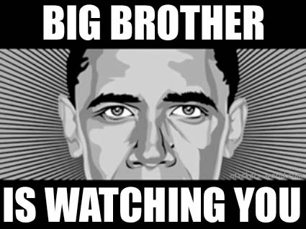


Slide 3
Cell Phone
Surveillance &
Searches
Sex, Drugs, and Surveillance
Texas Bar CLE
Presented by:
Donald H. Flanary, III
Goldstein Goldstein and Hilley

Slide 4
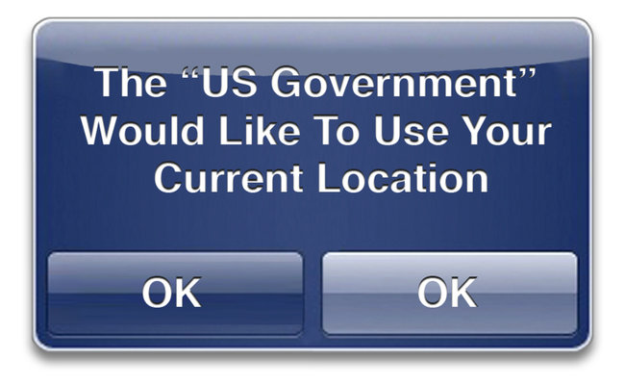

Slide 5


Slide 6


Slide 7
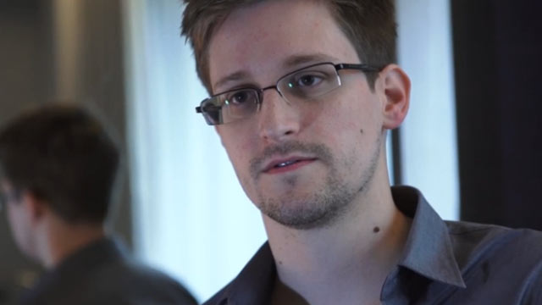
Edward Snowden: the whistleblower behind the NSA surveillance revelations
Guardian.co.uk – By: Glenn Greenwald, Ewan MacAskill, Laura Poltras – June 8, 2013
The individual responsible for one of the most significant leaks in US political history is Edward Snowden, a 29-year-old former technical assistant for the CIA and current employee of the defence contractor Booz Allen Hamilton. Snowden has been working at the National Security Agency for the last four years as an employee of various outside contractors, including Booz Allen and Dell.
He left the CIA in 2009 in order to take his first job working for a private contractor that assigned him to a functioning NSA facility, stationed on a military base in Japan. It was then, he said, that he "watched as Obama advanced the very policies that I thought would be reined in", and as a result, "I got hardened."
Over the next three years, he learned just how all-consuming the NSA's surveillance activities were, claiming "they are intent on making every conversation and every form of behaviour in the world known to them".

Slide 8
Revelations about NSA in December
“Snowden documents show NSA gathering 5 billion cell phone records daily”
“By cracking cellphone code, NSA has capacity for decoding private conversations”
“How the NSA is tracking people right now”

Slide 9
Revelations about NSA in December
“New documents show how the NSA infers relationships based on mobile location”
“NSA tracking cellphone locations worldwide, Snowden documents show”
“Cellphone data spying: It's not just the NSA”

Slide 10
JUST CELL PHONE ISSUES
Warrantless Search of Cell Phones Incident to Arrest
Basics of Cell Phones and Evidence Collection
The Electronic Tracking Post-Jones
Cell Phone Data and Records
Technologies Used by the Gov to Collect Information

Slide 11
Cell Phone Stats
83% of Americans have a cell phone
45% of cell phones are “Smartphones”

Slide 12
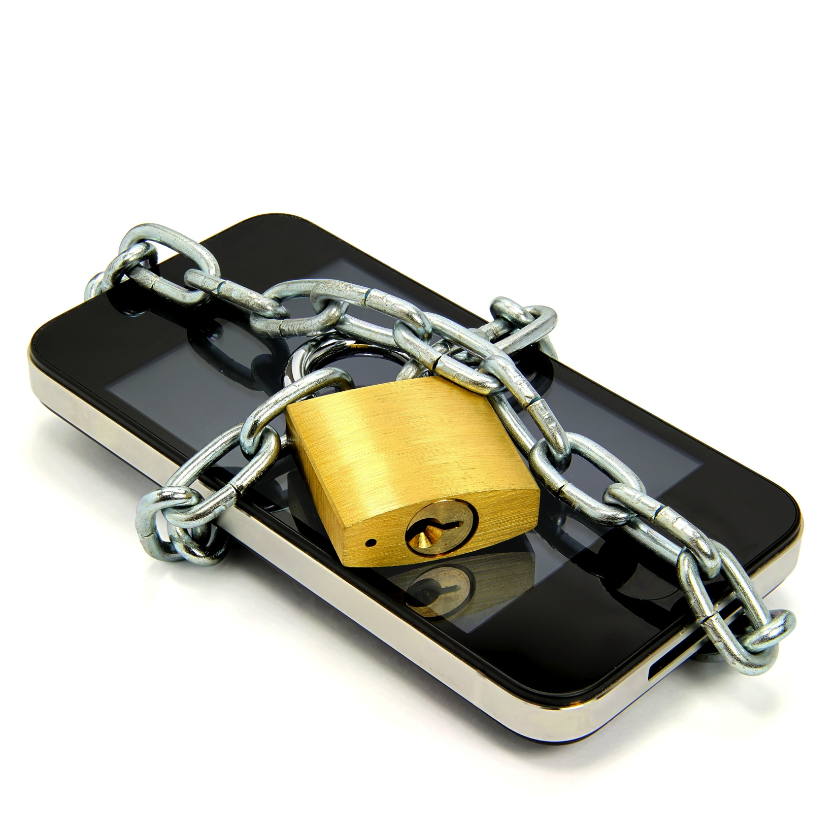
Only way to keep your cell phone safe:

Slide 13
Warrantless Search of Cell Phones Incident to Arrest
Constitutional Debate:
  Cell phone is a “Container”
vs
  Cell phone is a “mini-computer”

Slide 14
Back to the Basics of
Search Incident to Arrest
Weeks v. U.S. (1914)
  Police can search accused when arrested to discover evidence of a crime
Katz v. U.S. (1967)
  Search must be reasonable, meaning: pursuant to a warrant or an established exception

Slide 15
Search Incident to Arrest
Chimel v. California (1969)
Police searched Chimel’s entire home incident to his arrest
Warrantless search incident to arrest is limited to:
  (1) the arrestees person
  (2) area under immediate control of arrestee.
    Meaning “the area from within which he might gain possession of a weapon or destructible device”

Slide 16
Search Incident to Arrest
U.S. v. Robinson (1973)
Police searched pack of cigarettes found in breast pocket of arrestee’s jacket
  Two permitted searches of “areas”:
    Search “of the person”
    Search of “the area within control of arrestee”

Slide 17
Search Incident to Arrest
U.S. v. Edwards (1974)
Police examined clothing to see if paint from crime scene was present. Because it was late and he had no other clothes to wear they searched the next morning.
  Search of “both person and property in his immediate possession may be searched at the station house after arrest has occurred at another place”

Slide 18
Search Incident to Arrest
U.S. v. Chadwick (1977)
Agents searched a footlocker found in a trunk 90 minutes after arrest and at the station
  A closed container in immediate control of arrestee is different than the clothing of the arrestee
  If search of container is remote in time or place of arrest or exigency then there is no exception to the warrant requirement

Slide 19
Search Incident to Arrest
U.S. v. Chadwick (1977)
Since the locker was not part of Chadwick’s “person” when arrested,
Then a warrantless search is not reasonable if no danger arrestee could access property to get a weapon or destroy evidence.

Slide 20
Search Incident to Arrest
Clothing in Robinson and Edwards are considered to be part of “arrestee’s person”
Distinguishably different from the closed container in the “area within immediate control of arrestee” as in Chadwick

Slide 21
Search Incident to Arrest
New York v. Belton (1981)
  “Area within immediate control of arrestee”can be searched incident to arrest, including passenger compartments
  This includes “containers” in the passenger compartments within reach regardless of whether it could actually hold a weapon or evidence of crime under investigation
  “Container” is any object capable of holding another object

Slide 22
Search Incident to Arrest
Arizona v. Gant (2009)
Limited Belton
  Search of a car incident to arrest unauthorized “after the arrestee has been secured and cannot access the interior of the vehicle”

Slide 23
Cell Phone Search Incident to Arrest
The debate hinges on whether a cell phone is:
  a container immediately associated with the person
    Like a cigarette pack in Robinson or clothing in Edwards
  Or
  an item not associated with the person, but an item within a person’s immediate control
    Like a footlocker in Chadwick

Slide 24
Circuit Split on Searches of Cell Phones
4th 5th 7th and 10th Circuits, Alabama, California, Colorado, and Kansas
  Allow searches of cell phones incident with little limitation
1st Circuit, Ohio, and Florida
  Search incident to arrest exception does not extend to the contents of cell phones

Slide 25
SPLIT between Circuits
Incident-to-Arrest Exception Not Applicable United States v. Wurie, WL 2129119 (1st Cir. May 17, 2013) United States v. DiMarco, 2013 LEXIS 16279 (S.D.N.Y. 2013) State v. Smith, 920 N.E.2d 949 (Ohio 2009) Smallwood v. State, 2013 WL 1830961 (Fla. May 2, 2013) | Search Incident to Arrest Upheld United States v. Finley, 477 F.3d 250 (5th Cir. 2007) Silvan W. v. Briggs, 309 Fed. Appx. 216 (10th Cir. 2009) People v. Diaz, 244 P.3d 501 (Cal. 2011)

Slide 26
Case’s that DO allow Search of Cell Phone Incident to Arrest

Slide 27
Warrantless Search of Cell Phone Upheld
United States v. Finley, 477 F.3d 250 (5th Cir. 2007), search of cell phone was valid still incident to arrest.
Silvan W. v. Briggs, 309 Fed. Appx. 216 (10th Cir. 2009), scope of search incident to arrest includes contents of cell phone.
People v. Diaz, 244 P.3d 501 (Cal. 2011), no reasonable expectation of privacy in cell phone.

Slide 28
U.S. v. Finley,
447 F.3d 250 (5th Cir. 2007)
U.S. v. Finley, 447 F.3d 250 (5th Cir. 2007)
Police conducted warrantless search of Finley’s cell phone incident to arrest and used incriminating text messages to prove trafficking case.
Fifth Circuit refused to acknowledge the difference between modern technologies and containers used to hold physical objects

Slide 29
Finley Rational
5th Circuit relied upon U.S. v. Chan, 830 F.Supp 531 (N.D.Cal. 1993)
“Police officers are not constrained to search for weapons or instruments of escape on the arrestee’s person; they may also, without any additional justification, look for evidence of arrestee’s crime on his person in order to preserve it for use at trial.” Finley

Slide 30
U.S. v. Chan
Upheld warrantless search of a pager by stating that it is similar to an “electronic” container.

Slide 31
Case’s that DO NOT allow Search of Cell Phone Incident to Arrest

Slide 32
Suppression of Warrantless Search of Cell Phone
United States v. DiMarco, 2013 LEXIS 16279 (S.D.N.Y. 2013), suppressed photographs found on defendant’s cell phone.
State v. Smith, 920 N.E.2d 949 (Ohio 2009), “officer may not conduct a search of a cell phones’ contents incident to a lawful arrest without first obtaining a warrant.”

Slide 33
Smallwood v. State, 2013 WL 1830961 (Fla. May 2, 2013)
Police found evidence of a robbery when they searched a defendant’s cell phone that had been seized incident to arrest a year after the arrest as the State was preparing for trial.

Slide 34
Smallwood v. State, 2013 WL 1830961 (Fla. May 2, 2013)
A warrant is required before contents of a cell phone may be accessed and searched by police
Good-faith exception to exclusionary rule did not apply to warrantless search of cell phone.

Slide 35
United States v. Wurie,
WL 2129119 (1st Cir. May 17, 2013)
Wurie was arrested and the cell phone in his possession was examined to find evidence drug dealing which lead to a search warrant of his home.
Search-incident-to-arrest exception does not allow warrantless search of data on a cell-phone
“Today, many Americans store their most personal “papers” and “effects,” in electronic format on a cell phone, carried on the person.”

Slide 36
Wurie
“A cell phone should be viewed not as item immediately associated with the person under Robinson and Edwards but as a possession within an arrestee’s immediate control under Chadwick which cannot be searched once the cell phone comes into the exclusive control the police”

Slide 37
Wurie
“We suspect that the 85% of Americans who own cell phones and use the devices to do much more than make phone calls, would have some difficulty with the government’s view that ‘Wurie’s cell phone was indistinguishable from other kinds of personal possessions, like a cigarette package, wallet, pager, or address book, that fall within the search incident to arrest exception…”

Slide 38
Wurie
“In reality, ‘a modern cell phone is a computer’ and ‘a computer… is not just another purse or address book.”’
“Indeed, modern cell phones provide direct access to the home in a more literal way as well; iPhones can now connect their owners directly to a home computer’s webcam, via an application called iCam, so that users can monitor the inside of their homes remotely.”

Slide 39
Cell Phone searches in Texas

Slide 40
State v. Granville, 373 S.W.3d 218 (Tex. App.-Amarillo 2012)
Defendant’s cell phone was searched after arrest which contained “improper photography”
Amarillo Court of Appeals said:
  Cell phones contain “Private” Information
  Cell phones are Not “Containers”
  Cell phones are in arrestee’s “Immediate Control”

Slide 41
State v. Granville, 373 S.W.3d 218
(Tex. App.-Amarillo 2012)
Most logical and outspoken rejection of Finley
“we know of no authority that allows the State to search property merely because its officers have probable cause to believe that a crime occurred and evidence of that crime can be found on the property to be searched.” at 222.

Slide 42
State v. Granville, 373 S.W.3d 218
(Tex. App.-Amarillo 2012)
The court held that “the State's suggestion that the search of the phone was permissible since probable cause to believe a crime had occurred and that Granville's cell phone contained evidence of it, without more, is wrong.”

Slide 43
State v. Granville, 373 S.W.3d 218
(Tex. App.-Amarillo 2012)
“In effect, the State fights to enable any, if not every, law enforcement officer the ability to walk into a property room, pick up whatever… device he may discover… and use it as he cares to just because the device was within the property room.”

Slide 44
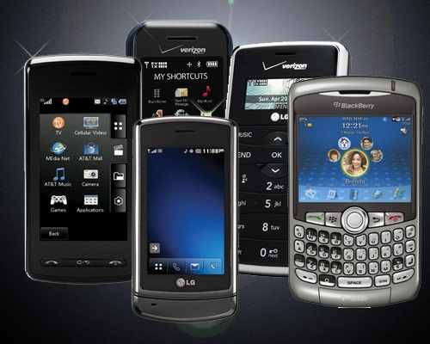
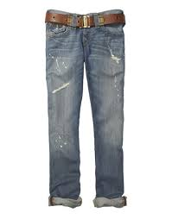

State v. Granville,
373 S.W.3d 218 (Tex. App.-Amarillo 2012)
“A cell phone is not a pair of pants. The order of suppression entered below is affirmed.”

Slide 45
TCCA to Rule on State v. Granville
PDR has been granted

Slide 46
Cell Phones Contain
“Private” Information

Slide 47
Schlossberg v. Solesbee,
844 F. Supp. 2d 1165 (D. Or. 2012)
Schlossberg filed a 1983 action against a police sergeant that arrested him for filming the officer and demanding Schlossberg to turn over his camera.

Slide 48
Schlossberg v. Solesbee,
844 F. Supp. 2d 1165 (D. Or. 2012)
Refused to accept Finley.
“Electronic devices such as plaintiff’s digital camera hold large amounts of private information, entitling them to a higher standard of privacy.”
“[W]arrantless searches of such devices are not reasonable incident to a valid arrest…”

Slide 49
Cell Phones Are Not “Containers”

Slide 50
State v. Smith,
920 N.E.2d 949 (Ohio 2009)
The Ohio Supreme Court refused to accept the premise that cell phones are like other containers that might hold objects inside them.
Even the most basic cell phones are capable of holding digital information unlike the physical objects found within a closed container.
Therefore, police must obtain a warrant before conducting a search of an individual's cellphone.

Slide 51
Arrestee’s Immediate Control

Slide 52
United States v. Park,
WL 1521573 (N.C. Cal. 2007)
Court did not expressly reject the idea that phones were “containers”
Did explain that cell phones are possessions within an arrestee’s immediate control and therefore protected per United States v. Chadwick, 433 U.S. 1 (1977).
Also focused on the amount of private information that can be stored on cell phones.

Slide 53
Attacking Cell Phone Searches
In Fed Court:
  Circuit split, Supreme Court likely to weigh in eventually
  Look at Wurie to preserve objections
In State Court:
  Wait for Granville to be decided

Slide 54
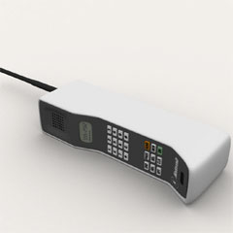
Basics of Cell Phones and Evidence Collection
The first handheld mobile phone was first invented in 1973

Slide 55
Nuts and Bolts of Cell Phones
30 minute battery life, charge time 10 hours
By 2014 there will be 7.4 billion cell phones world wide
326 million cell phones in the U.S.
300,000 Cell sites in the U.S.
In 2012 the average person sent/received 164.5 calls, 10 hours of voice, and 764 texts per month.

Slide 56
Nuts and Bolts of Cell Phones
“A modern cell phone is a computer” Judge Posner. U.S. v. Lopez, 670 F.3d 803 (7th Cir. 2012)
Modern Cell phones:
  send and receive text messages
  emails,
  photos and video
  access the Internet
  play games,
  Play and store music,
  Act as GPS device
  Run any of the 375,000 apps

Slide 57
Basic Cell Phone Location
Technology
Sophisticated radios
That connect to a cellular network
That accesses a public telephone network.

Slide 58
WHAT IS A CELL?
In typical analog cell phone system, each carrier receives 800 frequencies to use across city
carrier chops the city into the cells
Each cell is thought of as hexagons on a big hexagonal grids

Slide 59
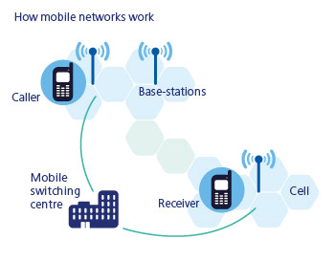
WHAT IS A CELL?

Slide 60
WHAT IS A CELL?
Typically sized at about 10 square miles(26 kilometers)
Each cell has base station consisting of tower and radio equipment
Different cells (non-adjacent )can use the same set of frequencies

Slide 61
The Core Idea: Cellular Concept
The core idea that led to today’s system was the cellular concept.
The cellular concept: multiple lower-power base stations that service mobile users within their coverage area and handoff users to neighboring base stations as users move. Together base stations tessellate the system coverage area.

Slide 62
Cellular Concept
Thus, instead of one base station covering an entire city, the city was broken up into cells, or smaller coverage areas.
Each of these smaller coverage areas had its own lower-power base station.
User phones in one cell communicate with the base station in that cell.

Slide 63
3 Core Principles
Small cells tessellate overall coverage area.
Users handoff as they move from one cell to another.
Frequency reuse.

Slide 64
Tessellation
Some group of small regions tessellate a large region if they over the large region without any gaps or overlaps.
There are only three regular polygons that tessellate any given region.

Slide 65
Tessellation (Cont’d)
Three regular polygons that always tessellate:
  Equilateral triangle
  Square
  Regular Hexagon
Triangles
Squares
Hexagons

Slide 66
Circular Coverage Areas
Original cellular system was developed assuming base station antennas are omnidirectional, i.e., they transmit in all directions equally.
Users located outside
some distance to the
base station receive
weak signals.
Result: base station has
circular coverage
area.
Weak signal
Strong signal

Slide 67
Circles Don’t Tessellate
Thus, ideally base stations have identical, circular coverage areas.
Problem: Circles do not tessellate.
The most circular of the regular polygons that tessellate is the hexagon.
Thus, early researchers started using hexagons to represent the coverage area of a base station, i.e., a cell.

Slide 68
Thus the Name Cellular
With hexagonal coverage area, a cellular network is drawn as:
Since the network resembles cells from a honeycomb, the name cellular was used to describe the resulting mobile telephone network.
Base
Station

Slide 69
Handoffs
A crucial component of the cellular concept is the notion of handoffs.
Mobile phone users are by definition mobile, i.e., they move around while using the phone.
Thus, the network should be able to give them continuous access as they move.
This is not a problem when users move within the same cell.
When they move from one cell to another, a handoff is needed.

Slide 70
A Handoff (Cont’d)
At some point, the user’s signal is weak enough at B₁ and strong enough at B₂ for a handoff to occur.
Specifically, messages are exchanged between the user, B₁, and B₂ so that communication to/from the user is transferred from B₁ to B₂.

Slide 71
Frequency Reuse
Extensive frequency reuse allows for many users to be supported at the same time.
Total spectrum allocated to the service provider is broken up into smaller bands.
A cell is assigned one of these bands. This means all communications (transmissions to and from users) in this cell occur over these frequencies only.

Slide 72
Example of Frequency Reuse
Cells using the same frequencies

Slide 73
Directional Antenna
One way to get more capacity (number of users) while maintaining cell size is to use directional antenna.
Assume antenna which radiates not in alldirections (360 degrees) but rather in 120 degrees only.

Slide 74
Directional Antenna at Base Station
With 120 degree antenna, we draw the cells as:

Slide 75
Directional Antenna (Cont’d)
Because these directional antenna only receive signals in particular direction, the amount of interference power they receive assuming a clustersize of 7 is reduced by 1/3.
With less interference power, the speech quality is much better than it needs to be.
So we can reduce the clustersize (increase interference power) and still have good speech quality.

Slide 76
Directional Antenna
Trials show that in systems with 120 degree antenna, the clustersize can be as small as 3.
This allows more users to be supported, while keeping cell size fixed.
Because of the benefits offered by 120 degree antenna, these are most readily used by base station towers.

Slide 77
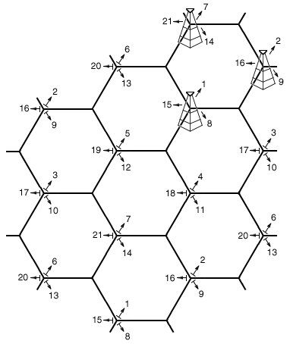
Cellular Network with Directional Antennas

Slide 78
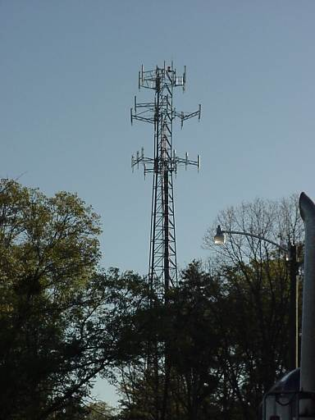
120 Degree Antenna Towers

Slide 79
PHONE CHANNELS
There are 395 voice channels available per carrier
No chance of collision
Remaining 42 are used as control channels 56 voice channels are available in a cell, which means in cell
56 people can talk at the same time
Mobile telephone switching office (MTSO)

Slide 80
CELL PHONE CODES
All cell phones have special codes associated with them
Service identification code (SID): 5 digit code assigned to each carrier
Electronic serial number (ESN): 32 bit code programmed into phone by manufacturer
Mobile identification number (MIN): 10 digit derived from phone’s number

Slide 81
PURPOSE OF CODES
Let say we switch on the phone, then what happens?
It listen for SID on control channel (special frequencies)
“no service” message displayed
Comparison of SID on control channel with the one programmed in phone.
MTSO keeps track of phone’s location in database

Slide 82
The Electronic Tracking Post-Jones
Cell phones are similar to GPS devices but,
Only GPS addressed in Jones

Slide 83
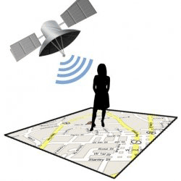
U.S. v. Jones,
132 S.Ct. 645 (2012)
Placing a GPS device on a vehicle and using it to track a vehicle’s movement constitutes a search for 4th Amendment purposes.
Agents obtained a warrant to placed a GPS device on Jones’ Jeep during a drug investigation. However, Agents placed the GPS on the vehicle beyond the timing that the warrant allowed.

Slide 84
U.S. v. Jones,
132 S.Ct. 645 (2012)
Decision based on 18th century law of Trespass
Although a unanimous decision, 5-4 split on whether it is a violation as a trespass on property or a violation of expectation of privacy
Access to factory installed or cell phone GPS was not addressed in Jones (Sotomayor concurring)
Alito addresses Reasonable Expectation of Privacy and GPS

Slide 85
Cell Phone Data and Records
Cell Phones as Tracking Devices
The Stored Communications Act
    NEXT BIG FIGHT:
      Cellular Site Location Information (CSLI)
    Millions of Subpoena Requests by Law Enforcement

Slide 86
Cell Phones as Tracking Devices
Triangulation
New phones are GPS devices

Slide 87
Triangulation
Since phones connect to multiple towers, signal strength is analyzed and the distance from each tower is estimated.
The more towers the phone is connected to, the better the estimation.
This method cannot exactly pinpoint where a phone is, but is accurate enough to narrow it down to an area the size of an average neighborhood.
REAL time or Historic

Slide 88
GPS
Wireless service providers are required by law to have the capability to estimate position within 328 feet.
These devices offer much higher levels of accuracy. In principle, they work on the premise of triangulation.
Devices receives signals from 12 or more satellites in low-Earth orbit. These phones have software that runs in the background, unknown to the user, that gives the provider accurate readings on the customer's whereabouts.
Only REAL time, not Historic (that we know of)

Slide 89
Four Categories of Electronic Surveillance
(1) wiretaps, which are authorized pursuant to 18 U.S.C. §§ 2510-2522, upon what could be called a “probable cause plus” showing;
(2) tracking devices, which are authorized pursuant to 18 U.S.C. § 3117, upon a Rule 41 probable cause showing;
(3) stored communications and subscriber records, which are authorized pursuant to the Stored Communication Act (SCA) upon a showing of specific and articulable facts showing that there are reasonable grounds to believe that the information sought is relevant and material to an ongoing criminal investigation; and
(4) pen registers and trap and trace devices authorized pursuant to the pen register statute (PRS), upon the government’s certification that the information sought is relevant and material to an ongoing criminal investigation

Slide 90


Slide 91
Different Standards for Different Data
Intercepted real time electronic communications (Title III Wiretap, “super-warrants”):
18 U.S.C. § 2510-2522 requiring probable cause to believe that a crime has been, is being, or is about to be committed; that communication is relevant to the crime; that normal investigation procedures have been tried, but failed; and the location of communication is connected to the crime.

Slide 92
Different Standards for Different Data
Tracking Device installed GPS devices and Beepers
Magistrate must issue the warrant if there is probable cause to search for and seize a person or property or to install and use a tracking device. Rule 41, Fed Rules Crim. Pro.

Slide 93
Different Standards for Different Data
Stored communications and subscriber or customer account records (Billing records and ID information):
Administrative Subpoena requiring an application to a Federal Court including specific and articulable facts showing reasonable grounds for relevancy and materiality to ongoing investigation. 18 USC 2703(d) “Stored Communications Act”

Slide 94
Administrative Subpoenas
Courts have held: no expectation of privacy in subscriber information and, therefore, a lesser showing is required of law enforcement to obtain the information United States v. Bynum, 604 F.3d 161, 164 (4th Cir. 2010), United States v. Perrine, 518 F.3d 1196, 1204, (10th Cir. 2008); Guest v. Leis, 255 F.3d 325, 335-336 (6th Cir. 2001), United States v. Kennedy, 81 F. Supp. 2d 1103, 1110 (D. Kan. 2000).

Slide 95
Administrative Subpoenas
With an administrative subpoena, therefore, only the recipient of the subpoena, meaning the third party company, has cause to challenge the subpoena.
Recently, Twitter challenged a government subpoena served to obtain the record information of people suspected to be members of WikiLeaks. In re Application of the United States of America for an Order Pursuant to 18 U.S.C. § 2703(d), No. GJ3793, 2011 WL 5508991 (E.D.Va. Nov. 10, 2011).

Slide 96
Different Standards for Different Data
Pen register and trap and trace device (incoming and outgoing numbers, data sent and received): Administrative Subpoena requiring an application to a Federal Court showing that the information to be obtained is likely to be “relevant to an ongoing criminal investigation” 18 USC 3122(b)(2)

Slide 97
NEXT BIG FIGHT
Cellular Site Location Information (CSLI)
  Gives real time or historical information of a cell phone’s location
Turning a phone into a GPS
Internet based privacy information
  Google Accounts, Facebook profiles, Carrier IQ data…
What about Jones?

Slide 98
Different Standards for Different Data
What about Cellular Site Location Information?
What about Internet based private information
What about Cell phone based private information
  Some courts say probable cause
  Some courts say less than probable cause
  Post Jones, it is questionable
  SCOTUS will likely resolve in the future

Slide 99








Third Party Records

Slide 100
Third Party Records
BIG QUESTIONS!
Content of stored communication rather than subscriber or billing records
i.e. – Your Emails and Texts
Not just the date and time of transmission.
U.S. v. Miller, 425 U.S. 436 (1976) says no expectation of privacy in Third Party Records
  i.e.: Bank Records, etc.

Slide 101
National Association of Criminal Defense Lawyers
“Electronic Surveillance & Government Access to Third Party Records”
Has Jones cast doubt on the general rule that anything you expose to the public is fair game for law enforcement?
The Electronic Communications Privacy Act, the Stored Communications Act, the USA Patriot Act, Wiretap Act, and the Foreign Intelligence Surveillance Act all govern the standards of third party records

Slide 102
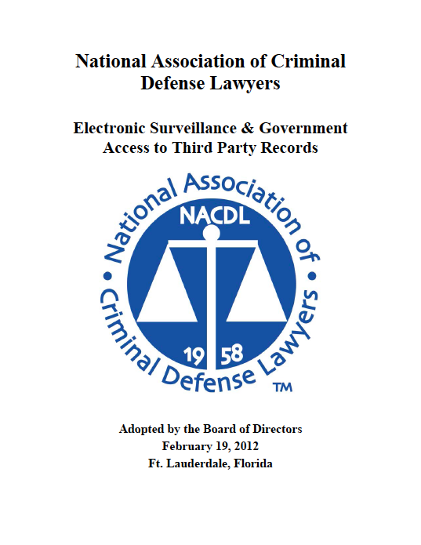

Slide 103
National Association of Criminal Defense Lawyers Recommendations
The NACDL is currently asking Congress to re-write the provisions of law governing third party records to a standard that requires Probable Cause for:
  Content including things that demonstrate the substance of electronic communications including clouds, transactional search query strings, URL’s, browser history and email subject lines
  Prospective or retrospective geo-location information through third party or GPS
  Opening Emails even on third party servers
Extending the exclusionary rule to these searches is also necessary

Slide 104
Millions of Subpoena Requests by Law Enforcement
State and Federal law enforcement are making millions of requests on cell phone providers for records

Slide 105
U.S. v. Pineda-Moreno
In a companion case to Jones
  9th Circuit Chief Judge Kozinski dissented to the denial of rehearain en banc: “1984 may have come a bit later than predicted, but it’s here at last.”
“If you have a cell phone in your pocket, then the government can watch you. At the government’s request, the phone company will send out a signal to any cell phone connected to its network, and give the police its location. Last year, law enforcement agents pinged users of just one service provider-Sprint-over eight million times. The volume requests grew so large that the 110-member electronic surveillance team couldn’t keep up, so Sprint automated the process by developing a web interface that gives agents direct access to users’ location data.”

Slide 106
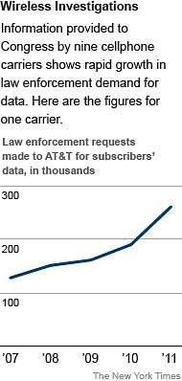
More Demands on Cell Carriers in Surveillance
NYTimes.com – Eric Lictblau – July 8, 2012
In the first public accounting of its kind, cellphone carriers reported that they responded to a startling 1.3 million demands for subscriber information last year from law enforcement agencies seeking text messages, caller locations and other information in the course of investigations.
CONGRESS GETS INVOLVED
The cellphone carriers’ reports, which come in response to a Congressional inquiry, document an explosion in cellphone surveillance in the last five years, with the companies turning over records thousands of times a day in response to police emergencies, court orders, law enforcement subpoenas and other requests.
ALL LEVELS OF LAW ENFORCEMENT
While the cell companies did not break down the types of law enforcement agencies collecting the data, they made clear that the widened cell surveillance cut across all levels of government — from run-of-the-mill street crimes handled by local police departments to financial crimes and intelligence investigations at the state and federal levels.

Slide 107
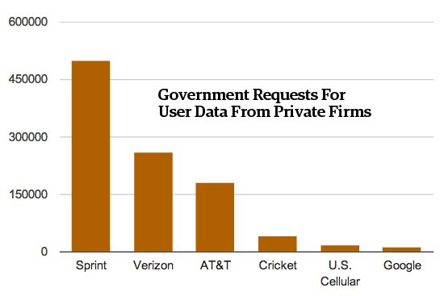
Here's How Often AT&T, Sprint, And Verizon Each Hand Over Users' Data To The Government
Forbes.com – By: Andy Greenburg – July 7, 2012
The vast majority of law enforcement’s demands that phone carriers and Internet services hand over users’ private data don’t require a warrant, and occur with little or no accountability. It’s not just that we don’t know how much surveillance takes place.
To paraphrase Donald Rumsfeld, we don’t even know what we don’t know about how much the government knows about us.
It’s important to remember that the information revealed Monday includes “tower dumps,” too, says Chris Calebrese, an attorney with the ACLU. “Just the sheer volume of orders is amazing, but a significant chunk are dumps from entire cell towers,” he says. “That means tons of people’s information is being grabbed with a single one of these orders.”

Slide 109
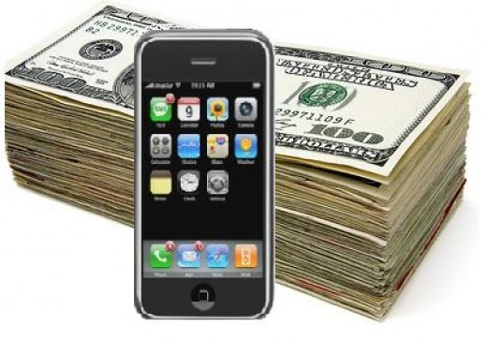
Prices AT&T, Verizon and Sprint Charge For Cellphone Wiretaps
Forbes.com – By: Andy Greenburg – April 3, 2012
Wiretaps
Voicemail & Text Messages
T-Mobile charges law enforcement a flat fee of $500 per target.
Sprint’s wireless carrier Sprint Nextel requires police pay $400 per “market area” and per “technology” as well as a $10 per day fee, capped at $2,000.
AT&T charges a $325 activation fee, plus $5 per day for data and $10 for audio.
Verizon charges a $50 administrative fee plus $700 per month, per target.
AT&T demands $150 for access to a target’s voicemail
Verizon charges $50 for access to text messages.
Sprint asks $120 for pictures or video, $60 for email, $60 for voice mail and $30 for text messages.

Slide 110
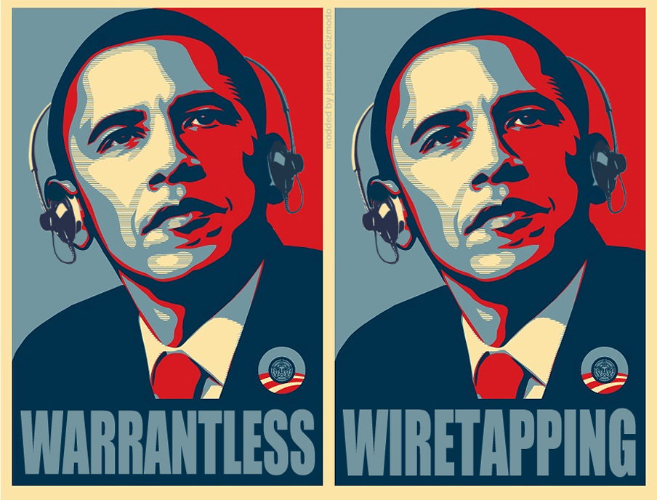
Cell Tower Dumps
AT&T charges $75 per tower per hour, with a minimum of two hours.
Verizon charges between $30 and $60 per hour for each cell tower.
T-Mobile demands $150 per cell tower per hour.
Sprint charges $50 per tower, seemingly without an hourly rate.
Real Time Location Data
Sprint charges $30 per month per target to use its L-Site program for location tracking.
AT&T’s E911 tool costs $100 to activate and then $25 a day.
T-Mobile charges a much pricier $100 per day.

Slide 114
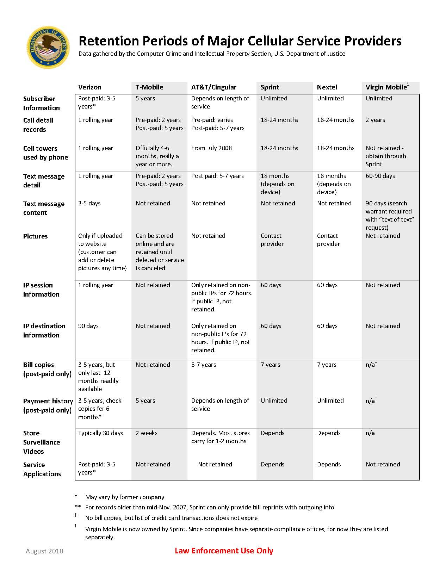

Slide 115
Technologies Used by the Gov to Collect Information
Cell Phone Software Extractors
Stingray and Kingfish Cell Phone Tracking Devices
Government Software/Internet Surveillance Programs

Slide 116
Cell Phone Software Extractors
“Extraction Devices” download personal information from cell phones,
  including contacts
  videos
  GPS data
  pictures
“The handheld machines have various interfaces to work with different models and can even bypass security passwords and access some information,”

Slide 117
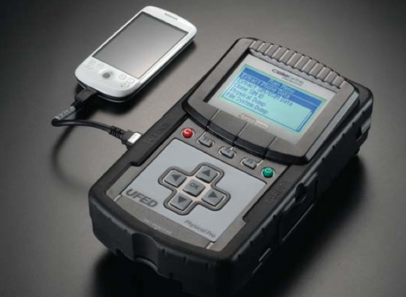
Mich. Cops Can Now Steal Your Cell Phone Data — ‘Without the Owner Knowing’
TheBlaze.com – Jonathon M. Seidl – April 20, 2011
It’s a scary scenario. You’re driving down the road and get pulled over by a state patrolman. After checking your license and registration, the officer asks for your cell phone, and then uses a futuristic machine to download all your data. In Michigan, it’s happening.
Michigan State Police are using “Extraction Devices” to download personal information from motorists’ cell phones, including contacts, videos, GPS data, and pictures, “even if they’re not suspected of any crime.”
“The handheld machines have various interfaces to work with different models and can even bypass security passwords and access some information,”
What is Extracted???
“Complete extraction of existing, hidden, and deleted phone data, including call history, text messages, contacts, images, and geo-tags,” a brochure from device manufacturer Cellebrite says about the tool’s capabilities.
“The Physical Analyzer allows visualization of both existing and deleted locations on Google Earth. In addition, location information from GPS devices and image geo-tags can be mapped on Google Maps.”

Slide 118
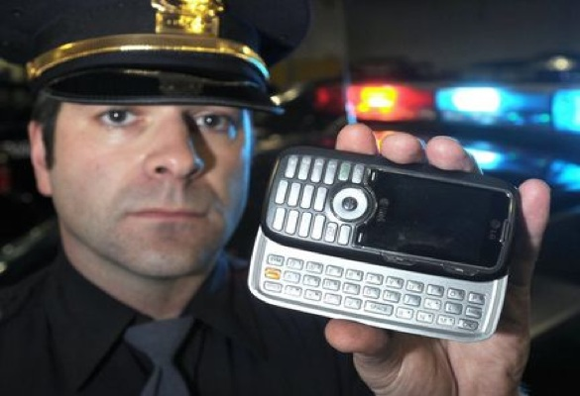
How Much Data Can Police Swipe From Suspects’ Phones Without a Warrant? (Hint: A lot)
ZD.net – By: Brian Whittaker – Feb 27, 2013
What can Law Enforcement Seize?
Call logs, text messages, geo-locations and even data relating to proprietary technologies, such as Apple's iMessage service: All of these can be downloaded by U.S. law enforcement when a suspect's phone is plugged in and the data harvested for intelligence purposes.
A court document submitted in connection with a drugs investigation shows that even Web history, data files, wireless networks and the user's custom dictionary are downloaded when advanced forensic tools are connected to a suspect's device.
Also collected were the device's geo-location points, including cell towers, allowing authorities to pinpoint roughly where the device—and therefore the suspect—may have been geographically.
No Warrants Needed!
Because many use their cell phones and smartphones to access email on the move, it could allow authorities access to a goldmine of data—whether it's used in the investigation or otherwise. This ultimately may allow authorities to bypass the need to submit subpoenas or search warrants -- under the Stored Communications Act -- to Apple, Google, Microsoft and others who provide email services, because the email data is already stored on the suspects' device.

Slide 119
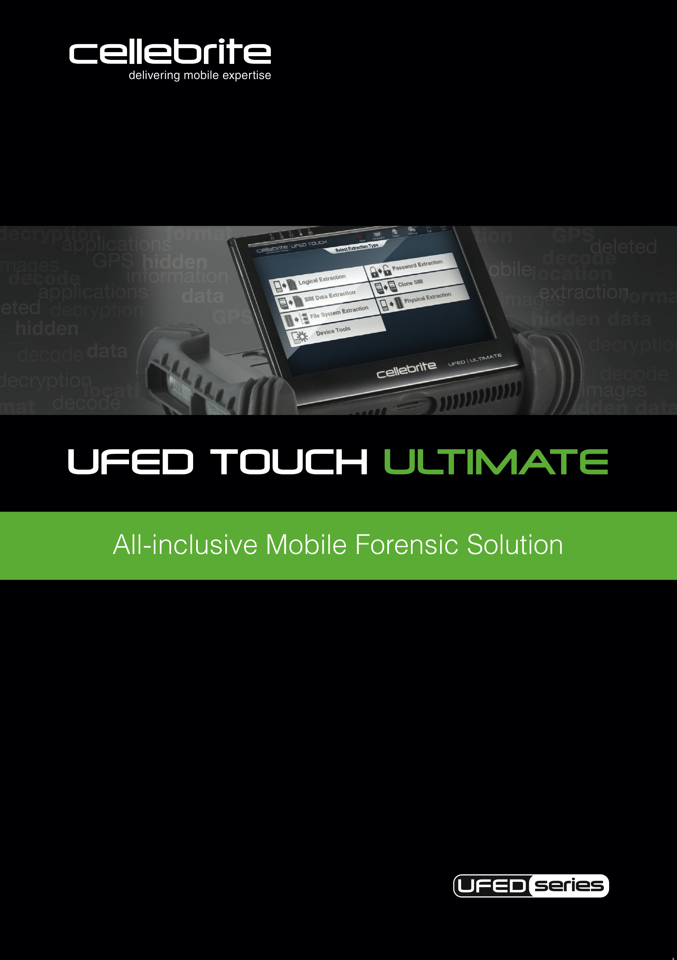
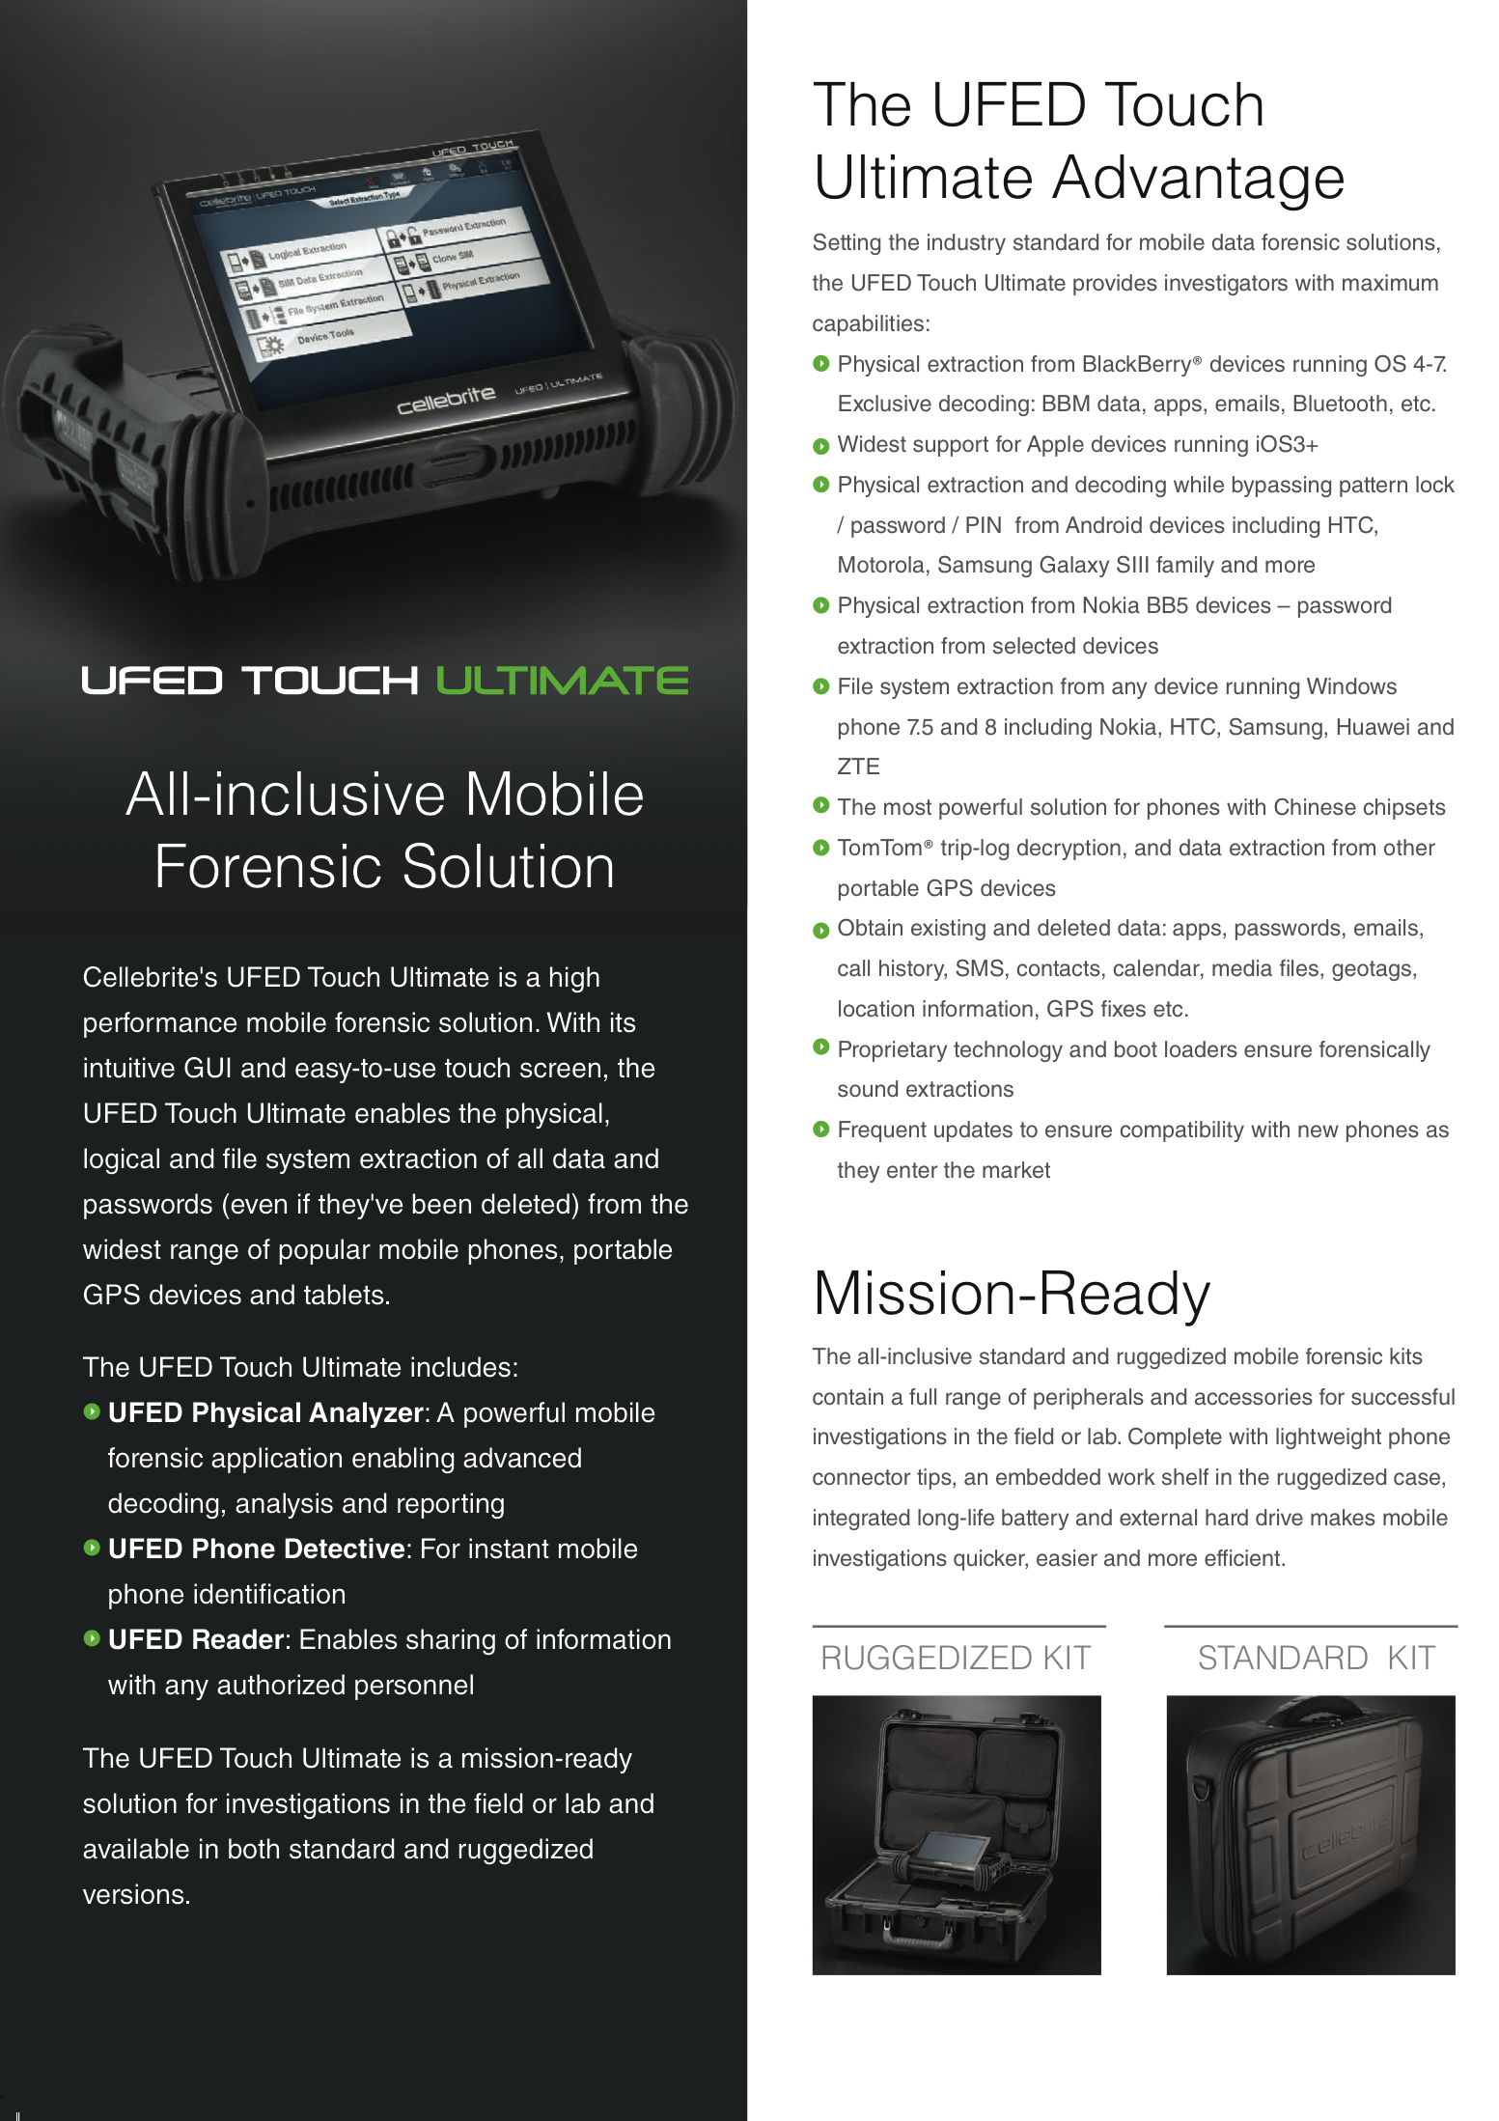

Slide 120
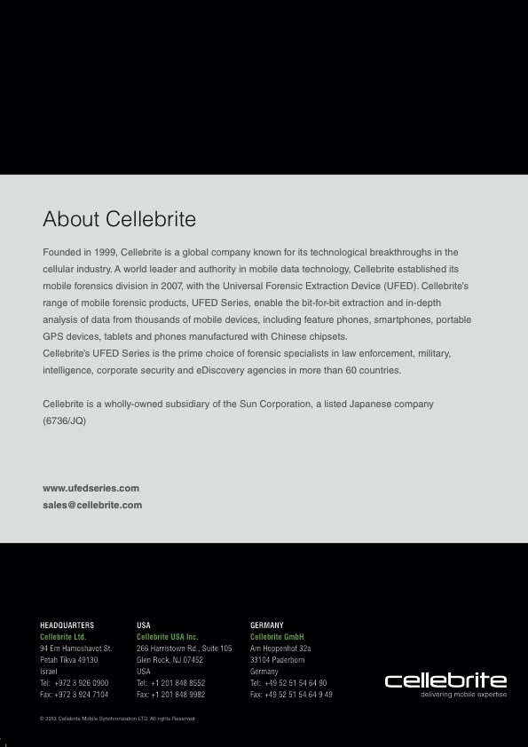
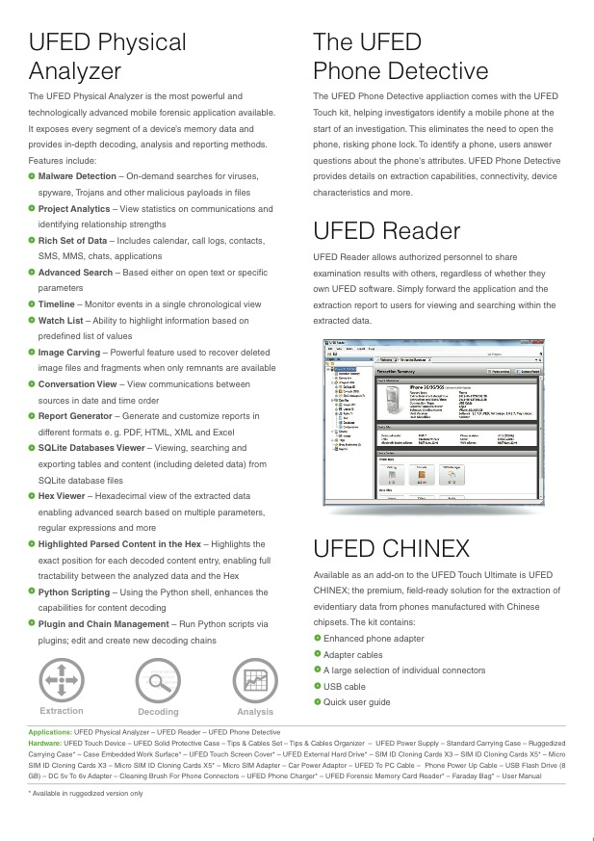

Slide 122
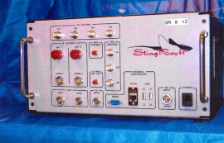
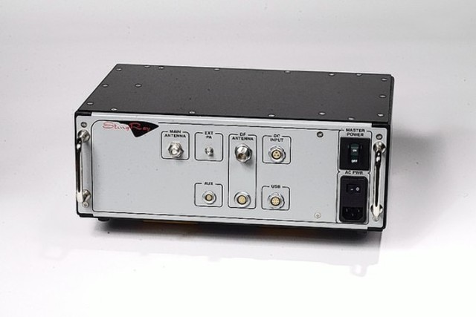
Stingray and Kingfish Cell Phone Tracking Devices

Slide 123
The “StingRay” Cell Phone Spying Device
Global Research – By: Clarence Walker – April 13, 2013
Federal Prosecutors try to “Fool” Judges
Originally intended for terrorism investigations, the feds and local law enforcement agencies are now using the James Bond-type surveillance to track cell phones in drug war cases across the nation without a warrant. Federal officials say that is fine — responding to a Freedom of Information Act (FOIA) request filed by the Electronic Freedom Foundation (EFF) and the First Amendment Coalition, the Justice Department argued that no warrant was needed to use StingRay technology.
“If a device is not capturing the contents of a particular dialogue call, the device does not require a warrant, but only a court order under the Pen Register Statute showing the material obtained is relevant to an ongoing investigation,” the department wrote.
The StingRay technology is so new and so powerful that it not only raises Fourth Amendment concerns, it also raises questions about whether police and federal agents are withholding information about it from judges to win approval to monitor suspects without meeting the probable cause standard required by the Fourth. At least one federal judge thinks they are. Magistrate Judge Brian Owsley of the Southern District of Texas in Corpus Christi told the Yale conference federal prosecutors are using clever techniques to fool judges into allowing use of StingRay. They will draft surveillance requests to appear as Pen Register applications, which don’t need to meet the probable cause standards.
“After receiving a second StingRay request,” Owsley told the panel, “I emailed every magistrate judge in the country telling them about the device. And hardly anyone understood them.”

Slide 124
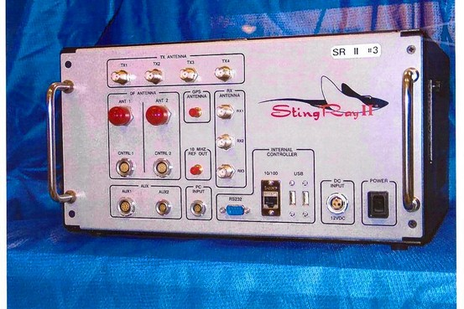
KingFish-ing for Info
Fwweekly.com – By: Zach Shlachter – May 30, 2012
Police Use Cell Tracking to Establish Probable Cause!
In a memo to the council, police officials promised to use the new system, called KingFish, “to establish probable cause” in criminal cases. Thing is, probable cause — that is, enough evidence to establish that there is probable cause to believe a crime has occurred — is what a law enforcement agency usually needs first, to convince a judge to approve invasive measures such as home searches, arrests, wiretaps or, in some contexts, use of tracking technology against an individual.
Police did not return Fort Worth Weekly’s calls seeking information for this story.
How Police avoid the 4th Amendment
The KingFish devices — of a type generally known as “stingrays” — work differently than usual GPS monitors. Made by the Harris Corporation of Florida, the devices act like dummy cell phone towers, so that a cell phone signal will ping off the device and make it unnecessary for police to get a court order to have the cell phone company release the information.
Under a 1986 federal law that controls some government information-gathering practices, “non-content” information like location requires less of a legal showing than, say, a wiretap.
So it’s possible that Fort Worth police could legally use the their new stingray devices without getting warrants.

Slide 125
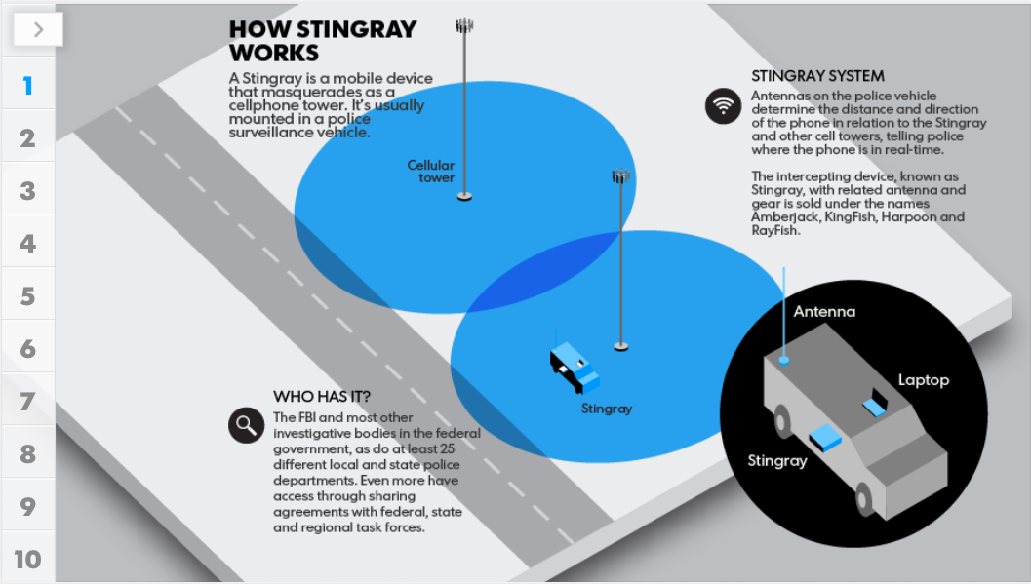

Slide 126
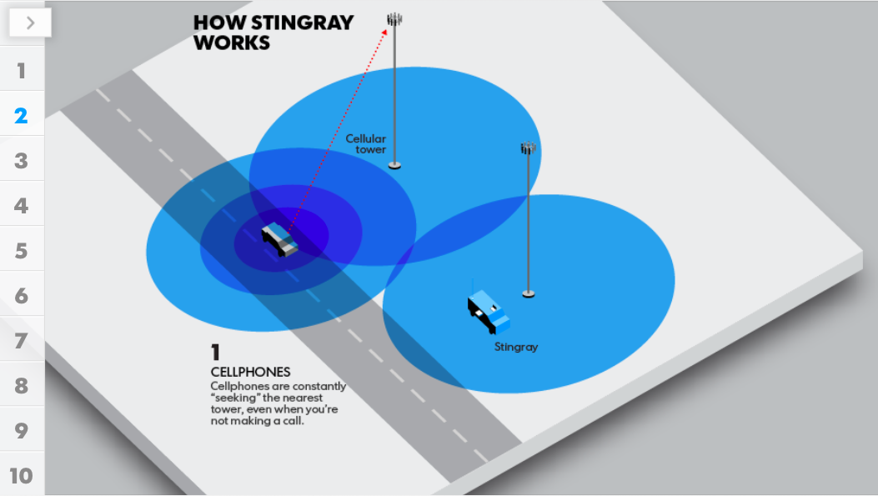

Slide 127
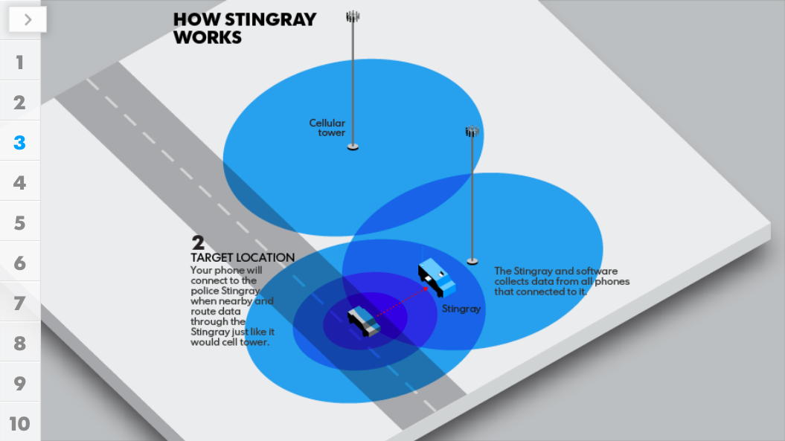

Slide 128
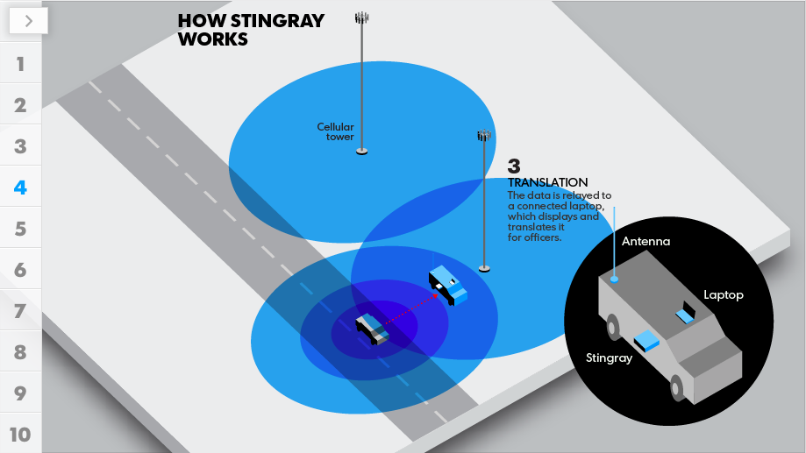

Slide 129
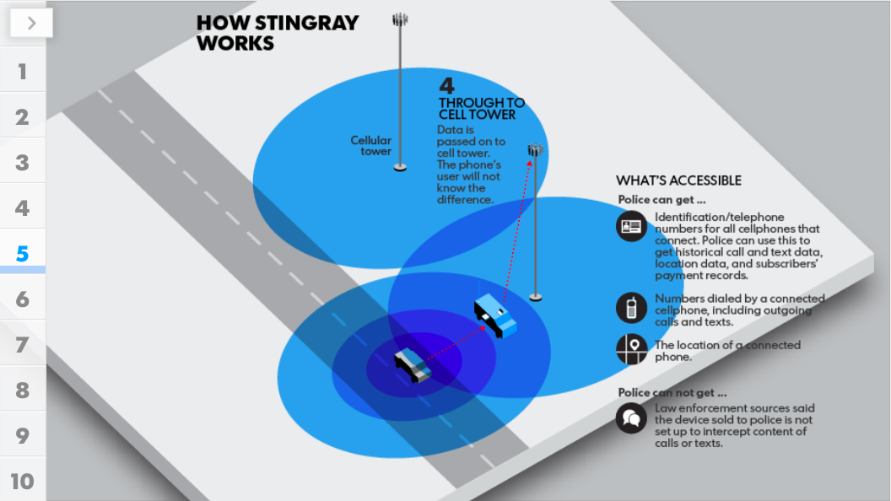

Slide 130
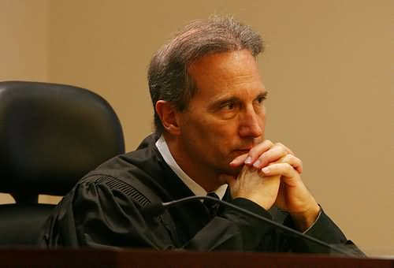
Judges Questioned Use of Cellphone Tracking Devices
WSJ.com – By: Jennifer Valentino-DeVries – March 27, 2013
Feds Aren’t Giving Judges the Whole Story
Stingray Use is Hidden Within Pen Register Applications
Judges in California, like a few others across the country, have raised concerns about federal use of cellphone tracking devices known as “stingrays,” suggesting that investigators have been using the technology without explaining to judges exactly what they are doing.
A handful of federal judges have now expressed concerns about similar cellphone tracking technologies, particularly because federal officers have been using them after getting lower court orders that don’t meet the same standard as search warrants.
In California, emails written by several U.S. attorneys in 2011 indicate that this has become what they describe as a “problem” in that state as well. One of the emails explains that magistrate judges there have “collective concerns” about whether the court orders, known as pen register orders, are “sufficient to authorize the use” of the technology.
“It has recently come to my attention that many agents are still using [stingray] technology in the field although the pen register application does not make that explicit,” one of the attorneys wrote, adding that the office was working on a “long term fix.”
Pen registers are tools that gather signals from phones such as numbers dialed but don’t receive the content of conversations. To use them, investigators don’t have to show probable cause, the way they would with a search warrant. But pen registers were designed before the widespread use of cellphones, which can transmit more data than landline phones and can be used to pinpoint a person’s location. The template that investigators use when writing pen register requests doesn’t necessarily indicate when the device being used is actually a stingray, the California emails suggest.

Slide 131
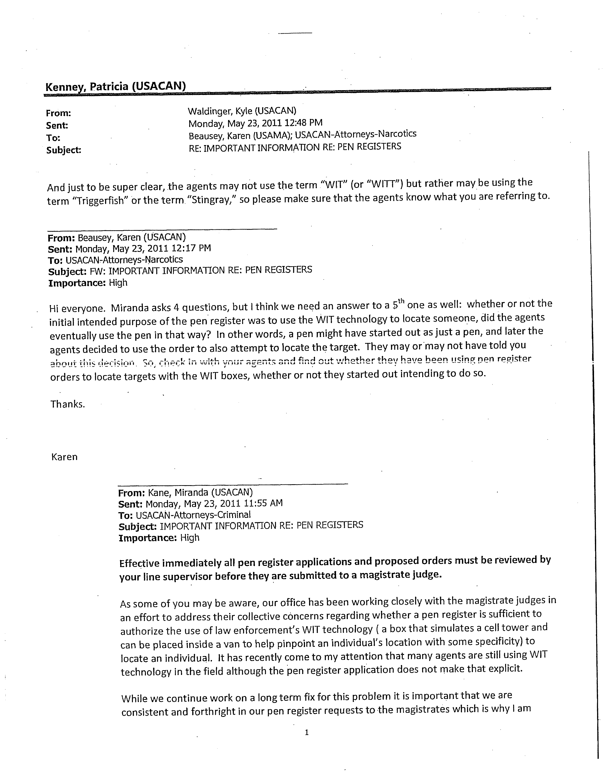

Slide 132
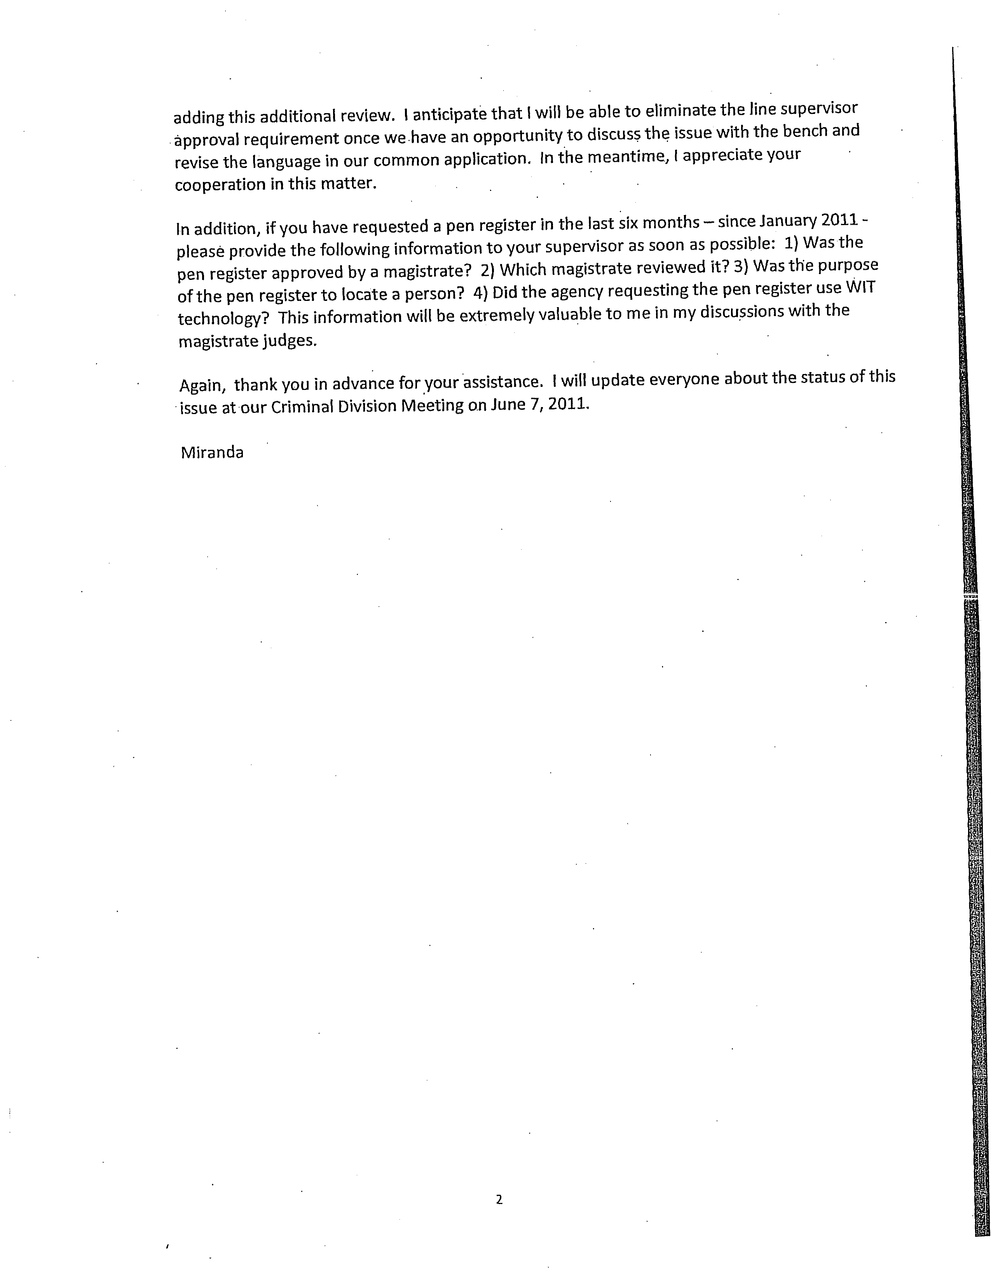

Slide 133
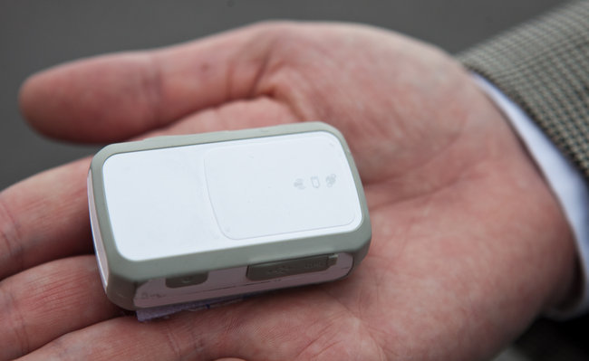
Police Are Using Phone Tracking as a Routine Tool
NYTimes.com – By: Eric Lichtblau – March 31, 2012
Strategies used by Law Enforcement
In cities in Nevada, North Carolina and other states, police departments have gotten wireless carriers to track cell-phone signals back to cell towers as part of nonemergency investigations to identify all the callers using a particular tower.
In California, state prosecutors advised local police departments on ways to get carriers to “clone” a phone and download text messages while it is turned off
GPS TRACKER
How Law Enforcement Avoids Legal Battles
“Do not mention to the public or the media the use of cell-phone technology or equipment used to locate the targeted subject,” the Iowa City Police Department warned officers in one training manual. It should also be kept out of police reports, it advised.
In Ogden, Utah, when the Sheriff’s Department wants information on a cell-phone, it leaves it up to the carrier to determine what the sheriff must provide. “Some companies ask that when we have time to do so, we obtain court approval for the tracking request,”
A Nevada police training manual warns their officers to only use cell-tracking without a warrant in Life Threatening Emergency Situations only, and states that officers have been known to “misuse” the technology during standard investigations to collect information the police officers had absolutely no authority to collect.

Slide 134
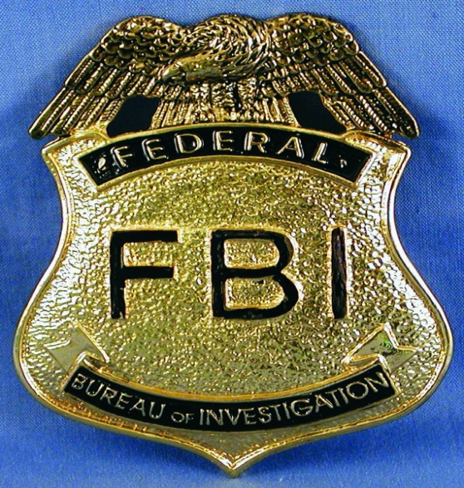
Are All Telephone Calls Recorded and Accessible to the US Government?
Guardian.co.uk – Glenn Greenwald – May 4, 2013
Over the past couple days, cable news tabloid shows such as CNN's Out Front with Erin Burnett have been excitingly focused on the possible involvement in the Boston Marathon attack of Katherine Russell, the 24-year-old American widow of the deceased suspect, Tamerlan Tsarnaev.
As part of their relentless stream of leaks uncritically disseminated by our Adversarial Press Corps, anonymous government officials are claiming that they are now focused on telephone calls between Russell and Tsarnaev that took place both before and after the attack to determine if she had prior knowledge of the plot or participated in any way.
On Wednesday night, Burnett interviewed Tim Clemente, a former FBI counterterrorism agent, about whether the FBI would be able to discover the contents of past telephone conversations between the two. He quite clearly insisted that they could
Interview with Erin Burnett and Tim Clemente
BURNETT: Tim, is there any way, obviously, there is a voice mail they can try to get the phone companies to give that up at this point. It's not a voice mail. It's just a conversation. There's no way they actually can find out what happened, right, unless she tells them?
CLEMENTE: "No, there is a way. We certainly have ways in national security investigations to find out exactly what was said in that conversation. It's not necessarily something that the FBI is going to want to present in court, but it may help lead the investigation and/or lead to questioning of her. We certainly can find that out.
BURNETT: "So they can actually get that? People are saying, look, that is incredible.
CLEMENTE: "No, welcome to America. All of that stuff is being captured as we speak whether we know it or like it or not."

Slide 135
Carrier IQ
Carrier IQ is a program for mobile devices that records every keystroke and every piece of data that comes in or out of your device.
The data is sent back to Carrier IQ’s servers.
The program cannot be turned off and is very hard to track.
It is believed to be used on HTC, Android and Blackberry phones. There is some evidence that it exists on Apple products as well.
AT&T confirms that it uses the software while Verizon and Nokia deny that it exists on there phones.

Slide 136
Carrier IQ
The rational is that the information collected will help the device manufacturers and software developers create better products and services for the consumer.
Problem: Can the government access this information?
We could see class-action litigation over these issues.
Source: http://www.washingtonpost.com/business/technology/what-is-carrier-iq/2011/12/01/gIQApql1GO_story.html

Slide 158
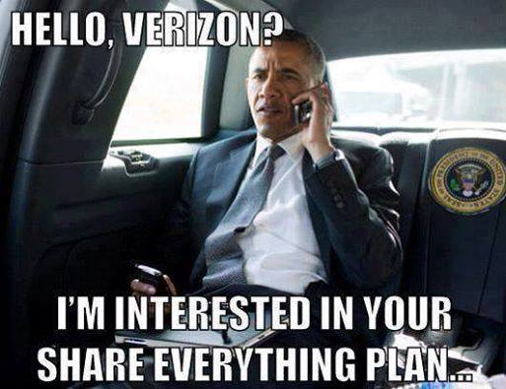

Slide 160
The End

Slide 165
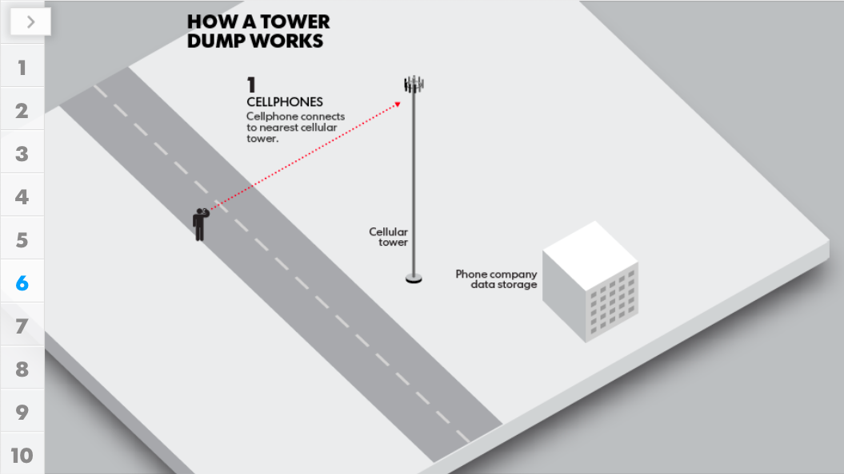

Slide 166
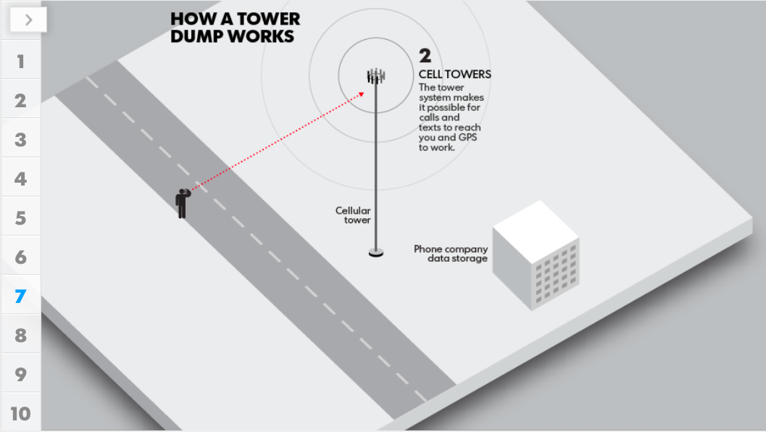

Slide 167
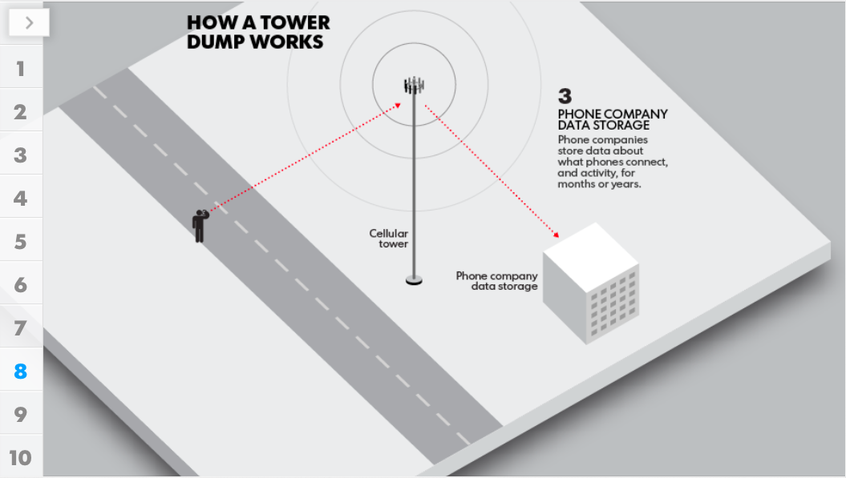

Slide 168
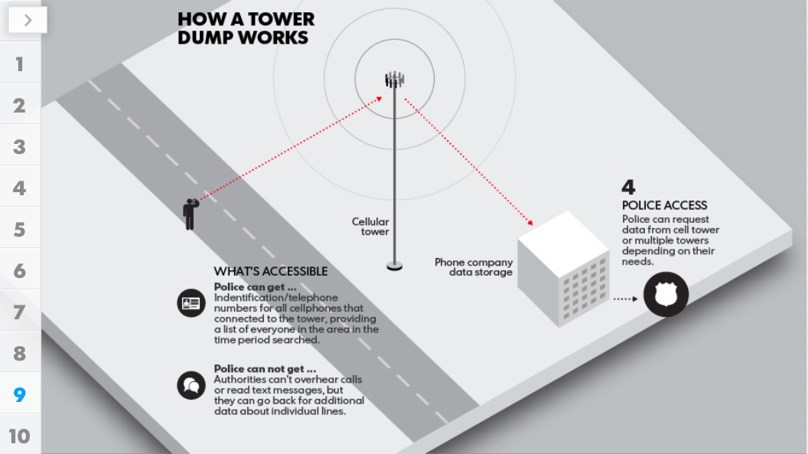

Slide 169
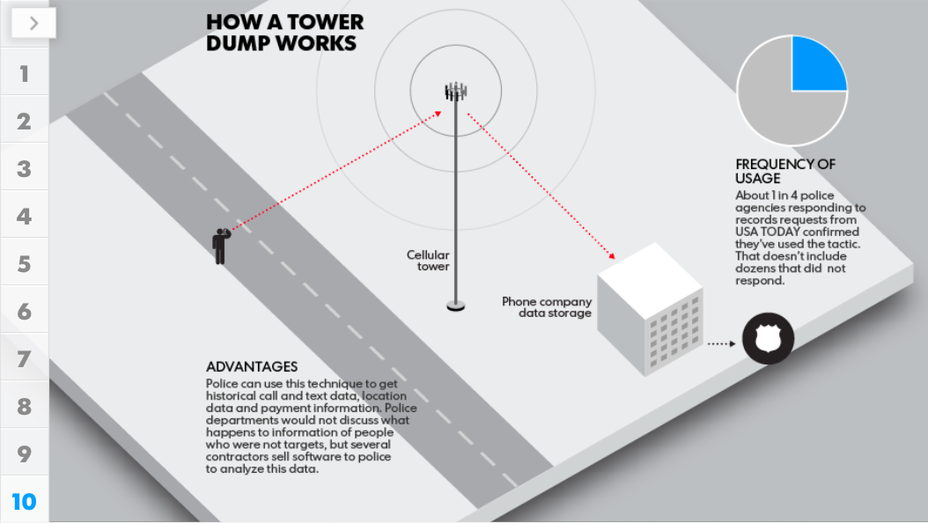

Slide 170
Government Software
Surveillance Programs
PRIZM
Carnivore
Echelon

Slide 171
Edward Snowden: the whistleblower behind the NSA surveillance revelations
Guardian.co.uk – By: Glenn Greenwald, Ewan MacAskill, Laura Poltras – June 8, 2013
The individual responsible for one of the most significant leaks in US political history is Edward Snowden, a 29-year-old former technical assistant for the CIA and current employee of the defence contractor Booz Allen Hamilton. Snowden has been working at the National Security Agency for the last four years as an employee of various outside contractors, including Booz Allen and Dell.
He left the CIA in 2009 in order to take his first job working for a private contractor that assigned him to a functioning NSA facility, stationed on a military base in Japan. It was then, he said, that he "watched as Obama advanced the very policies that I thought would be reined in", and as a result, "I got hardened."
Over the next three years, he learned just how all-consuming the NSA's surveillance activities were, claiming "they are intent on making every conversation and every form of behaviour in the world known to them".

Slide 172
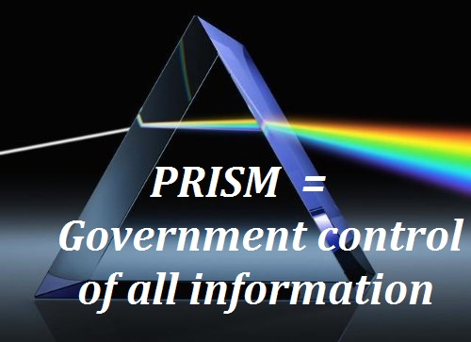
What’s in the Rest of the Top-Secret NSA PowerPoint Deck?
Wired.com – By: Kevin Poulsen – June 10, 2013
Now that Snowden has revealed himself to the world as the NSA whistleblower, details about his interaction with the press are surfacing. And at the center of the drama is a still mostly unpublished 41-slide presentation, classified top secret, that Snowden gave to the Washington Post and the Guardian to expose the NSA’s internet spying operation “PRISM.”
Only five slides from the presentation have been published. The other 36 remain a mystery
Both the Guardian’s Glenn Greenwald and the Post’s Barton Gellman have made it clear that the rest of the PowerPoint is dynamite stuff … which we’re not going to be seeing any time soon. “If you saw all the slides you wouldn’t publish them,” wrote Gellman on Twitter, adding in a second tweet: “I know a few absolutists, but most people would want to defer judgment if they didn’t know the full contents.”

Slide 173
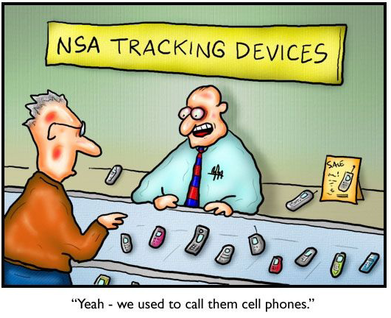

Slide 174
TOP SECRET NSA PRISM POWERPOINT

Slide 175
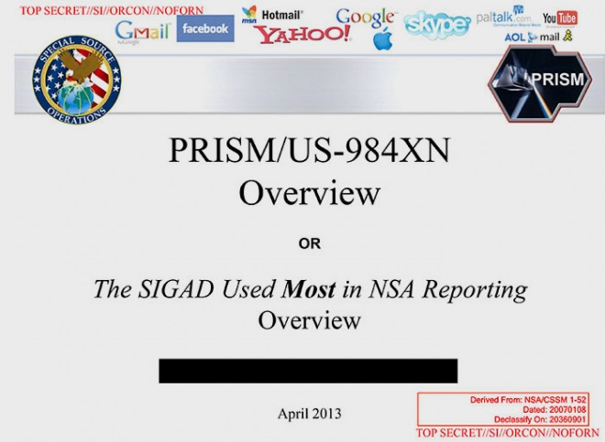

Slide 176
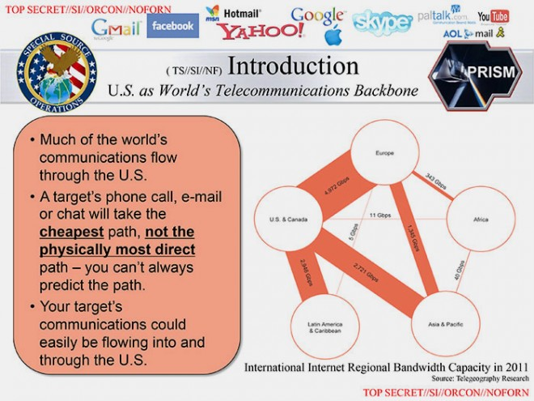

Slide 177
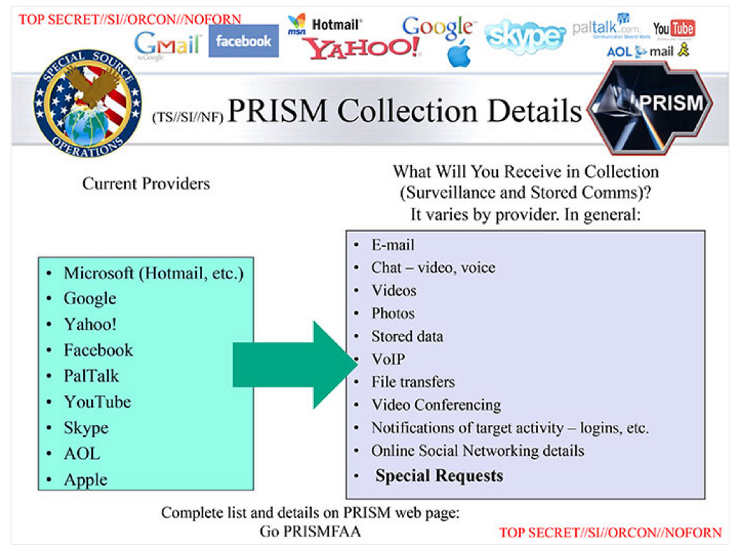

Slide 178
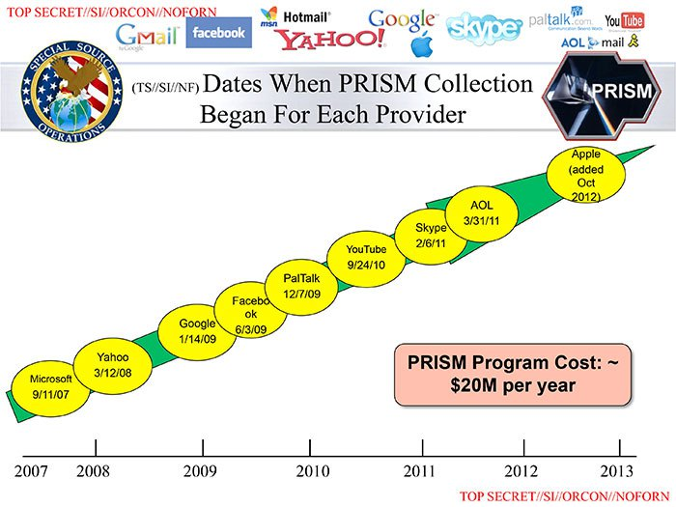

Slide 179
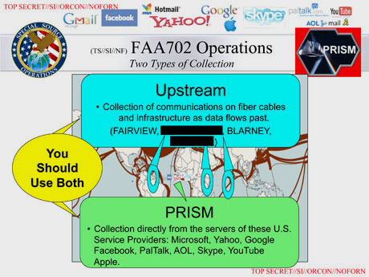

Slide 180
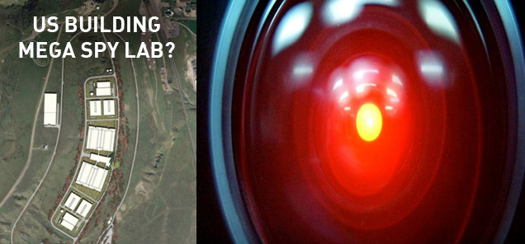
The NSA Is Building the Country’s Biggest Spy Center (Watch What You Say)
Wired.com
By: James Bamford – March 15, 2012
Under construction by contractors with top-secret clearances, the blandly named Utah Data Center is being built for the National Security Agency. A project of immense secrecy, it is the final piece in a complex puzzle assembled over the past decade.
ITS PURPOSE:
To intercept, decipher, analyze, and store vast swaths of the world’s communications as they zap down from satellites and zip through the underground and undersea cables of international, foreign, and domestic networks. The heavily fortified $2 billion center should be up and running in September 2013.
WHAT THEY ARE STORING:
Flowing through its servers and routers and stored in near-bottomless databases will be all forms of communication, including the complete contents of private emails, cell phone calls, and Google searches, as well as all sorts of personal data trails—parking receipts, travel itineraries, bookstore purchases, and other digital “pocket litter.” It is, in some measure, the realization of the “total information awareness” program created during the first term of the Bush administration—an effort that was killed by Congress in 2003 after it caused an outcry over its potential for invading Americans’ privacy.

Slide 181


Slide 182
Third Party Records

Slide 183

APP- TRACKING

Slide 184

Texas Leads the Way in Privacy Protection
ACLU.org – By: Allie Bohm – May 22, 2013
Victory for the 4th Amendment
The Texas House of Representatives passed the first bill in the nation that would require law enforcement to obtain a probable cause warrant before tracking individuals’ location by collecting their cell phone location data.
ACLU Responds
“By approving this amendment, our legislators would take a significant step to preserve the Fourth Amendment rights of Texas citizens, protecting them from potential unreasonable searches and seizures that could take place entirely outside judicial review.”
Making the Bill a LAW!!
It’s been a long slog to get to this point. Despite having over 100 co-sponsors in Texas’s 150-member House, the original cell phone location tracking bill, HB 1608, was not brought up for a vote before Texas’ deadline for moving legislation through its first chamber. But, not to be deterred, the amazing bill sponsors, Rep. Hughes and Sen. Hinojosa, the ACLU of Texas, and the rock star Texas Electronic Privacy Coalition got the legislation added as a House amendment to a Senate bill, SB 1052, that requires a warrant for access to electronic communications content.
(Congress, are you taking notes? Texas is about to show you how to update the Electronic Communications Privacy Act (ECPA), the outdated federal law that governs access to communications content and is, as of yet, silent on location tracking.) The Texas bill still has to go back to the Senate to approve the House amendments before making it to the governor’s desk.

Slide 185
S.B. 1052
Sec. 5A. WARRANT ISSUED IN THIS STATE FOR STORED CUSTOMER
DATA OR COMMUNICATIONS.
(a) This section applies to a warrant required under Section 4 to obtain electronic customer data, including the contents of a wire communication or electronic communication.
(b) On the filing of an application by an authorized peace officer, a district judge may issue a search warrant under this section for electronic customer data held in electronic storage, including the contents of and records and other information related to a wire communication or electronic communication held in electronic storage, by a provider of an electronic communications service or provider of a remote computing service described by Subsection (g), regardless of whether the customer data is held at a location in this state or at a location in another state. An application made under this subsection must demonstrate probable cause for the issuance of the warrant and must be supported by the oath or affirmation of the authorized peace officer.
(c) A search warrant MAY NOT be issued under this section unless the sworn affidavit required by Article 18.01(b) sets forth sufficient and substantial facts to establish probable cause that:
(1) a specific offense has been committed; and
(2) the electronic customer data sought:
(A) constitutes evidence of that offense or evidence that a particular person committed that offense; and
(B) is held in electronic storage by the service provider on which the warrant is served under Subsection (h).
(d) Only the electronic customer data described in the sworn affidavit required by Article 18.01(b) may be seized under the warrant.

Slide 187


Slide 188


