Slide 1
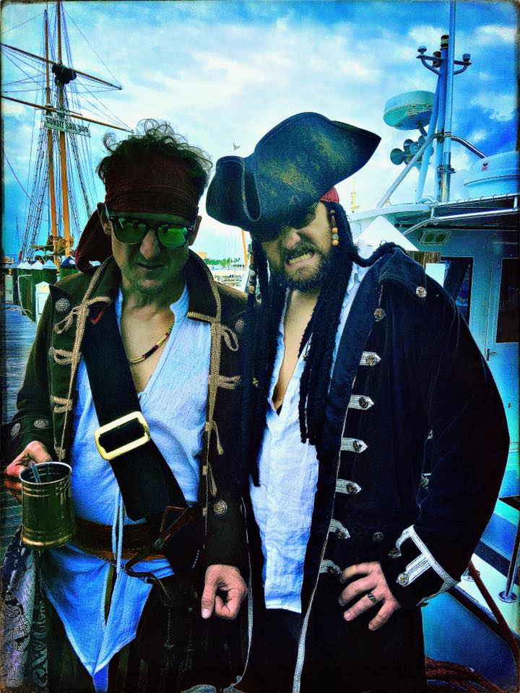


PIRACY CASES
Presented by:
DONALD H. FLANARY, III.

Slide 2
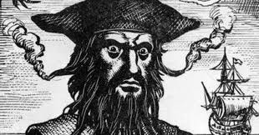
Piracy Cases from Supreme Court History

Slide 3
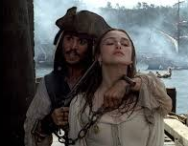
United States v. Palmer (1818)
3 men broke onto a ship, the Industria Raffaelli, assaulted the Spanish crew, and stole expensive cargo, including sugar, rum, honey, and cash.
At issue was whether robbery committed at sea could be punishable by death, even if robbery on land could not be.

Slide 4
United States v. Palmer (1818)
A 1790 statute prescribed death for murder or robbery committed at sea,
or any other offense for which death was a punishment if it were committed on land.

Slide 5
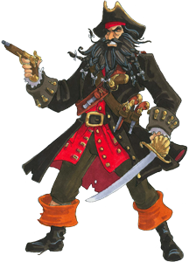
United States v. Palmer (1818)
Chief Justice John Marshall held that even though robbery wasn't among the laws that were punishable by death on land, Congress intended specifically to add it to the class of laws punishable by death when committed at sea.

Slide 6
United States v. Palmer (1818)
The Court also concluded that the United States couldn't punish piracy committed by a foreigner on a foreign ship.

Slide 7

United States v. Smith (1820)
In March, 1819, Thomas Smith was part of the crew of the Creollo, a private ship commissioned by Buenos Aires, which was at war with Spain.
Smith and others left the Creollo while it was docked in Margarita, seized another ship (the Irresistible) and then used it to rob and plunder Spanish vessels.

Slide 8
United States v. Smith (1820)
What is Piracy?

Slide 9
United States v. Smith (1820)
This issue on appeal was whether these actions constituted piracy as "defined by the law of nations."

Slide 10
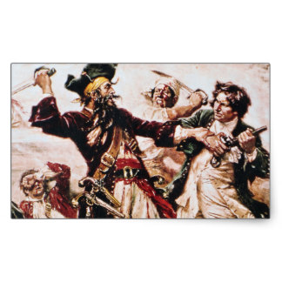
United States v. Smith (1820)
Justice Joseph Story held that Congress not only has the power to punish piracy, but to "define" piracy as it likes.
He then concluded that "piracy" was not too vague a crime, and the facts of the indictment sufficiently indicated what Smith had done.

Slide 11
United States v. Smith (1820)
Justice Livingston dissented, saying that there was no accepted definition of "piracy," meaning the law was unconstitutionally vague.

Slide 12
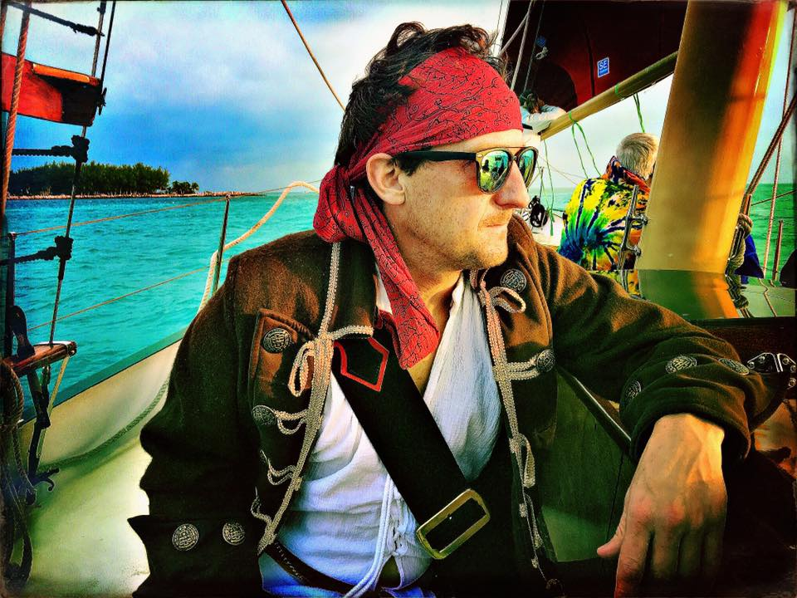
United States v. Wiltberger (1820)
Wiltberger was charged with manslaughter on the Benjamin Rush while it was on a river in China.
The question for the Supreme Court was whether a river was "the high seas" for purposes of the statute.

Slide 13
United States v. Wiltberger (1820)
Chief Justice Marshall held:
Applying the rule that criminal laws should be strictly construed, and in light of other words used in the statute, he concluded that "the seas" don't encompass rivers and streams.

Slide 14
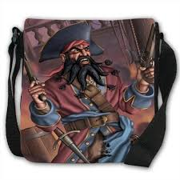
United States v. Wiltberger (1820)
Especially telling was that, in other sections of the statute, Congress prohibited acts in specific places, including rivers and basins -- but manslaughter wasn't one of them.

Slide 15
United States v. Wiltberger (1820)
Marshall assumed that this was no accident and found that the United States didn't have jurisdiction over this non-capital offense committed on a river.

Slide 16

More Recent Cases…

Slide 17

Eastern District of Virginia – the Forefront
The Norfolk Division of Eastern District of Virginia (EDVA), which is home to the largest naval base in the world, is at the forefront of United States piracy prosecutions.

Slide 18
Eastern District of Virginia – the Forefront
Since 2010, EDVA has charged 26 alleged pirates captured on the high seas around Somalia.
25 of those pirates were alleged to have operated on the high seas, utilizing weapons ranging from AK-47’s to rocket propelled grenades.

Slide 19
Eastern District of Virginia – the Forefront
One of those alleged pirates was captured in Somalia and has been described in the media as the highest ranking Somali pirate captured and prosecuted to date.

Slide 20
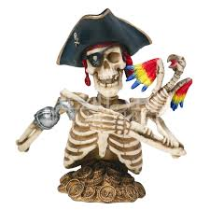
Eastern District of Virginia – the Forefront
These prosecutions resulted in the first successful piracy trial in the United States in approximately 200 years.

Slide 21
Eastern District of Virginia – the Forefront
To date, EDVA has convicted a total of 17 pirates, which have resulted in or will result in:
  5 defendants being sentenced to life plus 80 years,
  11 defendants sentenced to life, and
  1 defendant sentenced to 30 years.
  A number of defendants are still pending trial.

Slide 22
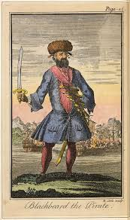
United States v. Hasan et al. (E.D. Va. 2010)
5 defendants were Somali pirates who, on April 1, 2010, mistook the USS Nicholas for a merchant vessel and attacked it at night using AK-47’s and carrying an rocket propelled grenade.

Slide 23
United States v. Hasan et al. (E.D. Va. 2010)
Case resulted in what is believed to be the longest opinion on the meaning of piracy under the law of nations since the 1820 Supreme Court decision in United States v. Smith.

Slide 24
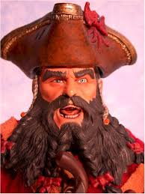
United States v. Hasan et al.
After a three week trial in November 2010, all defendants were found GUILTY on all charges.

Slide 25
United States v. Hasan et al.
Each defendant was sentenced to life plus 80 years.
The case was affirmed sub nomine by the 4th Circuit in 2012 in United States v. Dire, 680 F.3d 446 (4th Cir. 2012).

Slide 26
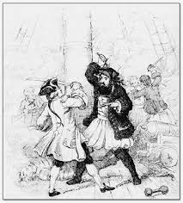
United States v. Said et al. (4th Cir. 2015)
The 6 defendants were Somali pirates who, on April 10, 2010, mistook the USS Ashland for a merchant vessel and attacked it using an AK-47.

Slide 27
United States v. Said et al. (4th Cir. 2015)
Defendants were convicted of piracy and other offenses in the Eastern District of Virginia, but the District Court declined to impose the life sentence mandated by piracy statute on ground that it would be cruel and unusual in violation of defendants' Eighth Amendment rights.

Slide 28
United States v. Said et al. (4th Cir. 2015)
Defendants appealed from their convictions, and government cross-appealed from the District Court's sentencing.

Slide 29
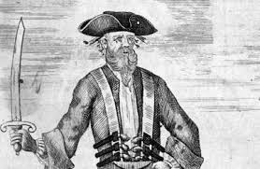
United States v. Said et al. (4th Cir. 2015)
The 4th Circuit, held:
1) Evidence was sufficient to support their convictions of federal offense of piracy;

Slide 30
United States v. Said et al. (4th Cir. 2015)
The 4th Circuit, held:
2) evidence was sufficient to support defendants' convictions of conspiring to commit hostage taking and kidnapping;

Slide 31
United States v. Said et al. (4th Cir. 2015)
The 4th Circuit, held:
3) trial evidence was more than sufficient to prove that, at time of ill-fated seizure attempt, defendants were equipped and ready to commit violence; and

Slide 32
United States v. Said et al. (4th Cir. 2015)
The 4th Circuit, held:
4) mandatory life sentence provided by legislature for any defendant convicted of piracy was not grossly disproportionate to defendants' offense.
Convictions affirmed; sentences vacated; case remanded.

Slide 33
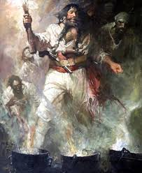
United States v. Salad et al./United States v. Shibin (4th Cir. 2013)
The 15 defendants in this case were alleged to be responsible for the piracy of the S/V Quest, a U.S. flagged sailboat, which resulted in the murder of the four United States citizens on board the Quest at the hands of the pirates.

Slide 34
United States v. Salad et al./United States v. Shibin (4th Cir. 2013)
This is the first case in which a land-based, management level pirate – Shibin – has been captured and prosecuted.
  11 defendants have pled guilty – with mandatory life sentences.
  3 defendants face capital charges

Slide 35
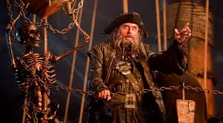
United States v. Salad et al./United States v. Shibin (4th Cir. 2013)
Defendant was convicted in the EDVA of charges arising from piracy of German and American vessels on the high seas beyond the territorial waters of Somalia, and he appealed.

Slide 36
United States v. Salad et al./United States v. Shibin (4th Cir. 2013)
The 4th Circuit held that:
1) defendant could be prosecuted as an aider and abettor of piracies of German and American vessels, which took place on the high seas, and

Slide 37
United States v. Salad et al./United States v. Shibin (4th Cir. 2013)
The 4th Circuit held that:
2) facts that defendant was forcibly seized and removed from Somalia by agents of the United States government and that no extradition treaty between the countries existed did not preclude assertion of personal jurisdiction over defendant.

Slide 38

District of Columbia Case
Somali Sentenced to 25 Years for Armed Piracy of Merchant Ship Held for 71 Days
Jama Idle Ibrahim, 39, of Somalia, was sentenced to 25 years in prison on April 7, 2011, for a violent act of piracy in the Gulf of Aden against a merchant vessel, the M/V CEC Future, that began in November 2008 and lasted for 71 days, until January 16, 2009.

Slide 39
District of Columbia Case
Ibrahim pled GUILTY to conspiracy to commit piracy under the law of nations and conspiracy to use a firearm during and in relation to a crime of violence.

Slide 40
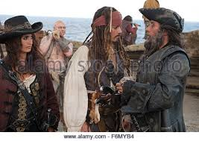
District of Columbia Case
Ibrahim and other Somali pirates were armed with AK 47s, a rocket-propelled grenade, and handguns when they attacked and seized the vessel, which was owned by Clipper Group, a Danish company, and contained cargo belonging to a Texas-based company, McDermott International, Inc.

Slide 41
District of Columbia Case
The pirates held the vessel, cargo, and 13 crew members captive and forced the crew to anchor in waters off the Somalia coast, until the Clipper Group delivered $1.7 million in ransom to the pirates.
THIS WAS THE FIRST CONVICTION IN D.C. for a piracy-related offense.

Slide 42
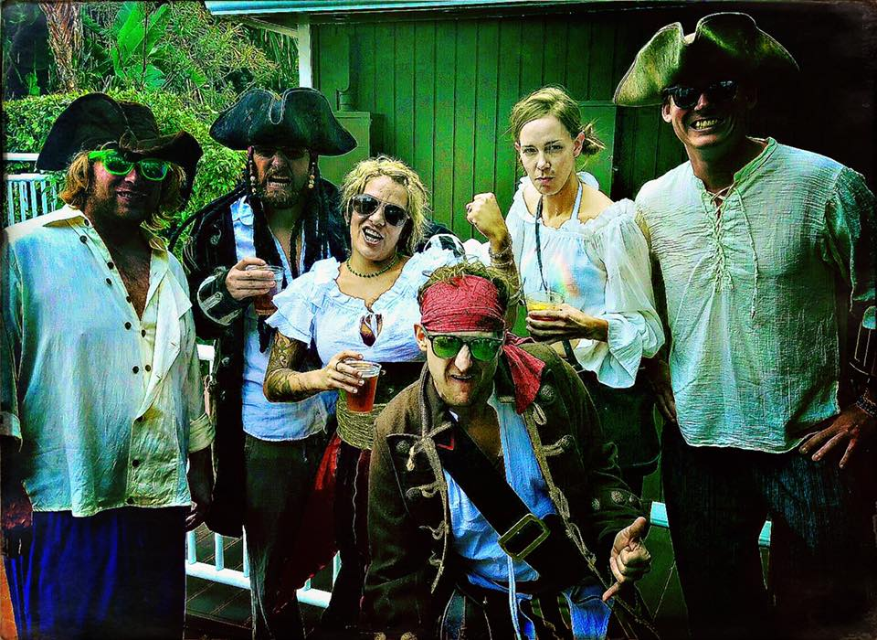
That’s all, mates.

