Slide 1
Search, Seizure & Dogs
“Woof, Woof, Judge, I Swear”
Presented by
Donald H. Flanary, III.
Goldstein Goldstein and Hilley
NORML LEGAL SEMINAR
December 3-4, 2009
Key West, Florida

Slide 2
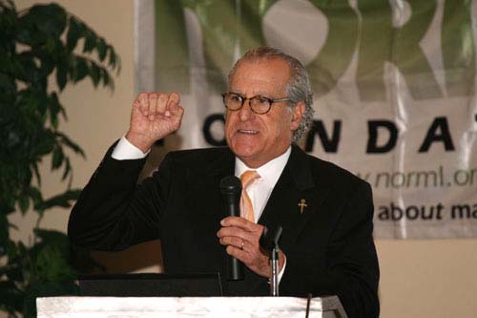

Slide 3
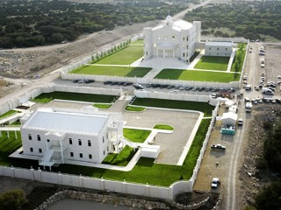
Fundamentalist Church of Jesus Christ of Latter Day Saints, Eldorado, Texas

Slide 4
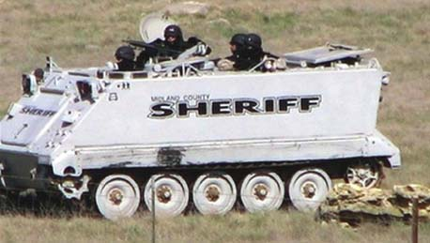
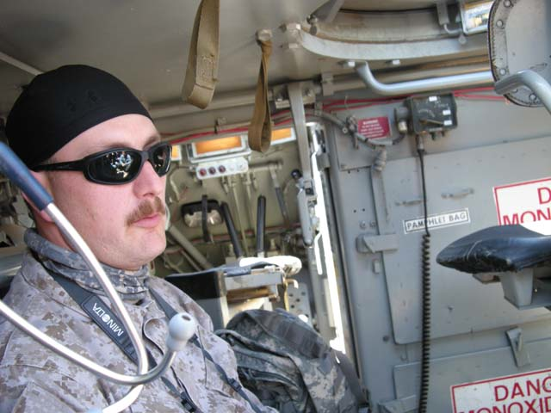
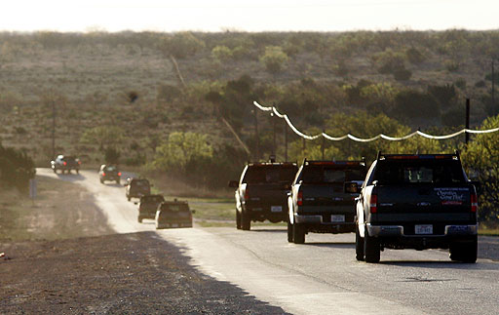
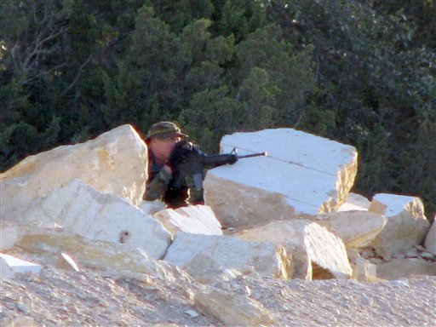

Slide 5
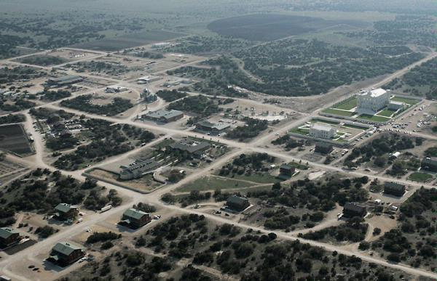


Slide 6
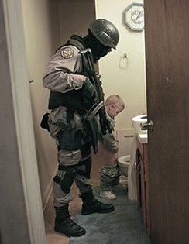
468 Children
Seized

Slide 7
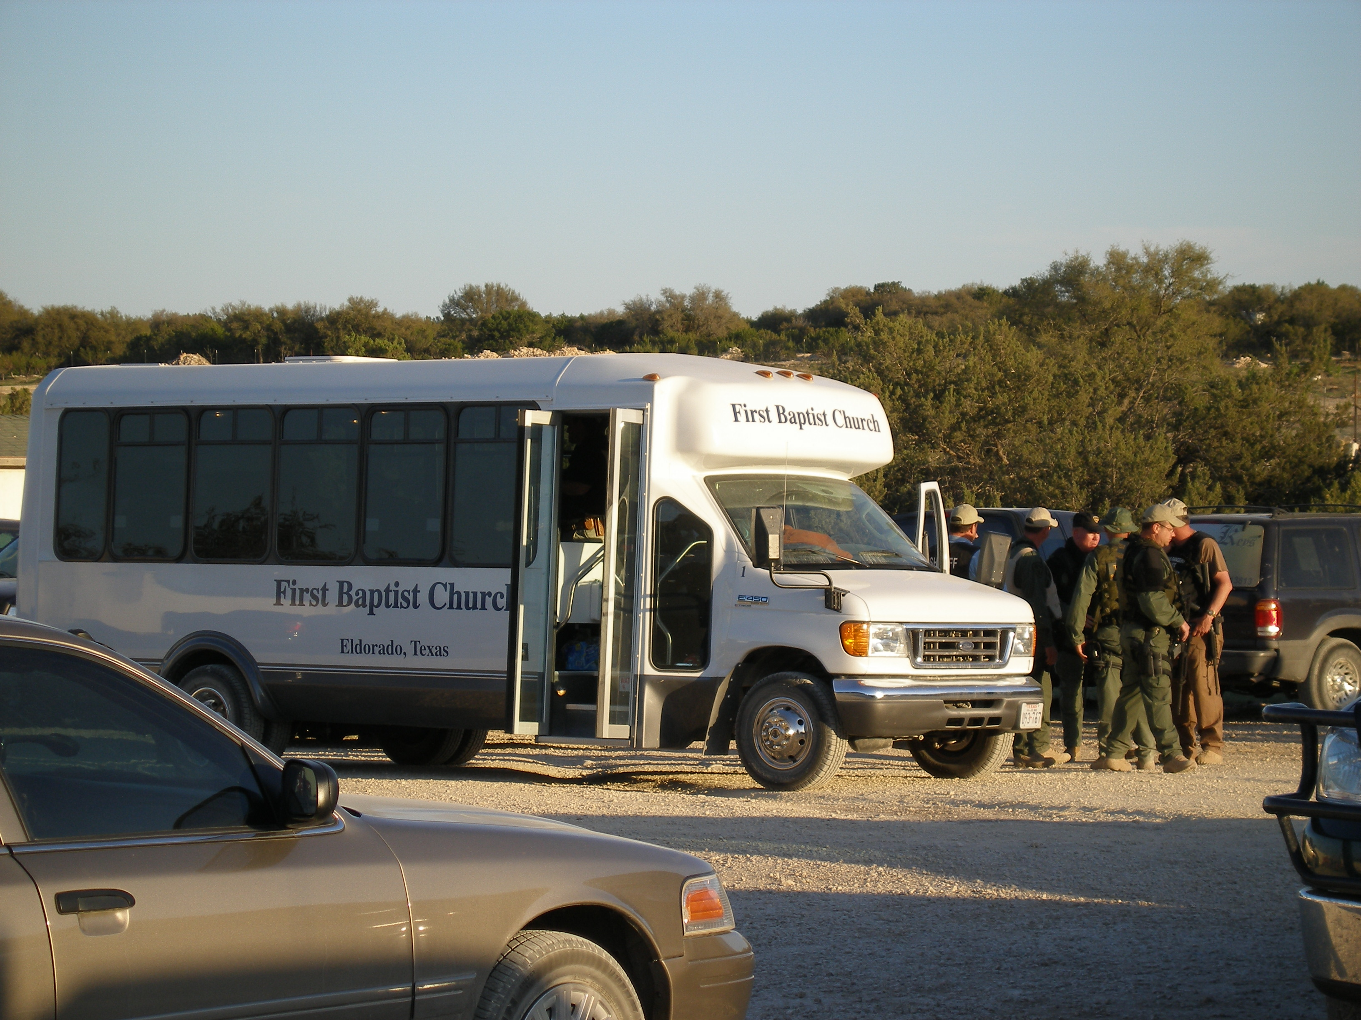

Slide 8
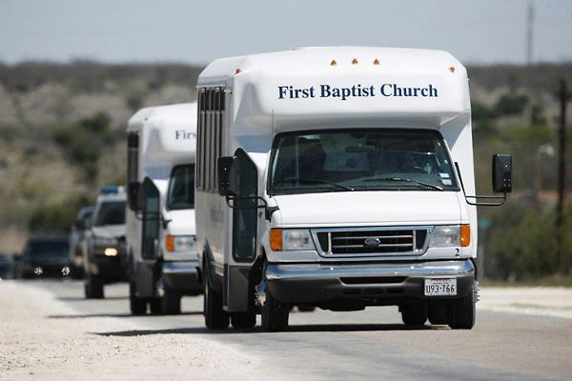

Slide 9
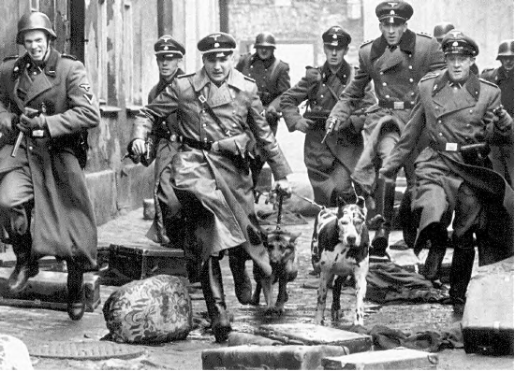

Slide 10
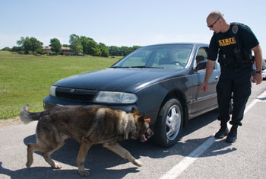
THE K-9 DETECTION TEAM

Slide 11
Narcotics-Detection K-9s
Valuable tool used by law enforcement during the war on drugs.
30 years of case law has developed concerning most 4th Amendment scenarios.
When used properly and under the right conditions, drug-dogs work…

Slide 12
Goals
Challenging Assumptions about Narcotics-Detection K-9s for:
      Judges
      Prosecutors
      You
The law regarding Narcotics-Detection K-9s
How K-9’s detect Narcotics

Slide 13
Areas to Sniff out Success
Was there violation of the Fourth Amend.?
    (a lot of bark, no bite)
Was the “K-9 Alert” reliable to establish P. C.?
    (the Real Focus)
      Look at the actions of the Narcotics Detection Team.
      Look at the “Alert” itself.
      Look at the Reliability of the K-9.

Slide 14
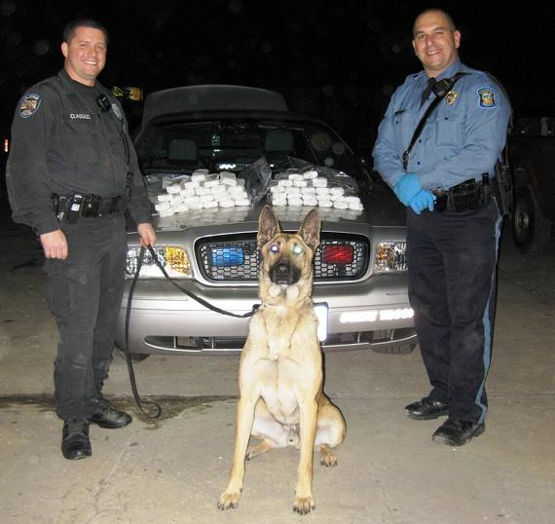
Narcotics Detection Team
The Team works as a “Unit.”
A trained Handler.
A trained K-9.
Reliable only when both are working together properly.

Slide 15
In General, a Sniff is not a Search
U.S. v. Place, 462 U.S. 696 (1983)
  Exposure of luggage to a trained narcotics-detection dog is not a search for 4th Amendment purposes.
Illinois v. Caballes, 543 U.S. 405 (2005)
  Where lawful traffic stop did not extend beyond time necessary to issue ticket and conduct inquires incident to the stop, other officer’s arrival and use of narcotics detection dog to sniff around the exterior of vehicle did not rise to level of infringement of 4th Amendment rights.

Slide 16
U.S. v. Place, 462 U.S. 696 (1983)
Passenger in Miami International Airport suspected of carrying Narcotics.
Passenger arrived at La Guardia and DEA seized his bags based on discrepancies on address tags and nervous behavior.
Took bags to Kennedy Airport and subjected to a drug-dog sniff.
Dog alerted.

Slide 17
U.S. v. Place, 462 U.S. 696 (1983)
Rational:
  The initial taking of the luggage was a reasonable temporary seizure under Terry
  “A K-9 sniff by a well-trained narcotics detection dog,… does not require opening the luggage.”
  “It does not expose non-contraband items that otherwise would remain hidden from public view, as does, for example, the officers rummaging through the contents of the luggage.”

Slide 18
U.S. v. Place, 462 U.S. 696 (1983)
Rational:
  The is “much less intrusive than a typical search.”
  A sniff does not subject the property owner to “embarrassment and inconvenience of a less discriminate and more intrusive investigation method.”

Slide 19
Illinois v. Caballes, 543 U.S. 405 (2005)
Motorist stopped with R.S. for a lawful traffic violation.
While a warning citation being written, second officer arrived with K-9 and sniffed exterior of vehicle.
Stop lasted no more than 10 minutes.
Dog Alerted.

Slide 20
Caballes Sniff
Trained narcotics detection K-9 Team
Lawful traffic stop
Traffic stop does not extended beyond time necessary
Sniff around the exterior of vehicle

Slide 21
Trained Narcotics Detection K-9 Team
The K-9 alert must be sufficiently reliable to provide probable cause to conduct the search.
Therefore, the Hander and the Dog must have received proper training and be current in that training.
Testimony and records must support proper training.

Slide 22
Trained Narcotics Detection K-9 Team
Remember FRE 702 Expert requirements.
The training that officers receive varies greatly from department to department.
The training records for the K-9 should be extensive and detailed.
The training records should include a log of every training session as well as every use of the dog in the field.
K-9s should receive a minimum of 4 hours training per week.

Slide 23
Trained Narcotics Detection K-9 Team
The dog must be trained, certified and reliable. The dog does not have to be 100% accurate or perfect. The courts have recognized the fact that “false responses”, “false positives” or “false alerts” occur and dogs can be as low as 54% accurate. United States v Cedano-Arellano, 332 F. 3d 568 (9th Cir 2003)

Slide 24
Trained Narcotics Detection K-9 Team
While the vast majority of cases in most jurisdictions simply require a showing that the dog was “trained,” the following issue can provide fertile ground for cross-examination of the officer regarding the sufficiency of training:
Type of training.
Duration of training.
Date of last training.
Ability of officer to explain training.
Relevancy of training to actual field use.

Slide 25
The Science of Sniff
(the place for great Cross-X)
Principles of Conditioning
There a number of steps that are required to take a dog from untrained to a Narcotics-Detection K-9.
Dogs must learn through a series of methodical steps.
Dogs are taught on each drug separately.
No short cuts in training.

Slide 26
Discovery of K-9 Training and Certification Materials
Since only a trained, certified , and reliable Narcotics Detection Team can give Probable Cause, then:
full disclosure of training and certification materials is vital to an adequate defense.

Slide 27
Discovery of K-9 Training and Certification Materials
Under Rule 16 of the Federal Rules of Criminal Procedure, the government is required to disclose materials pertaining to narcotics-detection K-9 Training. U.S. v. Cedano-Arellano, 332 F3d 568, 571 (9th Cir. 2003) .
The records are crucial for effective cross-examination.

Slide 28
Discovery of K-9 Training and Certification Materials
While a Daubert hearing is not necessarily the appropriate procedural vehicle to challenge the reliability of a canine inspection, the court must recognize the importance of a “trained and certified canine unit.” See United States v. Outlaw, 134 F.Supp.2d 807 (W.D. Texas 2001) citing United States v. Dovali-Avila, 895 F.2d 206 at 207 (5th Cir. 1990).

Slide 29
Discovery of K-9 Training and Certification Materials
Judge, “We are not asking for a Daubert, to challenge the sniff, we are challenging this officers ability to testify as an Expert.”

Slide 30
Discovery of K-9 Training and Certification Materials
The following should be discovered:
1. Verification that the canine was trained to detect the odors for the particular drug.
2. Verification of the canine’s success rate.
3. The method used to train the canine to indicate an alert.
4. The type of alert used.
5. A statement showing that the canine positively alerted to the presence of narcotics in the proper fashion.
6. Proof of the canine’s certification.
7. Proof that the canine has continued to meet all certification requirements and received necessary training on a regular basis.
8. Verification that the handler has been trained to handle narcotics-detection canines.

Slide 31
Lawful Traffic Stop
Reasonable suspicion required of an offense for a lawful traffic stop.
Lawful traffic stop at inception must remain lawful through out the stop. See U.S. v. Jacobsen, 466 U.S. 109 (1984)

Slide 32
Traffic Stop Must Not Extend Beyond Time Necessary
The Caballes stop lasted less than 10 minutes
“ A seizure that is justified solely by the interest in issuing a warning ticket to the driver can become unlawful if it is prolonged beyond the time reasonably required to complete that mission.” Illinois v. Caballes

Slide 33
Traffic Stop Must Not Extend Beyond Time Necessary
Items to Discover and Subpoena:
Dispatch or radio logs and Mobile Data Terminal (MDT) records for times of:
  Traffic Stop
  Call for or arrival of K-9 Unit
  Call for assisting officers
  When the individuals identification is checked
  Arrest of individual
  Conclusion of traffic stop
This documentation will allow a time line to be established to determine if the stop was unreasonably extended.

Slide 34
Sniff Around the Exterior of Vehicle
The sniff must be limited to the exterior of vehicle.
Dog cannot be taken in to the vehicle without prior probable cause.
*What if the dog jumps in?
*What if the dog “breaks the plane” of the window?
*What if the officer opens the door for the dog?

Slide 35
Caballes Did Not Challenge the Alert
Remember that Caballes only dealt with:
Trained K-9 Team.
Lawful traffic stop.
Short duration of traffic stop.
Sniff of Exterior of vehicle.
THE ALERT ITSELF WAS NOT CHALLENGED

Slide 36
Caballes Did Not Challenge the Alert
The vast majority of K-9 Sniff case law deals with the factors surrounding and leading up to the search.
Most case law does not deal with the validity of the Alert itself.

Slide 37
Other K-9 Searches
Luggage
Automobiles
Hotels, Motels, etc.
Packages
School Lockers
Persons
International Borders

Slide 38
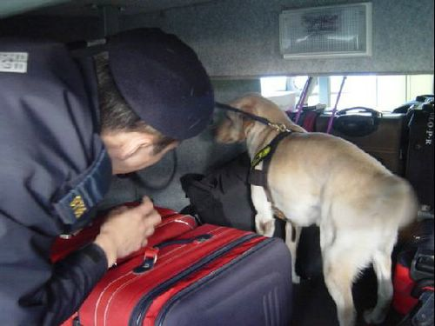
Luggage
The submission of luggage to a canine sniff for narcotics does not constitute a Fourth Amendment search. United States v. Williams, 365 F.3d 399 (5th Cir. 2004).

Slide 39
Breathing Luggage
* “Breathing the luggage” - officers will manipulate the bag to force out detectable air. Some will train dogs to walk on luggage to cause the same to occur.
The manipulation of luggage constitutes and search for 4th Amendment purposes, Bond v. United States, 529 U.S. 334, (2000)
Furthermore, a “squeeze and sniff” is the same sort of manipulation that Bond classifies as a Search U.S. v. Ellis, 330 F.3d 677, (2003), U.S. v. Jaime, 473 F.3d 178, (2006)
(Minnesota v. Dickerson)

Slide 40
Breathing Luggage
What if the dog is trained to “breath” the luggage by stepping on it or forcing air out of the luggage with his nose?
* “Breathing the luggage” video 1

Slide 41
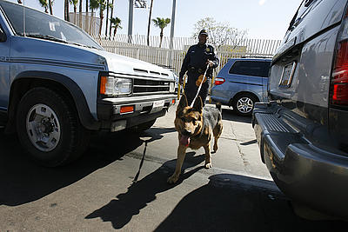
Automobiles
Pre-Caballes - Border Patrol agents may stop motorists, and selectively conduct dog sniffs of their vehicles, without reasonable suspicion because dog sniffs are not searches within the meaning of the Fourth Amendment. United States v. Hernandez, 976 F.2d 929 (5th Cir. 1992).
Caballes broadens Hernandez
to entire country.

Slide 42
Hotels, Motels, etc.
The use of a narcotics-detection dog at the exterior of a motel-room door that opens onto a public sidewalk and parking lot is not a search within the meaning of the Fourth Amendment. United States v. Marlar, 828 F.Supp 415 (N.D. Miss. 1993), dismissed, 68 F.3d 464 (5th Cir. 1995).
Different than residences because exterior of motel is public.
The Alert can still be challenged.

Slide 43
Packages
A canine sniff outside a package on a common air-carrier is not a search within the meaning of the Fourth Amendment. United States v. Daniel, 982 F.2d 146 (5th Cir. 1993).
Similar to luggage.

Slide 44
School Lockers
A dog sniff of a student’s locker at a school is not a search within the meaning of the Fourth Amendment. United States v. Daniel, 982 F.2d 146 (5th Cir. 1993).
Similar to hotel door.

Slide 45
Persons
The non-contact dog sniff of a passenger, after the dog had alerted to the presence of narcotics in the passenger compartment of a bus, was not a search within the meaning of the Fourth Amendment. The dog was four to five feet away from the passenger when sniffed, and the handler did not intend to have the dog sniff the passenger as he exited the bus. United States v. Reyes, 349 F.3d 219 (5th Cir. 2003).

Slide 46
Persons
BUT:
An up close sniffing of a person at the border by a trained K-9 offends reasonable expectations of privacy and is thus a “search” under the 4th Amendment. U.S. v. Kelly, 302 F.3d 291 (5th Cir. 2002.)

Slide 47
Border Exception to 4th Amendment
Under the “border-search doctrine,” government agents may conduct routine searches at international borders or their functional equivalents without probable cause, a warrant, or any suspicion to justify a search. U.S. v. Rivas, 157 F.3d 364, at 367 (5th Cir. 1998).
But the stop and search must be ROUTINE!!!!
Otherwise, reasonable suspicion is required.

Slide 48
Border Exception to 4th Amendment
Routine stop and searches under Rivas, are ones that do not “seriously invade a traveler’s privacy.”
In Rivas, the court suppressed a sniff known as “casting”.
Casting is an improper alert in which the handler claims that a K-9 smelled contraband from a distance.
The agents “drilled” into a vehicle in Rivas which would not be considered “routine”.

Slide 49
Border Exception to 4th Amendment
Remember Kelly, an up close sniff of a person, even a the border is a search,
But, under the “border-search doctrine,” an up close sniff at the boarder is permitted without reasonable suspicion as long as it is routine .

Slide 50
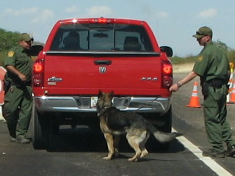
Border Check Points
Fixed Checkpoints have videos.
Request video early to preserve.
If video not preserved, file motion to exclude.
Show Video 2
What about alerting
to “Humans or Narcotics.”
Border Patrol specific
technique.

Slide 51
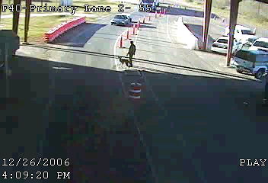

Slide 52
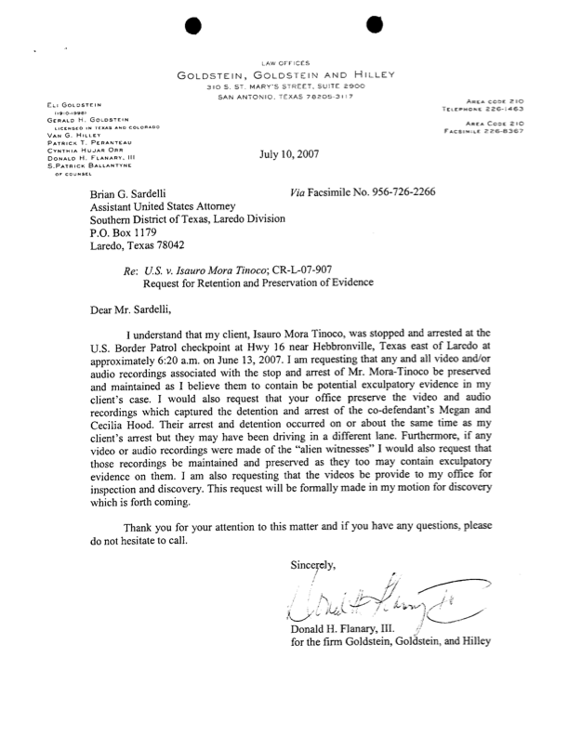

Slide 53
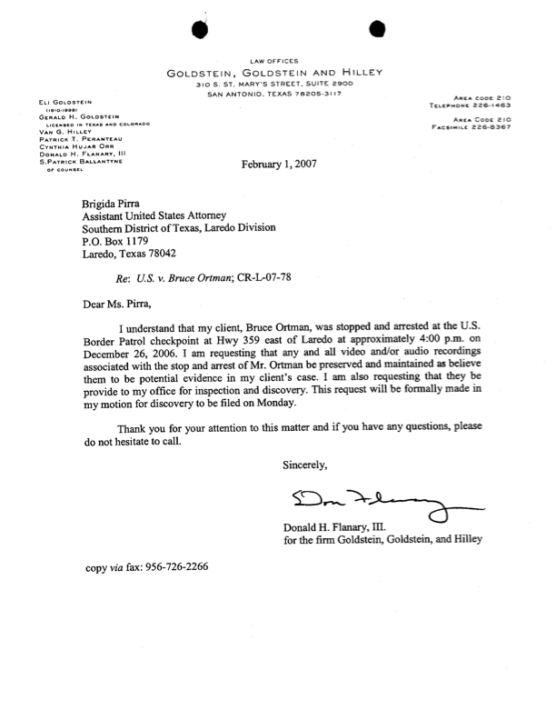

Slide 54
The Focus of the
Motion to Suppress
Was the “Alert” sufficiently reliable to establish probable cause for the Search?
  Look at the Alert itself
  Explore the reliability of the Team to do its job
    Was the Team properly trained?
    Does the Team execute its job according to that training?

Slide 55
Was it a legitimate “Alert”?
A trained or conditioned response by a K-9 to a stimulus.
Two types of alerts:
  Passive
    Sitting, stop and stare, lay down, a bark, something passive and non-aggressive.
  Aggressive
    Scratching, clawing, and/or biting

Slide 56
Reasons for different types
Alerts
Passive alerts are used for explosives, to prevent to personal property damage, and minimize liability.
Aggressive alerts is a more natural response for the dog and easier to train.
Neither are better than the other.

Slide 57
Signs of Legitimate Alerts
K-9 works independently of the Handler.
K-9 shows active and independent sniffing behavior.
  “Bracketing”
  Curiosity of the environment
  Mouth closed (can’t sniff if they are panting)
K-9 must make an independent choice to respond to stimulus.

Slide 58
Signs of Legitimate Alerts
K-9 must make an independent choice to respond to stimulus.
  Focused on the search, not the handler
  Does or does not respond regardless of handlers activities
  Not looking to Hander for direction or assistance
If the Handler immediately rewards the response, the Handler believes it is a good alert.
The K-9 should not leave the alert position until he receive the reward.

Slide 59
Signs of False Alerts
Handler must not cue the dog in any way.
  Should not stop and stand or stare at dog.
  Should not reach for the reward before the alert is given by the dog.
  Should not start talking to the dog before the alert is given by the dog.
Handler should not repeatedly run a dog through the same areas.
Handler should trust their dog.

Slide 60
Sole Purpose of Handler
“Portable toy Dispenser”
Insure that all productive areas have been checked.
Insure the dog is working the area properly.
Reward a legitimate alert.

Slide 61
Was the “Alert” sufficiently reliable to establish P.C. for the Search?
Only officer’s testimony
  Cross-Examine, get an expext
Video evidence
  Watch, get an expert
  (Your expert can be appointed*)

Slide 62
Its all about the TOY!
The Dog doesn’t care about the bad guy.
The Dog doesn’t care about the drugs.
The Dog doesn’t care about the law.
The Dog just wants his TOY.
The Dog has been conditioned what to do to get his TOY!

Slide 63
Dogs are Selfish!
DNA tests, Intoxilizers, Ballistics tests, and all other scientific instruments do not have a desires or agendas.
Unlike other Law Enforcement tools the dog has an agenda and a desire.
The Dog wants the toy and will do anything to get it.
Dogs are more like CI’s then they are like machines.

Slide 64
Top 10
Things to Look for on a K-9 Video
1. The actual response of the dog sitting is over rated.
It is the actions of the handler and canine in the 10 - 20 seconds before that which are important.

Slide 65
Top 10
Things to Look for on a K-9 Video
2. The K-9 should be showing "active sniffing behavior" and not just following along with the handler’s hand presentations.

Slide 66
Top 10
Things to Look for on a K-9 Video
3. The K-9 should be exploring and curious about areas other than the specific spots that the handler points out to it.

Slide 67
Top 10
Things to Look for on a K-9 Video
4. The K-9 should not be looking at the handler constantly.
This is a sign of a very dependant and unreliable K-9. This is also an indication of a K-9 looking for some sort of "cue" from the handler about where he is expected to respond.

Slide 68
Top 10
Things to Look for on a K-9 Video
5. Fluid motions of the handler.
The handlers should keep moving without stuttering their step or hesitating when the K-9 is showing an interest in an area.

Slide 69
Top 10
Things to Look for on a K-9 Video
6. Handlers should not “tap back.”
This is going back to an area where a K-9 has already checked and making them do it again. The K-9 will take this as a cue and respond even if nothing is there.

Slide 70
Top 10
Things to Look for on a K-9 Video
7. The K-9 should be working almost independently of the handler and not actively paying much attention to him
A good K-9 needs little or no presentations from the handler.
Handlers are merely portable toy or food dispensers for when the canine does right.

Slide 71
Top 10
Things to Look for on a K-9 Video
8. Once a K-9 responds, it should become still until the given its reward.
If a canine is seen to respond or “sit”, and then immediately get back up again, then this is a false response or a sign that the canine is weak in its task.

Slide 72
Top 10
Things to Look for on a K-9 Video
9. A good K-9 that does not get its reward in a timely manner (within 1 - 3 seconds) it will go back, sniff again and respond again and start getting antsy.
A weak canine will get up and walk off.

Slide 73
Top 10
Things to Look for on a K-9 Video
10. The handler should believe the K-9 the first time, whether it is a response or not.
If the K-9 responds and the handler has it check that area again, then rewards the response, this is a sign of a weak or poor handler that does not know how to read or trust his K-9.
Once a canine checks an area, the handler should not have it go back and check again.

Slide 74
Top 10
Things to Look for on a K-9 Video
11. (One More) Wind direction is CRITICAL!!!
Odor from drugs is heaver than air and will drop in low wind currents.
Odors will follow the wind currents.
This is the biggest issue in vehicle searches, large open buildings, or any other outdoor environment.
If the wind is blowing from the left to the right, and the canine responds on the door seam on the left side of the vehicle, but shows no interest on the right side, watch for cues from the handlers.

Slide 75
Videos
Watch Video 3 – Example of Good Training
Watch Video 4 – Example of Good Alert on structure
Watch Video 5 – Example of Good Alert on Vehicle
Watch Video 6 – FALSE ALERT, CUED BY COP
Watch Video 7 – Example of Bad Training
Watch Video 8 – Example of Bad Handler

Slide 76
Donald H. Flanary, III.
Goldstein Goldstein and Hilley
210-226-1463
donflanary@hotmail.com

Slide 79
FLDS
Fundamentalist Church of
Latter Day Saints

Slide 80
April 3, 2008

Slide 87
Texas Senate Bill 6
(2005)
Representative from Schleicher County, referring to the danger of the FLDS in his community:
1) Raised legal age for marriage from 14 to 16 years of age,
2) Raised punishment for “Bigamy” (creating a crime for “holding out”), and
3) Raised residency requirement for office holders from 1 year to 2.

Slide 88
468 Children
Seized,
Taken from Parents

Slide 89
CHILDREN
First taken to Fort Concho
Next to Municipal Auditorium
One restroom, no shower
Then spread throughout Texas
Siblings thousands of miles apart

Slide 90
HEARING

Slide 91
OVER 500 LAWYERS
Packed Courtroom
Auditorium
Coliseum
Attorneys separated from clients
No real opportunity to object
No real opportunity to view exhibits

Slide 92
SIMULTANEOUS WARRANTS
April 3, 2008
Criminal Search Warrant
Civil CPS Order
States that affidavit in support reflects that CPS’ prior attempts to enter premises had been refused.
The affidavit makes no such allegation, and no such attempt had ever been made.

Slide 93
Gates vs. TDPRS
(5th Cir. July 28, 2008)
3 Months later:
4th Amendment regulates social workers’ [CPS’] civil investigations.

Slide 94
CHILD PROTECTIVE SERVICES
Texas Rangers testified that they initially provided “security” for Child Protective Services, who:
Directed the occupants to bring “truckloads” of young girls,
Ages of 7 to 17,
To the schoolhouse for interrogation,
Between the hours of 12:30 to 3:00AM.

Slide 95
SEARCH OF ENTIRE VILLAGE
Warrant describes “premises” as:
1,600 acres,
“Multiple residential structures,”
Over 40 residences, with
700+ residents.
“Affiant has been to the suspected place and premises, YFZ Ranch, and knows that there are numerous residential structures, buildings and locations…” Search Warrant Affidavit, p. 3.

Slide 96
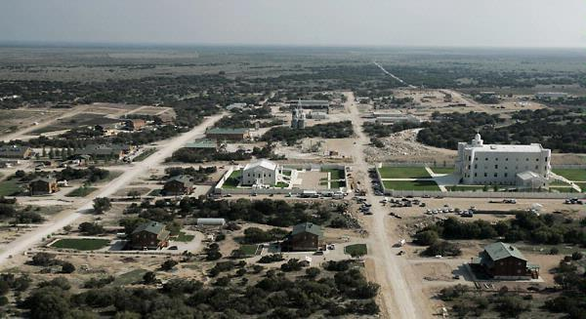

Slide 97
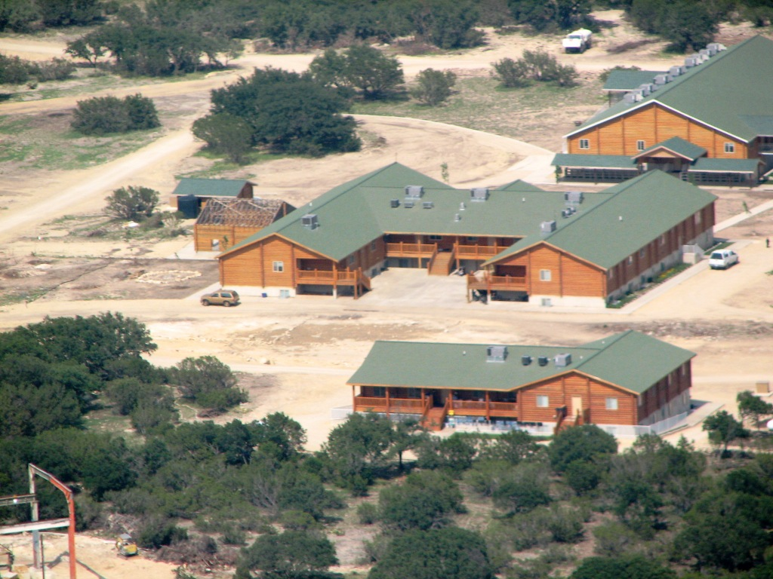

Slide 98
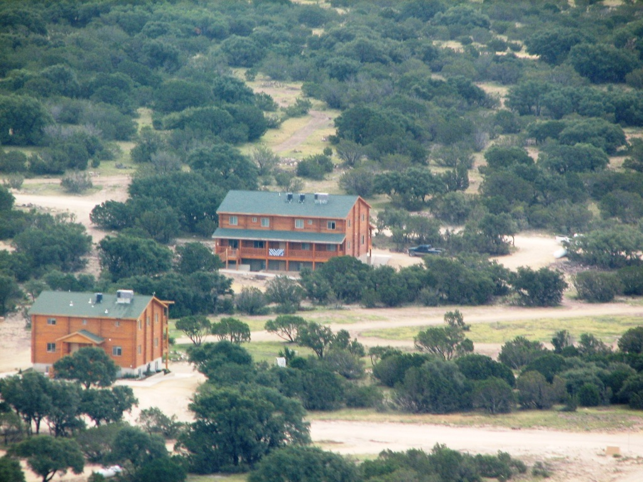

Slide 99
Dedicated streets
Stop Signs
Water District
Sewage Plant

Slide 101
MOST SWEEPING
WARRANT EVER?

Slide 102
PARTICULARIZED
DESCRIPTION
No Mention of Temple
Place of Worship
1st Amendment
“Scrupulous exactitude” N.Y. vs. P.J.Video
After entry of temple, 2nd Warrant specifically describes “temple.”

Slide 103
Franks Issues
Probable Cause:
16-Year-Old Mother by the name of “Sarah Jessup Barlow” calls a family shelter hot line,
Claiming to be abused by her “husband,” “Dale Evans Barlow”

Slide 104
POLICE FAILED
To tell issuing Judge that:
They were aware, at the time they sought the warrant for Dale Evans Barlow at the YFZ Ranch, of his address and phone number in Arizona, the name and phone number of his probation officer, and that his conditions of probation restricted him to Arizona.

Slide 105
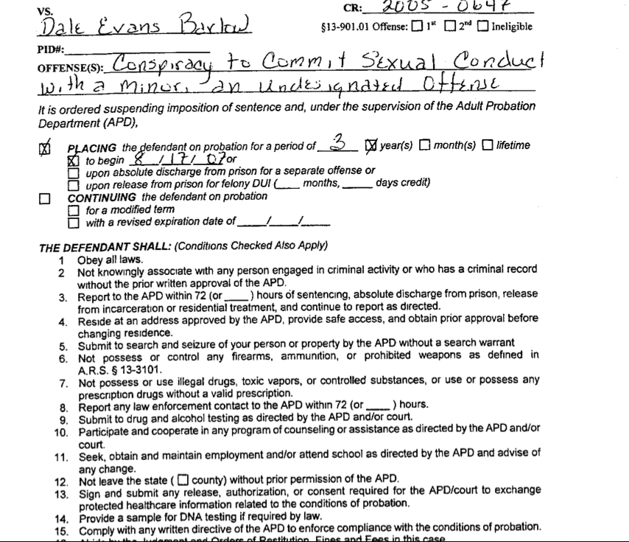

Slide 106
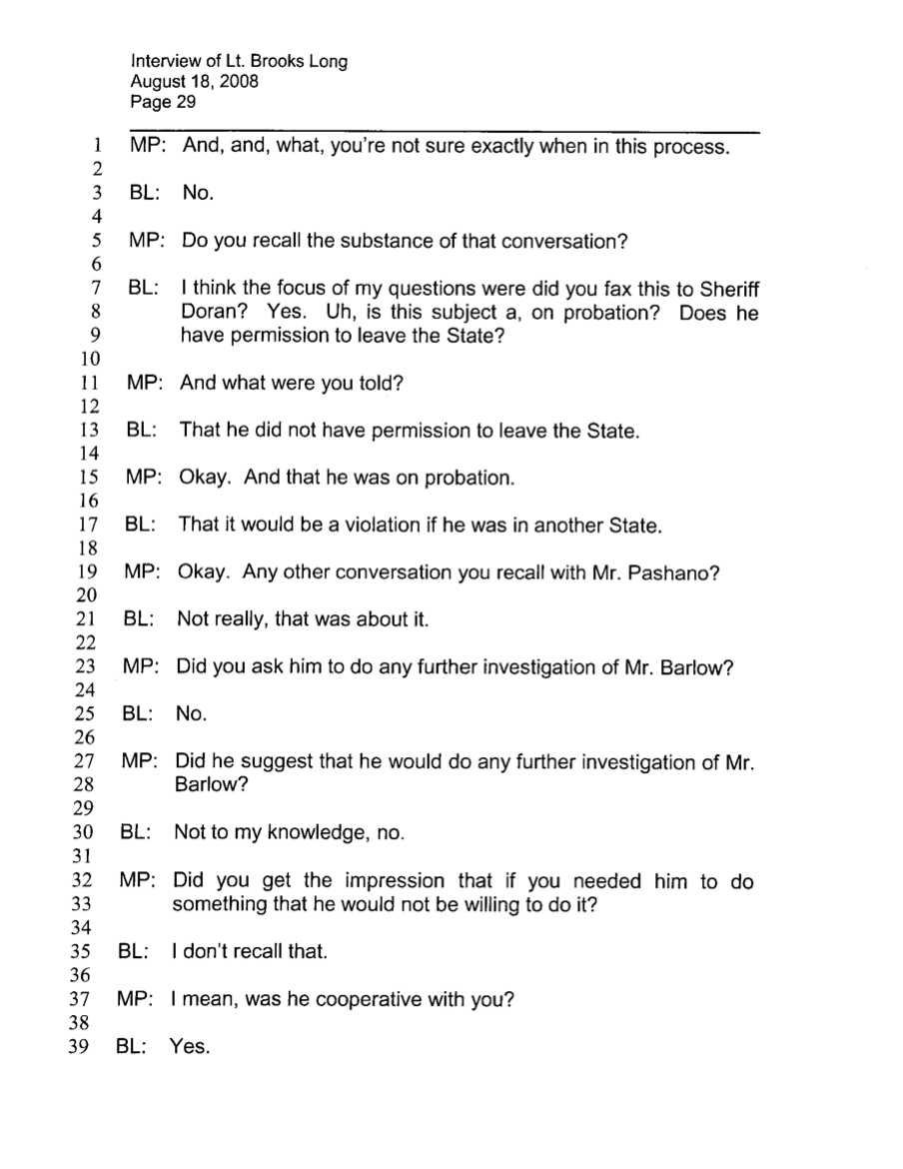

Slide 107
DANGEROUS
INDIVIDUAL
Not located on the premises!

Slide 108
HAD THE OFFICERS
Simply called the area code the alleged teenaged mother was calling from, they would have learned (first officer contacted in Colorado Springs told them):

Slide 109
The 16-year-old pregnant mother
Was in fact:
A 33-year-old,
Childless,
Single,
African American female,
Living in Colorado Springs!

Slide 110
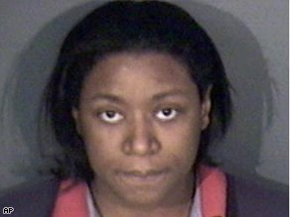
Rozita Swinton

Slide 111
PREVIOUSLY CONVICTED
Of “false reporting child abuse,” with current charges pending in that and some seven other jurisdictions (from Washington State to Florida).

Slide 112
INTERESTING FRANKS ISSUE
Were the officers being HONEST when they told the judge they wanted to search the ranch for one 16-year-old?
Could the officers have obtained a warrant if they had told the truth?

Slide 113
SUBJECTIVE vs OBJECTIVE
CAN COURT CONSIDER THE TRUE INTENTIONS OF THE OFFICERS?
WAS THIS HOTLINE TIP SIMPLY A “PRETEXT” TO GET ONTO THE RANCH?

Slide 114
Wren vs. U.S.
517 U.S. 806
[1996]
Supreme Court unanimously held:
With respect to the “motivations of individual officers,”
“subjective intentions play no role in ordinary, probable cause Fourth Amendment analysis.”

Slide 115
Arkansas vs. Sullivan
532 U.S. 769
(2001)
Supreme Court reiterates that it will “not entertain Fourth Amendment challenges based on the actual motivations of individual officers.”
“[a] traffic-violation arrest will not be rendered invalid by the fact that it was ‘a mere pretext for a narcotics search.”

Slide 116
FRANKS ISSUE
How could you ever determine whether an officer was lying, without looking at subjective intent?

Slide 117
HERRING ANALYSIS
How could you ever engage the Herring analysis to determine whether the officers acted deliberately or culpably, without looking to their subjective intent?

Slide 118
IF THEY WERE REALLY LOOKING FOR ONE 16-YEAR OLD GIRL…
WHY DID THEY NEED 150 ARMED OFFICERS?
WHY DID THEY NEED A TANK?
WHY DID THEY NEED HELICOPTERS?
WHY DID THEY NEED TO INTERROGATE ALL THE GIRLS BETWEEN 7 AND 17?
WHY DID THEY NEED BUSES TO REMOVE ONE 16-YEAR OLD?

Slide 120
LASTLY

Slide 121
IF THEY WERE REALLY ONLY LOOKING FOR ONE 16-YEAR OLD GIRL…
THEY HAD A PROBLEM.

Slide 122
AS 150 OFFICERS APPROACH THE MAIN GATE
THEY REALIZE FOR THE FIRST TIME IF THEY ARE REALLY LOOKING FOR ONE 16-YEAR-0LD GIRL…
PROBLEM

Slide 123
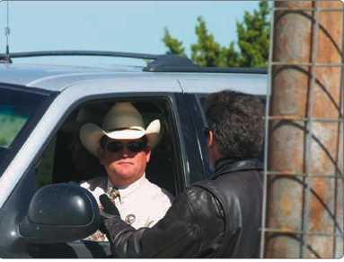

Slide 124
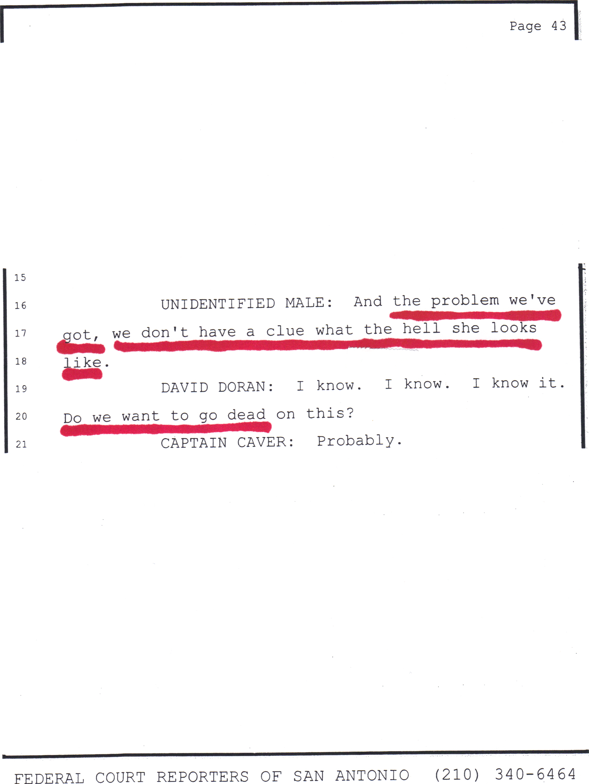


Slide 125
MOTION TO SUPPRESS
DENIED!

Slide 126
There are no national or state requirements for any type of certification or training standards. It is the responsibility of each individual police department or law enforcement agency to develop its own standards. This allows for the agencies to create as stringent or relaxed policies or standard operating procedures as the individual departments and agencies want to create. The problem with this situation is that smaller agencies may send officers to receive specialized narcotics-detection training, but there may be no follow up with retraining or recertification of the handler or the canine.
Generally, most canine officers, who are not trained by state or government agencies, receive their training from some sort of private training program. These schools can be very abbreviated in comparison to other governmental agencies. They give handlers "recommendations" as to how training and handling should be conducted and documented. Therefore, it is important to establish were a particular officer received his training.
Without adequate training and conditioning, a canine looses reliability quickly. For this reason, training should be maintained on a regular basis and documented properly. Proper training for the handler is also very important. As illustration of his importance, an experienced and well-trained handler is capable of cueing a response from the canine, even when no narcotics are present, however, a poorly trained and inadequately supervised handler will cue a response from the canine inadvertently, even when no narcotics are present.
The industry standard for a narcotics-detection canine alert proficiency should be a ninety percent detection rating. This is based on trials conducted and supervised by a third person where the handler goes into the scenario with no advance knowledge of the location of the training aids. All too often, handlers have to hide their own training narcotics. This improper technique will invalidate a proficiency trial, and therefore, if all training is conducted in that way, the narcotics-detection canine’s proficiency is unreliable.

