Slide 1
Bill of Rights: HBCA Criminal Law Conference
Concept SR-22 & Hidalgo County Bar Association
January 29, 2016

Slide 2
Government Surveillance, Cell Towers & K-9 Searches
Presented by:
Donald H. Flanary, III
Goldstein, Goldstein and Hilley

Slide 3



Slide 4
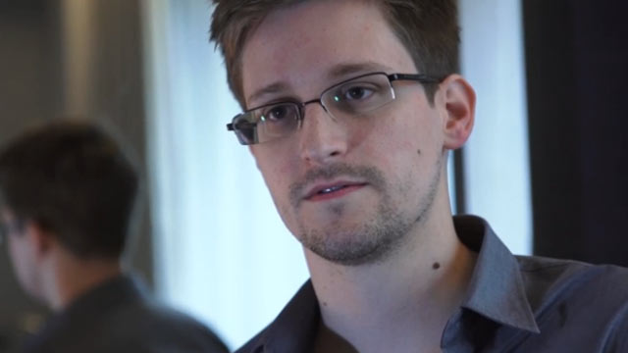
Edward Snowden: the whistleblower behind the NSA surveillance revelations
Guardian.co.uk – By: Glenn Greenwald, Ewan MacAskill, Laura Poltras – June 8, 2013
The individual responsible for one of the most significant leaks in US political history is Edward Snowden, a 29-year-old former technical assistant for the CIA and current employee of the defence contractor Booz Allen Hamilton. Snowden has been working at the National Security Agency for the last four years as an employee of various outside contractors, including Booz Allen and Dell.
He left the CIA in 2009 in order to take his first job working for a private contractor that assigned him to a functioning NSA facility, stationed on a military base in Japan. It was then, he said, that he "watched as Obama advanced the very policies that I thought would be reined in", and as a result, "I got hardened."
Over the next three years, he learned just how all-consuming the NSA's surveillance activities were, claiming "they are intent on making every conversation and every form of behaviour in the world known to them".

Slide 5


Slide 6
Revelations about NSA
“Snowden documents show NSA gathering
5 billion cell phone records daily”
“By cracking cell phone code, NSA has capacity for decoding private conversations”
“How the NSA is tracking people right now”

Slide 7
Revelations about NSA
“NSA infers relationships based on mobile location”
“NSA tracking cell phone locations worldwide, Snowden documents show”
“Cell phone data spying: It's not just the NSA”

Slide 8
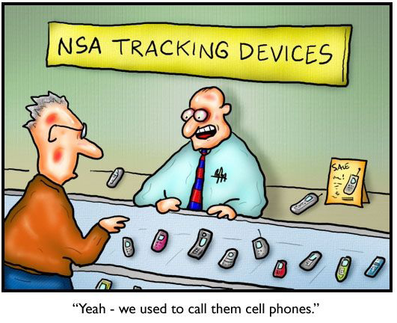

Slide 9
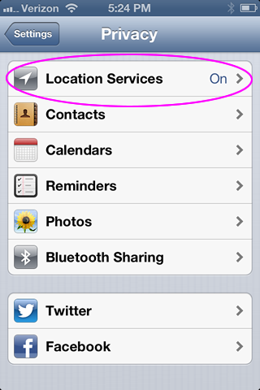
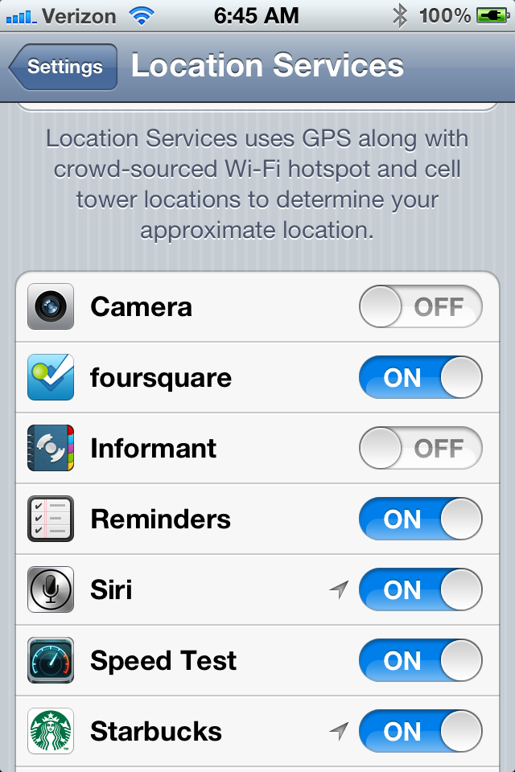
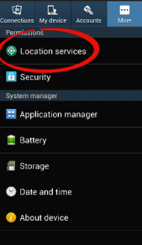
Who is locating YOU?

Slide 10
Is your cellphone always LISTENING to you?
In February 2015, CNN Reported that companies, clever hackers, and the GOVERNMENT have ways to turn on our cell phone microphones WITHOUT US KNOWING
Features like SIRI, OK GOOGLE, and even FACEBOOK use voice processing systems that are listening even when you didn’t turn on the microphone yourself
BUT THAT’S NOT ALL

Slide 11
Is your TEVLEVISON listening to you?
In the same report, CNN revealed that Internet-connected “Smart TVs” can eavesdrop on their owners
They don’t just listen, they can actually transmit everything they hear abut your life over the internet
Sometimes they even warn you without you realizing it

Slide 12
SAMSUNG’S ”PRIVACY” POLICY…
"Please be aware that if your spoken words include personal or other sensitive information, that information will be among the data captured and transmitted to a third party through your use of Voice Recognition."

Slide 13
Anything Else?
Newer vehicles have computers that record speed, steering wheel position, pedal pressure and other things insurance companies want to know about
Smart thermostats records your house’s temperature, ambient light and even nearby movement
Fitness trackers record your movements and some vital signs
Security cameras, recorders, drones, surveillance airplanes…

Slide 14
JUST CELL PHONE ISSUES
Warrantless Search of Cell Phones Incident to Arrest
Basics of Cell Phones & Evidence Collection
The Electronic Tracking Post Jones
Cell Phone Data and Records
Technologies Used by the Government to Collect Information

Slide 15
Cell Phone Statistics:
91% of the adult population now own some sort of mobile phone
In 2015 – 64% percent of American adults owned a smartphone
This statistic went up from 58% in early 2014

Slide 16
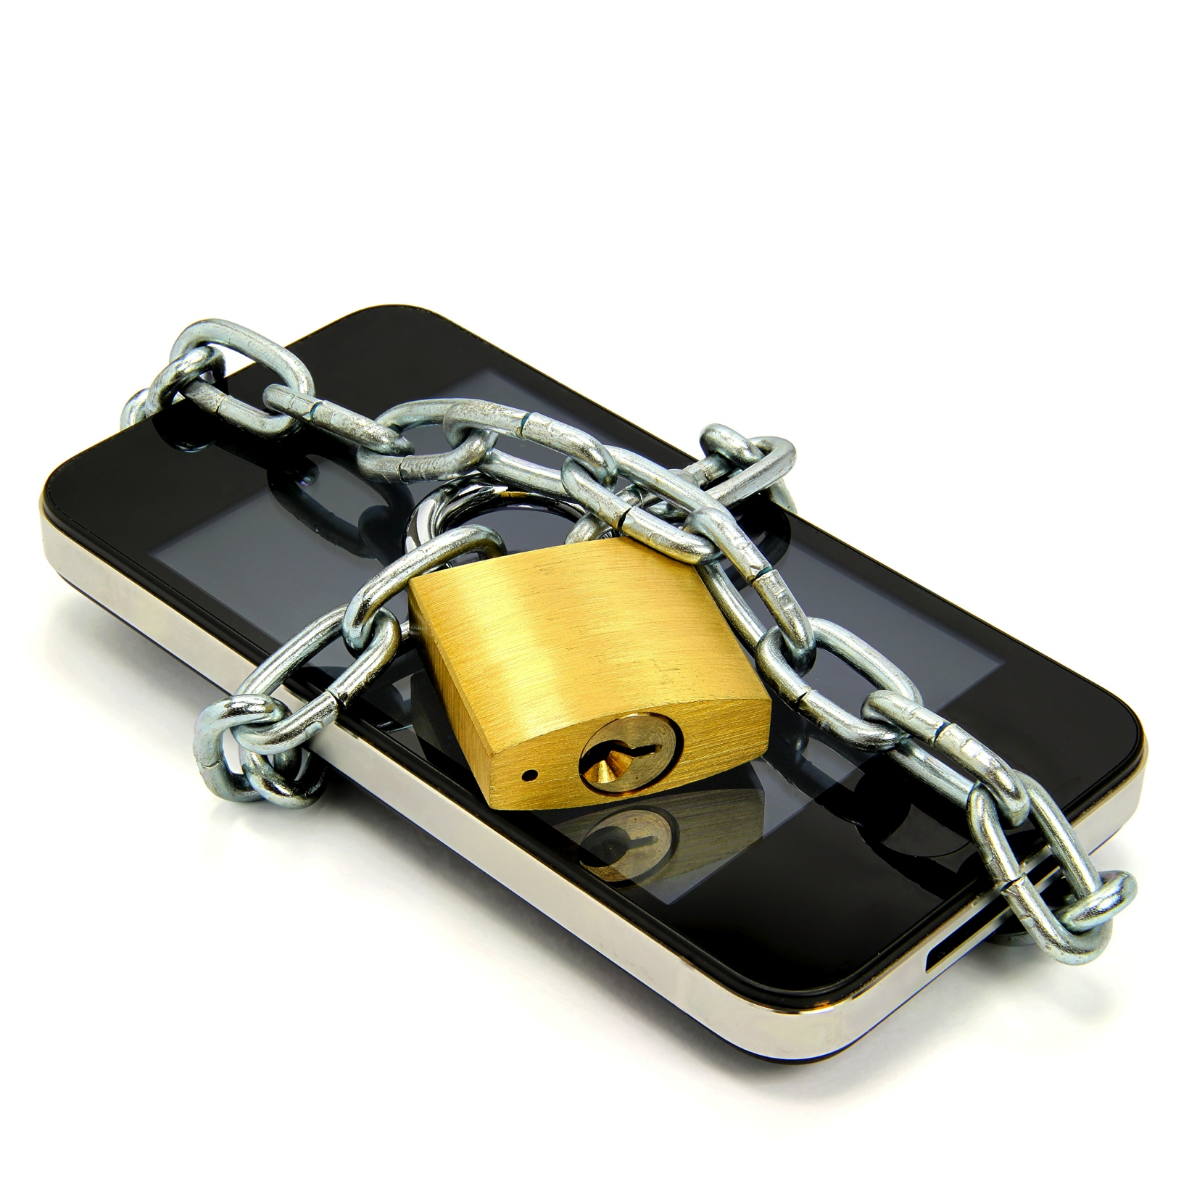
Only way to keep your cell phone safe:

Slide 17
Warrantless Search of Cell Phones Incident to Arrest
Constitutional Debate:
  Cell phone is a “Container”
vs
  Cell phone is a “mini-computer”
  18th Century concepts for 21st Century Technology

Slide 18
Back to the Basics - Search Incident to Arrest
Katz v. U.S. (1967)
  Search must be reasonable, meaning: pursuant to a warrant or an established exception
    Search incident to arrest
    Exigent circumstances
    Written policy on inventory
    Vehicle exception

Slide 19
Search Incident to Arrest
Chimel v. California (1969)
Police searched Chimel’s entire home incident to his arrest
Warrantless search incident to arrest is limited to:
  (1) the arrestees person
  (2) area under immediate control of arrestee.
    Meaning “the area from within which he might gain possession of a weapon or destructible device”

Slide 20
Search Incident to Arrest
U.S. v. Robinson (1973)
Police searched pack of cigarettes found in breast pocket of arrestee’s jacket
  Two permitted searches of “areas”:
    Search “of the person”
    Search of “the area within control of arrestee”

Slide 21
Search Incident to Arrest
U.S. v. Edwards (1974)
Police examined clothing to see if paint from crime scene was present. Because it was late and he had no other clothes to wear they searched the next morning.
  Search of “both person and property in his immediate possession may be searched at the station house after arrest has occurred at another place”

Slide 22
Search Incident to Arrest
U.S. v. Chadwick (1977)
Agents searched a footlocker found in a trunk 90 minutes after arrest and at the station
  A closed container in immediate control of arrestee is different than the clothing of the arrestee
  If search of container is remote in time or place of arrest or exigency then there is no exception to the warrant requirement
  “Repository of personal effects”

Slide 23
Search Incident to Arrest
U.S. v. Chadwick (1977)
Since the locker was not part of Chadwick’s “person” when arrested,
Then a warrantless search is not reasonable if no danger arrestee could access property to get a weapon or destroy evidence.

Slide 24
Search Incident to Arrest
Clothing in Robinson and Edwards are considered to be part of “arrestee’s person”
Distinguishably different from the closed container in the “area within immediate control of arrestee” as in Chadwick

Slide 25
Search Incident to Arrest
New York v. Belton (1981)
  “Area within immediate control of arrestee” can be searched incident to arrest, including passenger compartments
  This includes “containers” in the passenger compartments within reach regardless of whether it could actually hold a weapon or evidence of crime under investigation
  “Container” is any object capable of holding another object

Slide 26
Search Incident to Arrest
Arizona v. Gant (2009)
Limited Belton
  Search of a car incident to arrest unauthorized “after the arrestee has been secured and cannot access the interior of the vehicle”

Slide 27
Cell Phone Search Incident to Arrest
The debate hinges on whether a cell phone is:
  a container immediately associated with the person
    Like a cigarette pack in Robinson or clothing in Edwards
  Or
  an item not associated with the person, but an item within a person’s immediate control
    Like a footlocker in Chadwick

Slide 28
United States v. Wurie
Riley v. California
134 S. Ct. 2473 (2014)
Supreme Court unanimously ruled that the search incident to arrest exception does NOT extend to a cell phone and that police need to get a search warrant in order to search an arrestee's phone after arrest

Slide 29
Riley and Wurie
In Wurie, the United States appealed the judgment of the First Circuit which suppressed evidence from the cell phone of the defendant
In Riley, the defendant appealed the judgment of the California Court of Appeals which affirmed his conviction.

Slide 30
Riley and Wurie
In both cases, the contents of the defendants' cell phones were searched after they were arrested and evidence obtained from the cell phones was used to charge the defendants with additional offenses.
While the officers could examine the phones' physical aspects to ensure that the phones would not be used as weapons, digital data stored on the phones could not itself be used as a weapon to harm the arresting officers or to effectuate the defendants' escape.

Slide 31
Riley and Wurie
Further, the potential for destruction of evidence by remote wiping or data encryption was not shown to be prevalent and could be countered by disabling the phones.
Moreover, the immense storage capacity of modern cell phones implicated privacy concerns with regard to the extent of information which could be accessed on the phones.

Slide 32
Cell Phone searches in Texas

Slide 33
State v. Granville,
423 S.W.3d 399 (Tex Crim App 2014)
Defendant arrested at a school for disorderly conduct.
Defendant’s cell phone was searched and then charged with “improper photography”
Cell phone was in the property room and accessed by police
Most logical and outspoken rejection of Finley

Slide 34
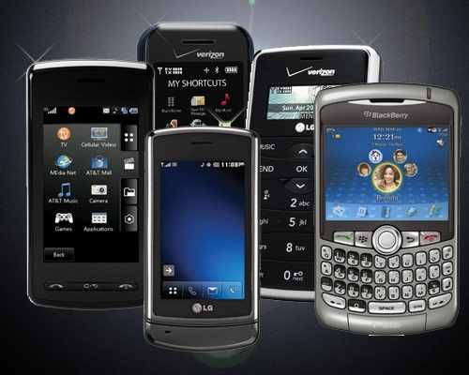

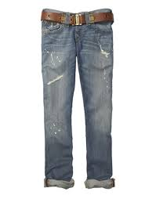
State v. Granville
“We reject [the State’s] argument that a modern-day cell phone is like a pair of pants or a bag of groceries, for which a person loses all privacy protection once it is checked into a jail property room.”

Slide 35
State v. Granville
“A cell phone is unlike other containers as it can receive, store, and transmit an almost unlimited amount of private information.”
“The potential for invasion of privacy, identify theft, or at a minimum, public embarrassment is enormous.”

Slide 36
State v. Granville
“Searching a person’s cell phone is like searching his home desk, computer, bank vault, and medicine cabinet all at once. There is no doubt that the Fourth Amendment protects the subjective and reasonable privacy interest of citizens in their homes and in their personal ‘papers and effects.’”

Slide 37
State v. Granville
Citizens do not lose their “expectation of privacy in the contents of [their] cell phone merely because [they have] been arrested and [their] cell phone is in the custody of police for safekeeping.”
The officer “could have seized appellant’s phone and held it while he sought a search warrant, but, even with probable cause, he could not ‘activate and search the contents of an inventoried cellular phone’ without one.”

Slide 38
Other Electronic Devices
Cell phones
Laptops
Tablets
USB drives
Digital Cameras
Smart Tv’s
Fitness Trackers

Slide 39
Nuts and Bolts of Cell Phones
The first mobile phone came out in 1973 - 30 minute battery life, charge time 10 hours
Today, battery life can exceed 15 hours with under an hour charging time

Slide 40
Nuts and Bolts of Cell Phones
“A modern cell phone is a computer” Judge Posner. U.S. v. Lopez, 670 F.3d 803 (7th Cir. 2012)
Modern Cell phones:
  send and receive text messages
  emails,
  photos and video
  access the Internet
  play games,
  Play and store music,
  Act as GPS device
  Run any of the 375,000 apps

Slide 41
Basic Cell Phone Location
Technology
Sophisticated radios
That connect to a cellular network
That accesses a public telephone network.

Slide 42
WHAT IS A CELL?
In typical analog cell phone system, each carrier receives 800 frequencies to use across city
carrier chops the city into the cells
Each cell is thought of as hexagons on a big hexagonal grids

Slide 43
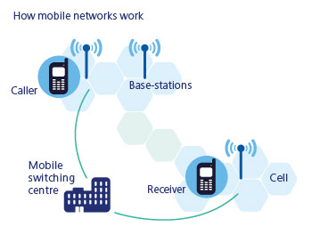
WHAT IS A CELL?

Slide 44
WHAT IS A CELL?
Typically sized at about 10 square miles(26 kilometers)
Each cell has base station consisting of tower and radio equipment
Different cells (non-adjacent )can use the same set of frequencies

Slide 45
The Core Idea: Cellular Concept
The cellular concept: multiple lower-power base stations that service mobile users within their coverage area and
handoff users to neighboring base stations as users move.
Together base stations tessellate the system coverage area.

Slide 46
3 Core Principles
Small cells tessellate overall coverage area.
Users handoff as they move from one cell to another.
Frequency reuse.

Slide 47
Tessellation (Cont’d)
Three regular polygons that always tessellate:
  Equilateral triangle
  Square
  Regular Hexagon
Triangles
Squares
Hexagons

Slide 48
Circles Don’t Tessellate
Thus, ideally base stations have identical, circular coverage areas.
Problem: Circles do not tessellate.
The most circular of the regular polygons that tessellate is the hexagon.
Thus, early researchers started using hexagons to represent the coverage area of a base station, i.e., a cell.

Slide 49
Thus the Name Cellular
With hexagonal coverage area, a cellular network is drawn as:
Since the network resembles cells from a honeycomb, the name cellular was used to describe the resulting mobile telephone network.
Base
Station

Slide 50
Handoffs
A crucial component of the cellular concept is the notion of handoffs.
Mobile phone users are by definition mobile, i.e., they move around while using the phone.
Thus, the network should be able to give them continuous access as they move.
This is not a problem when users move within the same cell.
When they move from one cell to another, a handoff is needed.

Slide 51
A Handoff (Cont’d)
At some point, the user’s signal is weak enough at B₁ and strong enough at B₂ for a handoff to occur.
Specifically, messages are exchanged between the user, B₁, and B₂ so that communication to/from the user is transferred from B₁ to B₂.

Slide 52
Example of Frequency Reuse
Cells using the same frequencies

Slide 53
Directional Antenna
One way to get more capacity (number of users) while maintaining cell size is to use directional antenna.
Assume antenna which radiates not in all directions (360 degrees) but rather in 120 degrees only.

Slide 54
Directional Antenna at Base Station
With 120 degree antenna, we draw the cells as:

Slide 55
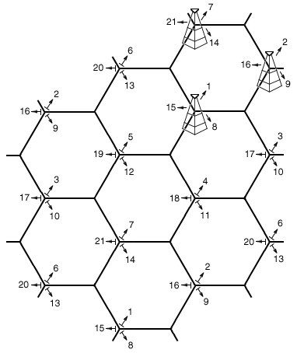
Cellular Network with Directional Antennas

Slide 56
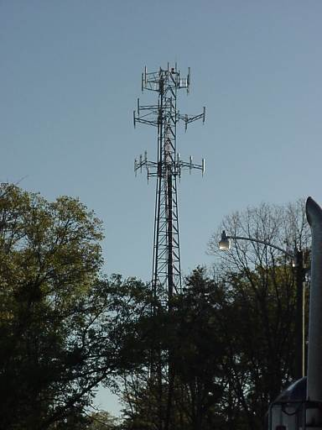
120 Degree Antenna Towers

Slide 57
CELL PHONE CODES
All cell phones have special codes associated with them
Service identification code (SID): 5 digit code assigned to each carrier
Electronic serial number (ESN): 32 bit code programmed into phone by manufacturer
Mobile identification number (MIN): 10 digit derived from phone’s number

Slide 58
PURPOSE OF CODES
Let we switch on the phone, then what happens?
It listen for SID on control channel (special frequencies)
“no service” message displayed
Comparison of SID on control channel with the one programmed in phone.
MTSO keeps track of phone’s location in database

Slide 59
Cell Phones as Tracking Devices
Cell phones can used to track location:
  “historically”
    Or
  in “Real Time”
Cell phones can give
  general location (by locating transmitting tower)
  specific location (by intercepting GPS function)

Slide 60
Areas of Concern
Line of sight
Geography
Weather
Traffic and usage
Scheduled/unscheduled maintenance
An other things recommend by expert

Slide 82
The Electronic Tracking Post-Jones
Cell phones are similar to GPS devices but,
Only GPS addressed in Jones

Slide 83
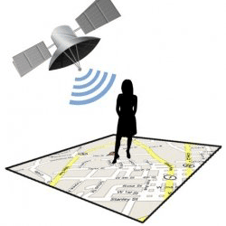
U.S. v. Jones,
132 S.Ct. 645 (2012)
Placing a GPS device on a vehicle and using it to track a vehicle’s movement constitutes a search for 4th Amendment purposes.
Agents obtained a warrant to placed a GPS device on Jones’ Jeep during a drug investigation. However, Agents placed the GPS on the vehicle beyond the timing that the warrant allowed.

Slide 84
U.S. v. Jones, 132 S.Ct. 645 (2012)
Decision based on 18th century law of Trespass
Although a unanimous decision, 5-4 split on whether it is a violation as a trespass on property or a violation of expectation of privacy
Access to factory installed or cell phone GPS was not addressed in Jones (Sotomayor concurring)
Alito addresses Reasonable Expectation of Privacy and GPS

Slide 85
Cell Phone Data and Records
Cell Phones as Tracking Devices
The Stored Communications Act
    Cellular Site Location Information (CSLI)
    Millions of Subpoena Requests by Law Enforcement

Slide 86
Cell Site Location Information (CSLI)
Each time your phone registers with a cell site (i.e., cell tower), “the service provider automatically captures and retains certain information about the communication, including identification of the specific cell site and sector through which the connection is made.”
  United States v. Graham, 796 F.3d 332, 343 (4th Cir.), reh’g en banc granted, opinion vacated, Nos. 12–4659 (L), 12–4825, 2015 WL 6531272 (4th Cir. Oct. 28, 2015)
This data (CSLI) allows law enforcement to ”interpolate the path the cell phone, and the person carrying the phone, traveled during a given period of time.” Id.

Slide 87
Cell Site Location Information (CSLI)
The issue before the courts is whether the Fourth Amendment requires a warrant based upon probable cause before the government an acquire a subscriber’s CSLI, a record created and maintained by the service provider

Slide 88
Cell Site Location Information (CSLI)
To Date, the 3rd, 4th, 5th, 7th & 11th Circuit Court of Appeal have taken the issue
  The 3rd, 5th and 11th Circuits permit the warrantless collection of CSLI;
  The 4th Circuit is pending a rehearing en banc after holding in favor requiring a warrant; and
  The 7th Circuit refused to decide the matter after realizing the subscriber waived his Fourth Amendment claim

Slide 89
Cell Phones as Tracking Devices
Triangulation
New phones are GPS devices

Slide 90
Triangulation
Since phones connect to multiple towers, signal strength is analyzed and the distance from each tower is estimated.
The more towers the phone is connected to, the better the estimation.
This method cannot exactly pinpoint where a phone is, but is accurate enough to narrow it down to an area the size of an average neighborhood.
REAL time or Historic

Slide 91
GPS
Wireless service providers are required by law to have the capability to estimate position within 328 feet.
These devices offer much higher levels of accuracy. In principle, they work on the premise of triangulation.
Devices receives signals from 12 or more satellites in low-Earth orbit. These phones have software that runs in the background, unknown to the user, that gives the provider accurate readings on the customer's whereabouts.
Only REAL time, not Historic (that we know of)

Slide 92
Four Categories of Electronic Surveillance
(1) wiretaps, which are authorized pursuant to 18 U.S.C. §§ 2510-2522, upon what could be called a “probable cause plus” showing;
(2) tracking devices, which are authorized pursuant to 18 U.S.C. § 3117, upon a Rule 41 probable cause showing;
(3) stored communications and subscriber records, which are authorized pursuant to the Stored Communication Act (SCA) upon a showing of specific and articulable facts showing that there are reasonable grounds to believe that the information sought is relevant and material to an ongoing criminal investigation; and
(4) pen registers and trap and trace devices authorized pursuant to the pen register statute (PRS), upon the government’s certification that the information sought is relevant and material to an ongoing criminal investigation

Slide 93
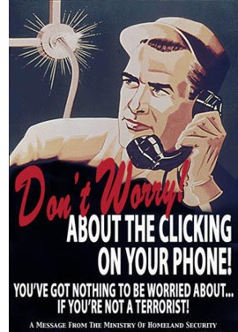

Slide 94
Different Standards for Different Data
Intercepted real time electronic communications (Title III Wiretap, “super-warrants”):
18 U.S.C. § 2510-2522 requiring probable cause to believe that a crime has been, is being, or is about to be committed; that communication is relevant to the crime; that normal investigation procedures have been tried, but failed; and the location of communication is connected to the crime.

Slide 95
Different Standards for Different Data
Tracking Device installed GPS devices and Beepers
Magistrate must issue the warrant if there is probable cause to search for and seize a person or property or to install and use a tracking device. Rule 41, Fed Rules Crim. Pro.

Slide 96
Different Standards for Different Data
Stored communications and subscriber or customer account records (Billing records and ID information as well as Historic Cell Location information):
Subpoena requiring an application to a Federal Court including specific and articulable facts showing reasonable grounds for relevancy and materiality to ongoing investigation. 18 USC 2703(d) “Stored Communications Act”

Slide 97








Third Party Records

Slide 98
Third Party Records
BIG QUESTIONS!
Content of stored communication rather than subscriber or billing records
i.e. – Your Emails and Texts
Not just the date and time of transmission.
U.S. v. Miller, 425 U.S. 436 (1976) says no expectation of privacy in Third Party Records
  i.e.: Bank Records, etc.

Slide 99
Different Standards for Different Data
Pen register and trap and trace device (incoming and outgoing numbers, data sent and received): Court order requiring an application to a Federal Court showing that the information to be obtained is likely to be “relevant to an ongoing criminal investigation” 18 USC 3122(b)(2)

Slide 100
In Re U.S. for Historical Cell Cite Data,
724 F. 3d 600 (5th Cir. 2013)
The Court found that because cell providers collect and store CSLI for its own business purposes, CSLI is clearly a business record
The Court speculated the government does not mandate or persuade providers to collect and store CSLI
The Court also applied the Third Party Doctrine to hold subscribers do not have a reasonable expectation of privacy

Slide 101
United States v. Guerrero –
768 F. 3d 351 (5th Cir. 2014)
The 5th Circuit addressed whether suppression was warranted since the government collected CSLI with a state subpoena rather than a 2703(d) order.
The Court found there was a clear violation of the Act, but the SCA does not provide for suppression
Thus, the appellant was required to show a Fourth Amendment violation
But, since the precedent already decided the warrantless collection of CSLI does not implicate the Fourth Amendment, the evidence was held properly admitted

Slide 102
The Warrantless Collection of CSLI in Texas
Ford v. State, No. PD-1396-14, WL 8957647 (Tex. Crim. App. Dec. 16, 2015)
While noting the apparent circuit split, it side with the 5th and 11th Circuits and held that the Third Party Doctrine dictates CSLI is “a record that the ‘provider has already created’ – [and therefore] is not subject to a reasonable expectation of privacy that implicates the Fourth Amendment”

Slide 103
Technologies Used by the Gov to Collect Information
Cell Phone Software Extractors
Stingray and Kingfish Cell Phone Tracking Devices
Government Software/Internet Surveillance Programs

Slide 104
Cell Phone Software Extractors
“Extraction Devices” download personal information from cell phones,
  including contacts
  videos
  GPS data
  pictures
“The handheld machines have various interfaces to work with different models and can even bypass security passwords and access some information,”

Slide 105
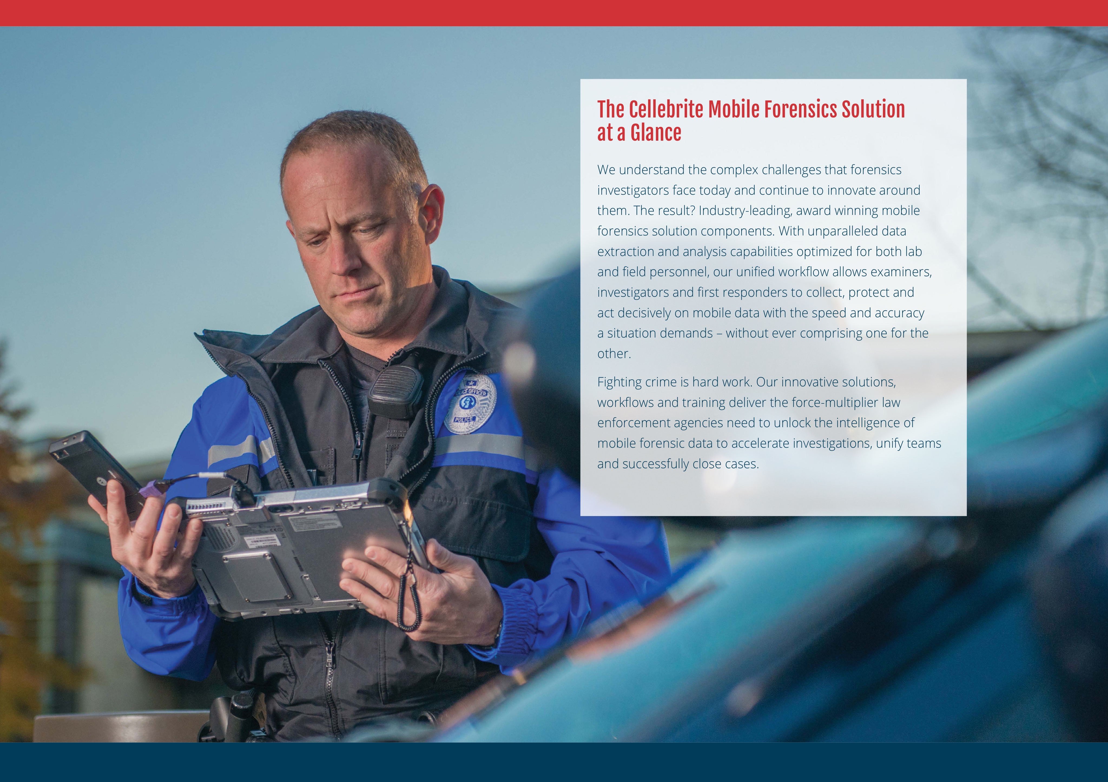

Slide 106
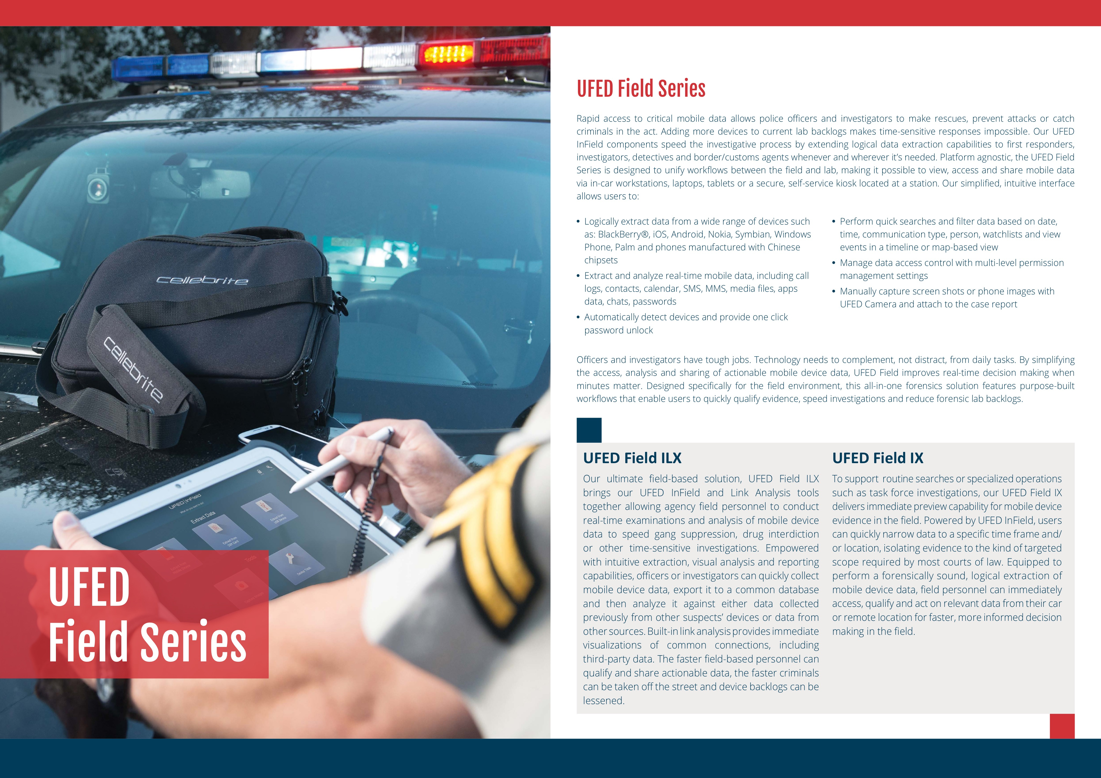

Slide 107
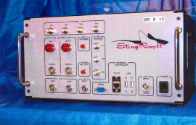
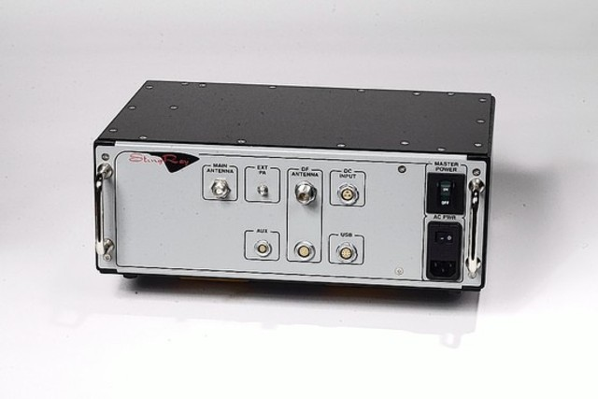
Stingray and Kingfish Cell Phone Tracking Devices

Slide 108
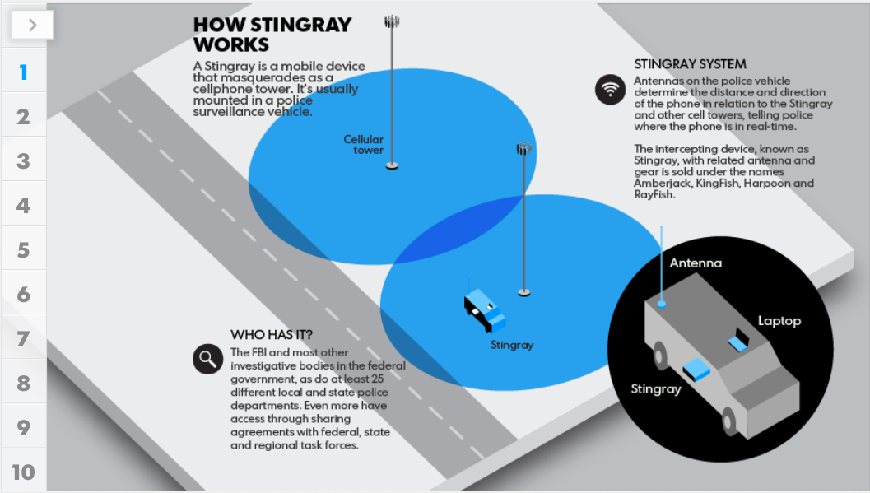

Slide 109
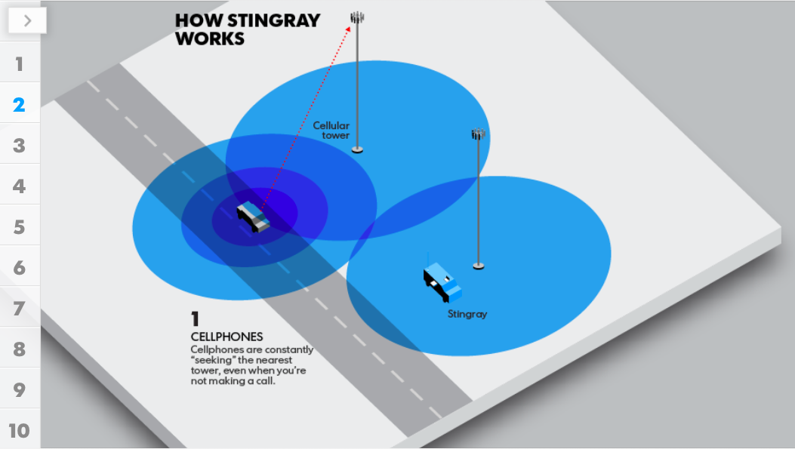

Slide 110
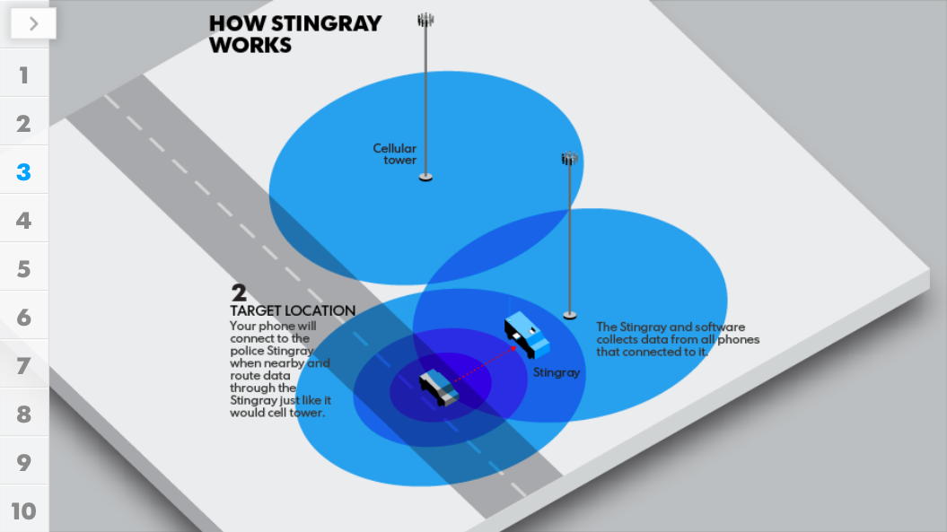

Slide 111
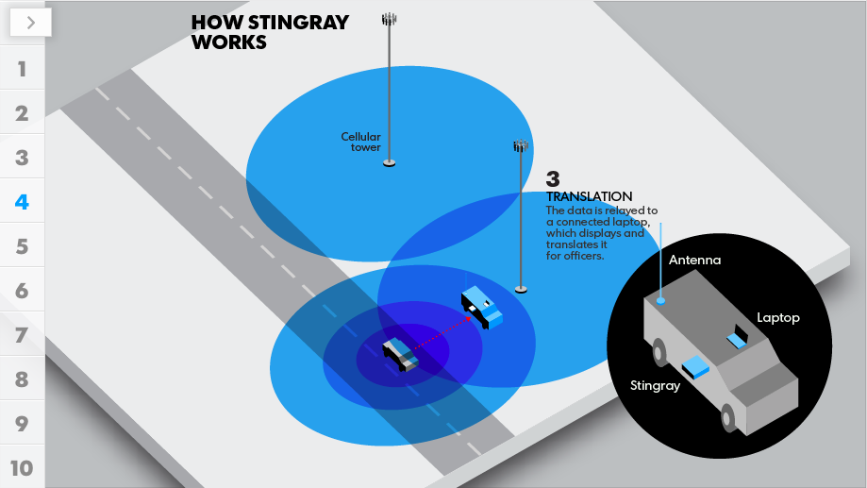

Slide 112
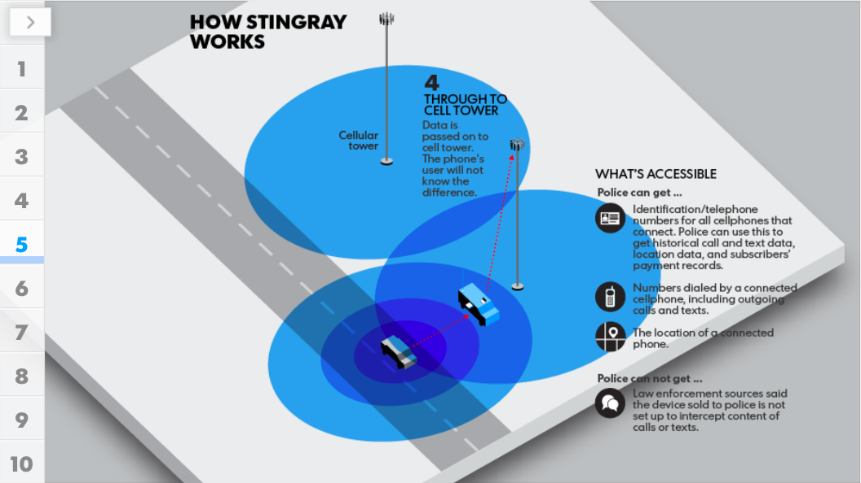

Slide 113
NEW POLICY FOR USING STINGRAYS
The Department of Justice took the first step in addressing privacy concerns relating to Stingrays in September of 2015
The DOJ issued a new policy requiring federal agents to get a search warrant before they deploy a Stingray in almost all situations

Slide 114
NEW POLICY FOR USING STINGRAYS
The new policy also prohibits federal agents from collecting actual data from cellphones; reading emails or texts; or getting GPS coordinates
Although this is a good first step, the rule does not apply to various state and local police departments that receive federal funds for this type of technology

Slide 115
Carrier IQ
Carrier IQ is a program for mobile devices that records every keystroke and every piece of data that comes in or out of your device.
The data is sent back to Carrier IQ’s servers.
The program cannot be turned off and is very hard to track.
It is believed to be used on HTC, Android and Blackberry phones. There is some evidence that it exists on Apple products as well.
AT&T confirms that it uses the software while Verizon and Nokia deny that it exists on there phones.

Slide 116
Carrier IQ
The rational is that the information collected will help the device manufacturers and software developers create better products and services for the consumer.
Problem: Can the government access this information?
We could see class-action litigation over these issues.
Source: http://www.washingtonpost.com/business/technology/what-is-carrier-iq/2011/12/01/gIQApql1GO_story.html

Slide 117
Things to Remember
Cell site location information can be a helpful tool in determining the location of a defendant.
There are strengths and weaknesses of the technology of which you should be aware.
Where necessary consult an expert.

Slide 118
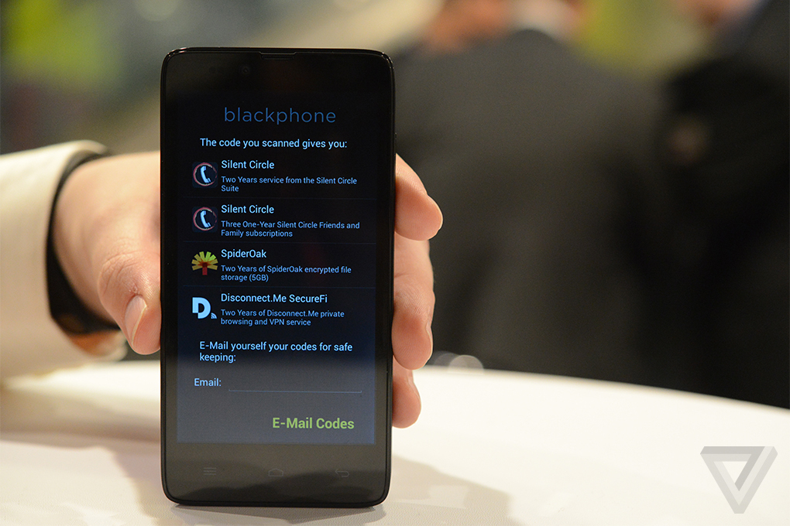
Get a Blackphone!

Slide 119
ABA Journal
Tools for Lawyers worried that NSA is Eavesdropping on their Confidential Conversations
www.abajournal.com
Posted Mar 30, 2014 12:44 PM CDT By Victor Li

Slide 120
Blackphone
“For lawyers worried about talking on the phone, their prayers could be answered in June when Spanish smartphone company GeeksPhone and software company Silent Circle launch Blackphone, an encrypted smartphone that protects phone calls, text messages, emails and Internet browsing. Using VPN technology, Blackphone promises to be an NSA-resistant phone.”

Slide 121
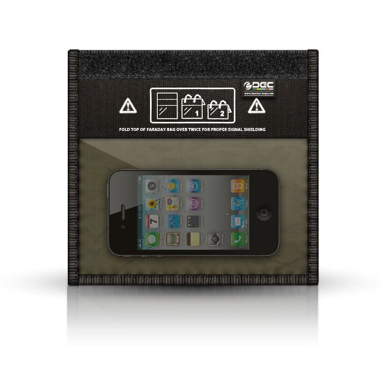
Get a Faraday Bag
(Radio wave sheild)

Slide 122
K-9 SEARCHES

Slide 123
The war on DRUGS?
For over 30 years, the US has been fighting the “war on drugs”
One of the many tools in the government’s arsenal in its efforts to interdict drug trafficking has been the use of narcotics-detection dogs

Slide 124
United States v Place – 462 U.S. 696 (1983)
The Supreme Court ruled that exposure of luggage to a trained narcotics detection dog is not a “search” under the Fourth Amendment

Slide 125
Illinois v. Caballes – 543 U.S. 405 (2005)
The Supreme Court clarified that where a “lawful” traffic stop does not extend beyond the time necessary to issue a ticket or conduct inquires that are instant to the stop, another officer’s arrival and use of a narcotics detection dog to sniff around the exterior of the vehicle is not a Fourth Amendment violation
BUT…

Slide 126
Rodriguez v. United States – 135 S. Ct 1609 (2015)
The Supreme Court held that the Fourth Amendment IS violated when the police extend an otherwise-completed traffic stop beyond the time reasonably required to issue a ticket for that offense.

Slide 127
Rodriguez v. United States – 135 S. Ct 1609 (2015)
Petitioner was stopped by a K-9 officer for a traffic violation
The Officer issued Petitioner and warning and asked for consent to search his vehicle
Petitioner refused consent, and the officer instructed him to wait outside the vehicle for another officer to arrive as backup

Slide 128
Rodriguez v. United States – 135 S. Ct 1609 (2015)
Another officer arrived on scene within 7 to 8 minutes and the K-9 was retrieved
The K-9 alerted almost immediately
The majority held that the question to ask is no when the officer issued the warning or ticket, but whether the dog sniff “prolonged the stop”
The Court ruled that Rodriguez’s prolonged stop violated the Fourth Amendment

Slide 129
Rodriguez v. United States – 135 S. Ct 1609 (2015)
Texas largely follows the precedent set by Cabellas and its progeny by holding that if a lawful traffic stop does not extend beyond the time necessary to conduct ordinary inquiries related to the stop and issue a ticket, a canine sniff is not a constitutional violation;
Texas Courts have also held that any unreasonable extension of time awaiting the arrival of a narcotics detection dog is in violation of the Fourth Amendment

Slide 130
Trespass on Curtilage by a K9 Team can Constitute a Search
In Florida v. Jardines, 133 S. Ct. 1409 (2013), Justice Scalia held that
  1 – Police use of a drug-sniffing dog on the front porch of a home, to investigate an unverified tip that marijuana was being grown in the home, was a trespassory invasion of the curtilage which consituted a ”search” under the Fourth Amendment; and
  2 – The officers lacked an implied license for the physical invasion of the curtilage

Slide 131
Florida v. Jardines, 133 S. Ct. 1409 (2013)
Using the logic the Court used to decide the Jones case involving the government’s trespass on a vehicle to place a GPS device, the Court rendered Jardines on the same concepts of 18th Century trespass law

Slide 132
Totality of the Circumstances
Florida v. Harris, 133 S. Ct. 1050 (2013)
The Supreme Court rejected the Florida Supreme Court’s approach of “creating a strict evidentiary checklist to assess a drug-detection dog’s reliability” and made it clear that the more appropriate test is “Totality of the Circumstances”

Slide 133
Florida v. Harris, 133 S. Ct. 1050 (2013)
No matter how much other proof the State offers of the dog’s reliability, the absent field performance records will preclude a finding of probable cause

Slide 134
How do you Litigate a Dog Sniff Case?
In order to evaluate a narcotics detection dog sniff case, you MUST pay great attention to the actions surrounding the detection…

Slide 135
Focus On-
1 – The actions of the “drug detection team;”
2 – The Alert Itself; and
3 – The reliability of the canine
It is very important to remember the drug detection team includes the handler as well!!

Slide 136
Top 10 Things to Look for on a K-9 Video
1. The actual response of the dog sitting is way over rated. It is the actions of the handler and canine in the 10 - 20 seconds before that which are important.

Slide 137
Top 10 Things to Look for on a K-9 Video
2. The canine should be showing "active sniffing behavior" and not just following along with the handler’s hand presentations.

Slide 138
Top 10 Things to Look for on a K-9 Video
3. The canine should be exploring and curious about areas other than the specific spots that the handler points out to it.

Slide 139
Top 10 Things to Look for on a K-9 Video
4. The canine should not be looking at the handler constantly. This is a sign of a very dependent and unreliable canine. This is also an indication of a canine looking for some sort of "cue" from the handler about where he is expected to respond.

Slide 140
Top 10 Things to Look for on a K-9 Video
5. Fluid motions of the handler. The handlers should keep moving without stuttering their step or hesitating when the canine is showing an interest in an area. Those actions on the part of the handler will become cues to the canine and cause a false or incarnate response.

Slide 141
Top 10 Things to Look for on a K-9 Video
6. Handlers should not do a “tap back.” This is going back to an area where a canine has already checked and making them do it again. The canine will take this as a cue and respond even if nothing is there.

Slide 142
Top 10 Things to Look for on a K-9 Video
7. The canine should be working almost independently of the handler and not actively paying much attention to him/her, other than checking the presentation areas on occasion. A good canine needs little or no presentations from the handler. Handlers are merely portable toy or food dispensers for when the canine does right.

Slide 143
Top 10 Things to Look for on a K-9 Video
8. Once a canine responds, it should become a statue until it is given its reward. If a canine is seen to respond or “sit”, and then immediately get back up again, then this is a false response or a sign that the canine is weak in its task.

Slide 144
Top 10 Things to Look for on a K-9 Video
9. If a canine does not get its reward in a timely manner, within 1 - 3 seconds, a good one will go back, sniff again and respond again and start getting antsy. A weak canine will get up and walk off.

Slide 145
Top 10 Things to Look for on a K-9 Video
10. The handler should believe the canine the first time, whether it is a response or not. If the canine responds and the handler has it check that area again, then rewards the response, this is a sign of a weak or poor handler that does not know how to read or trust his canine.

Slide 146
Top 10 Things to Look for on a K-9 Video
11. (One More) Wind direction is CRITICAL!!! Odor from drugs or whatever the dog is trained to find is heaver than air and will drop in low wind currents.
Likewise, the odors will follow the wind currents.

Slide 147

The End
For more information:
www.ggandh.com/presentations-lectures/

