Slide 1
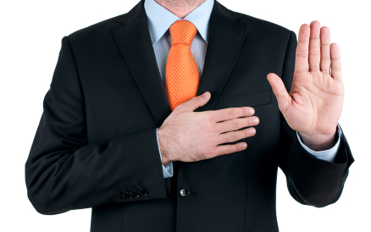
Preparing for Testimony
Texas Association of Licensed Investigators
October 20, 2016
Presented by:
Don Flanary
Goldstein Goldstein and Hilley

Slide 2

I’m here to Help You

Slide 3


Slide 4

Be Prepared
Know your case!!!
Don’t use notes
Use reports only if you are interpreting or explaining technical data

Slide 5


Slide 6
A trial is a STORY about EMOTIONS
The reason why good BOOKS, PLAYS, SONGS and MOVIES are successful
  Because they tell as STORY
People naturally follow STORIES
  Because they are EMOTIONALLY TRUE

Slide 7
People think in Stories
Jury’s employ storytelling as the primary means of interpreting evidence and reaching a verdict
They look for
  familiar themes
  Stereotypes
  Patterns

Slide 8
“Trials are storytelling, nothing more… The problem is that lawyers have forgotten how to speak to ordinary folks… Lawyers long ago abandoned ordinary English.”
-Gerry Spence

Slide 9
The Jury is your only SAVIOR
The jury will only rescue your client if they have an emotional bond with your client
The jury will only form the emotional bond if they trust you to tell a true story
They will only trust you if you are totally honest with them

Slide 10

Know your Audience

Slide 11
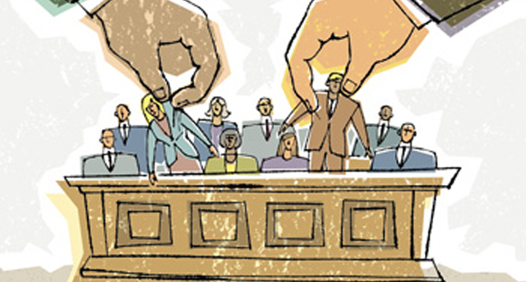
What is Voir Dire?

Slide 12

Help with JURY SELECTION
The lawyer needs HELP!
Who do you want on the Jury?
Who do you NOT want on the Jury?

Slide 13

Watch out for the BAD ONES

Slide 14
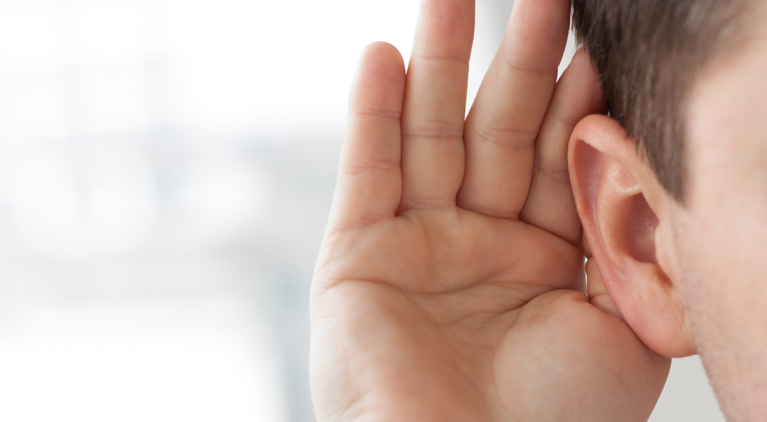
Find the GOOD ONES

Slide 15
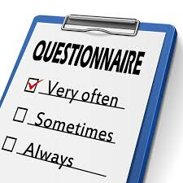
Help create a Questionnaire

Slide 16
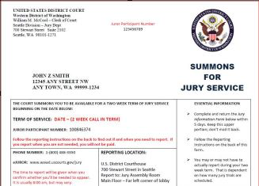
READ the JURY FORMS Closely
Lots of great info!!!

Slide 17
Jury Selection Apps
Juror
Jury Tracker
Jury Strike
iJury
Help manage information quickly
Works on iPad
Some work on android systems

Slide 18

The Trial is Story
The Court room is a Theater
All the world is a stage

Slide 19

The Lawyer is the Director
A good lawyer is a Good Director

Slide 20
Witnesses are Characters
Good Guys vs. Bad Buys
Your client is the Protagonist
Your job is to Support the Story

Slide 21
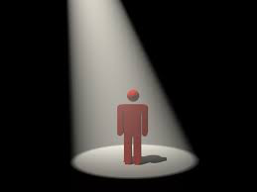
Direct Examination
Be a good character
Play your role

Slide 22


Slide 23


Slide 24


Slide 25

Don’t talk like Cop
Be yourself
Don’t be a know it all

Slide 26
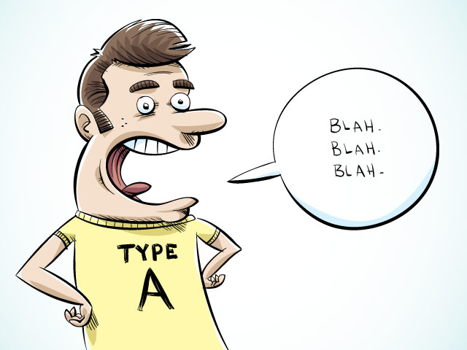
Be Humble
Don’t be a know it all

Slide 27

Tell Your Story
Be emotionally honest
Tell the emotional truth
It if feels right it is right

Slide 28

Who are you?
What’s your background?
Why should like you?
Why should we trust you?

Slide 29

Share Something
Share something that humanizes you
Let the jury relate to you

Slide 30

Tell a Story About the case
Present the case in story from, not offense report narrative
Find the emotional truth
If it feels right it is right

Slide 31
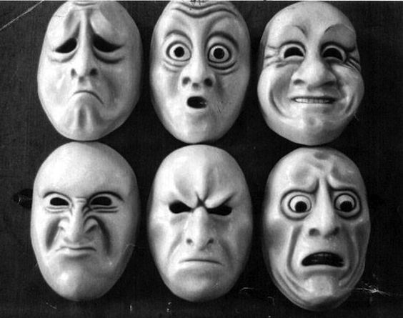
Use Language that Invokes Emotions
Paint pictures
Jurors remember feelings not words

Slide 32
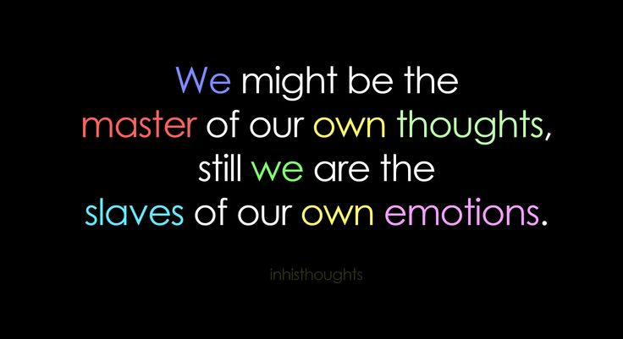

Slide 33

Use the Your Senses

Slide 34
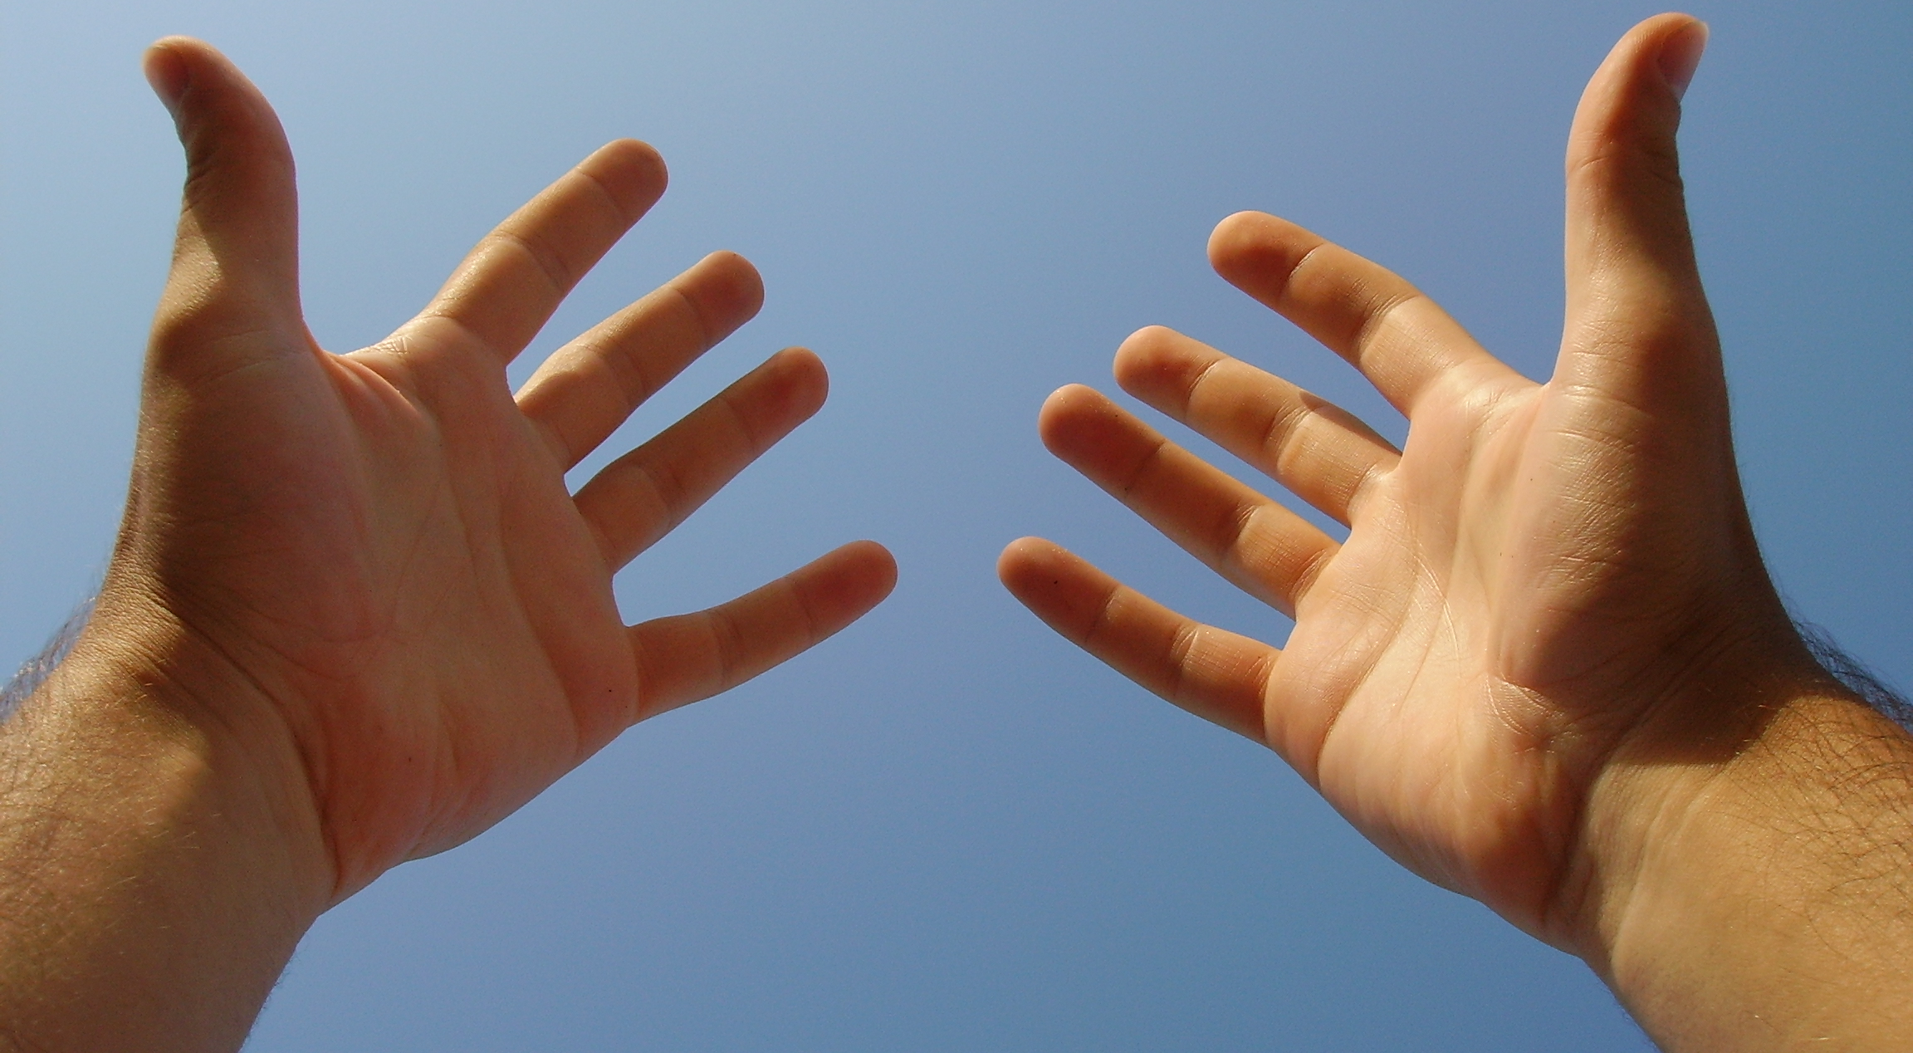
Use First Person Tense

Slide 35

Set the Scene
What is going on when we start the story?
Who is there?

Slide 36

Show the Story
Put the scene in Action!!!

Slide 37


You have a Part to Play
Know your part!
And Play it!

Slide 38

Practice makes Perfect
Go over your testimony
Think about what you are going to say
Does it make sense?

Slide 39

You can’t say anything to hurt me!
You wouldn’t be on the stand if the lawyer thought you would hurt the case

Slide 40

You Have Nothing to Hide
Jury’s can smell a rat

Slide 41
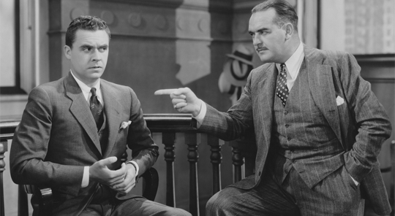
Cross-Examination

Slide 42
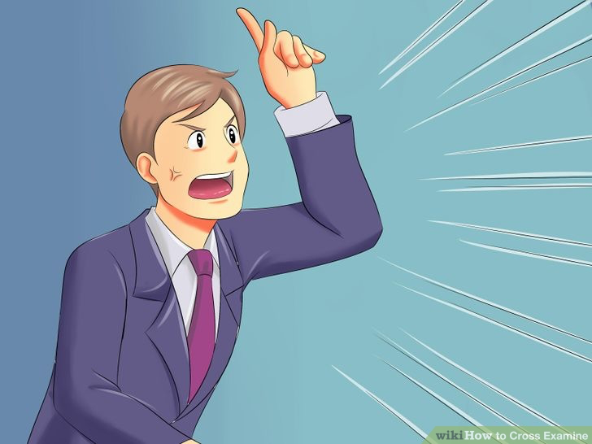
Let the Prosecutor be the BAD GUY

Slide 43
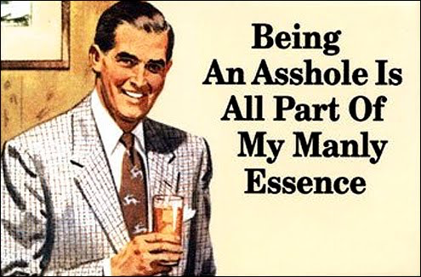
Let them act like an ASS

Slide 44

It’s Good to be the UNDERDOG

Slide 45


Slide 46


Slide 47
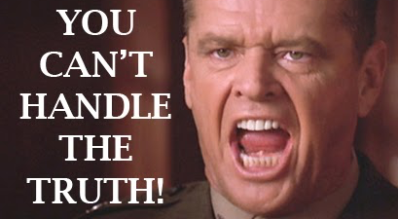
No need to fight

Slide 48
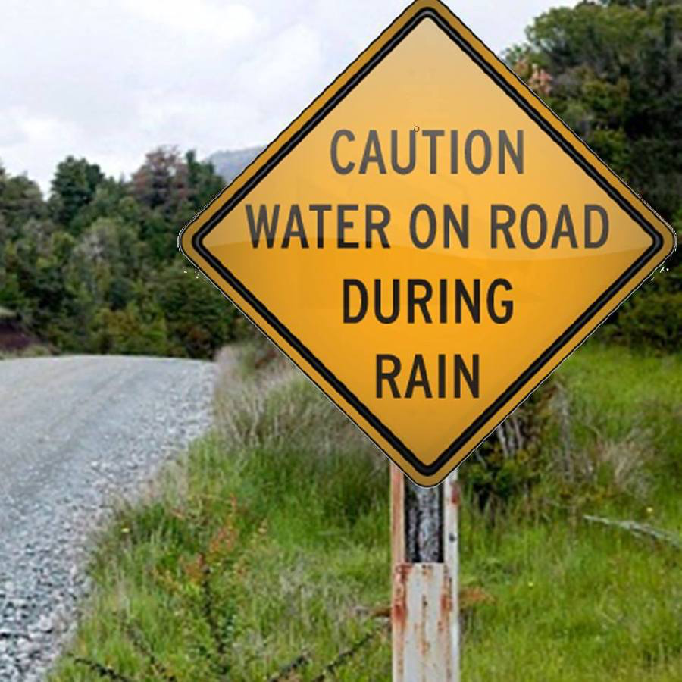
Concede the Obvious
Don’t argue over things that don’t matter

Slide 49

Be Reasonable
If your are reasonable you are credible

Slide 50
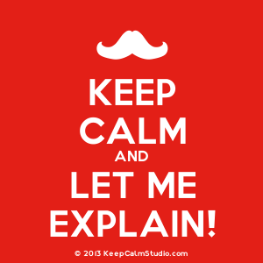
Ask to explain yourself
It is reasonable to need to explain yourself

Slide 51
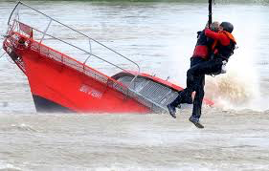
Let the Jury Rescue you
The Jury will save you if you are being bullied

Slide 52


Slide 53


Slide 54
FIN
Don Flanary
Goldstein Goldstein and Hilley
210-226-1463
donflanary@hotmail.com

